Slide 1
Plot a cumulative frequency diagram
Maths
Miss Parnham

Slide 2
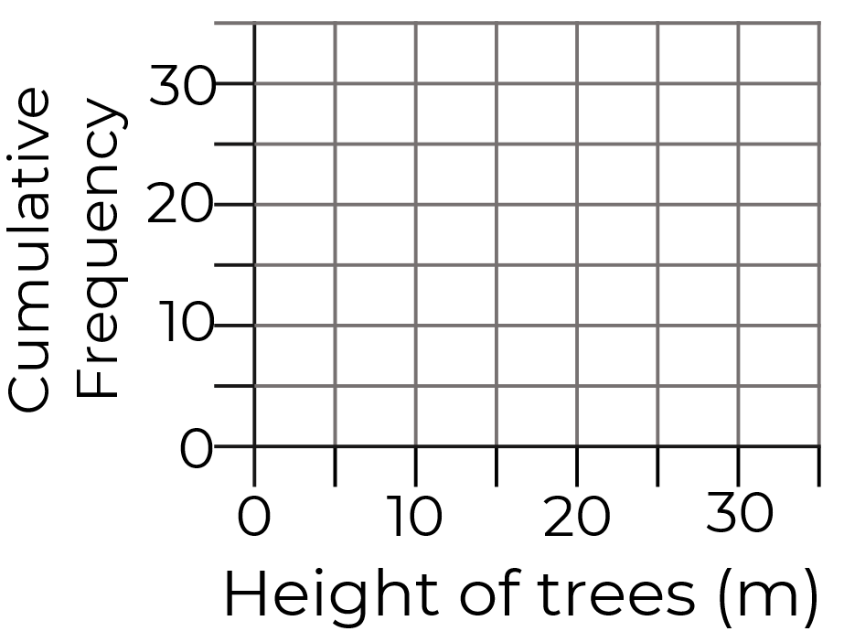
Plot a cumulative frequency diagram
1. The table shows the journey time for 30 students travelling to school.
Complete the table.
What is the modal class interval?
2. Plot a cumulative frequency diagram.
Height (m) | Frequency | C. F.
0 < t ≤ 5 | 3
5 < t ≤ 10 | 7
10 < t ≤ 15 | 12
15 < t ≤ 20 | 2
20 < t ≤ 30 | 1
Time (min) | Frequency | Cumulative Frequency
0 < t ≤ 10 | 7
10 < t ≤ 20 | 12
20 < t ≤ 30 | 8
30 < t ≤ 40 | 3

Slide 3
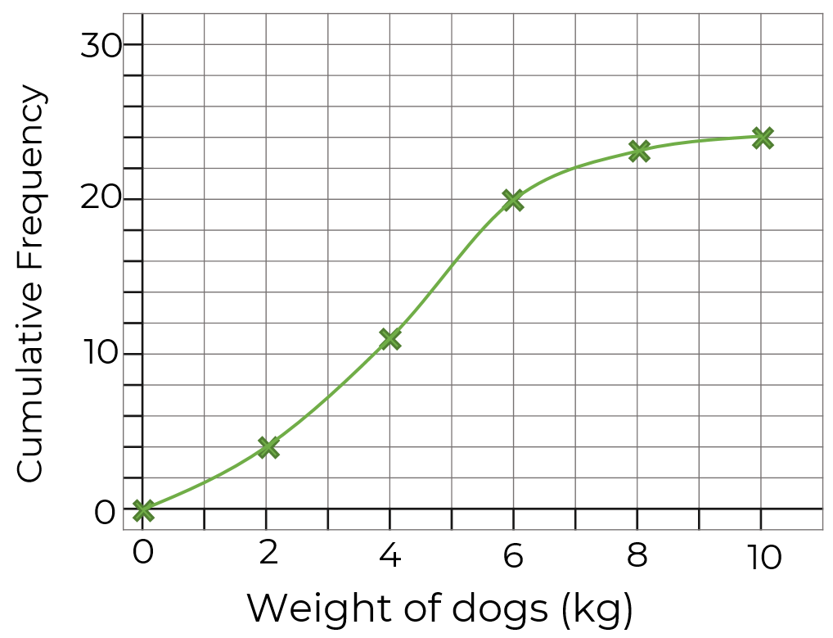
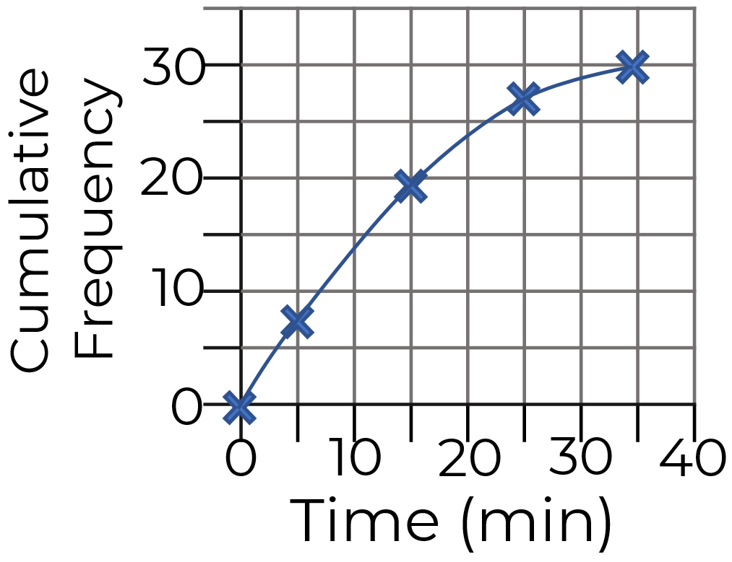
Plot a cumulative frequency diagram
3. Compare the table and the diagram, what error has been made?
4. Use the cumulative frequency diagram to complete the table.
Time (min) | Frequency | Cumulative Frequency
0 < t ≤ 10 | 7 | 7
10 < t ≤ 20 | 12 | 19
20 < t ≤ 30 | 8 | 27
30 < t ≤ 40 | 3 | 30
Weight (kg) | Frequency | C. F.
0 < w ≤ 2
2 < w ≤ 4
4 < t ≤ 6
6 < t ≤ 8
8 < t ≤ 10

Slide 4
Answers

Slide 5
Plot a cumulative frequency diagram
1. The table shows the journey time for 30 students travelling to school.
Complete the table.
What is the modal class interval?
2. Plot a cumulative frequency diagram.
Height (m) | Frequency | C. F.
0 < t ≤ 5 | 3 | 3
5 < t ≤ 10 | 7 | 10
10 < t ≤ 15 | 12 | 22
15 < t ≤ 20 | 2 | 24
20 < t ≤ 30 | 1 | 25
Time (min) | Frequency | Cumulative Frequency
0 < t ≤ 10 | 7 | 7
10 < t ≤ 20 | 12 | 19
20 < t ≤ 30 | 8 | 27
30 < t ≤ 40 | 3 | 30
10 < t ≤ 20

Slide 6
Plot a cumulative frequency diagram
3. Compare the table and the diagram, what error has been made?
4. Use the cumulative frequency diagram to complete the table.
Time (min) | Frequency | Cumulative Frequency
0 < t ≤ 10 | 7 | 7
10 < t ≤ 20 | 12 | 19
20 < t ≤ 30 | 8 | 27
30 < t ≤ 40 | 3 | 30
The midpoint of each class interval, rather than the upper bound, has been plotted against the cumulative frequency.
Weight (kg) | Frequency | C. F.
0 < w ≤ 2 | 4 | 4
2 < w ≤ 4 | 7 | 11
4 < t ≤ 6 | 9 | 20
6 < t ≤ 8 | 3 | 23
8 < t ≤ 10 | 1 | 24

