Slide 1
Add and Subtract Fractions with a Common Denominator
Worksheet
Mathematics
Mr Kelsall

Slide 2
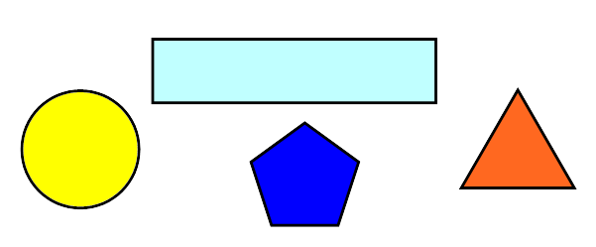
Revision: fractions
How many fractions can you represent by folding your piece of paper?

Slide 3
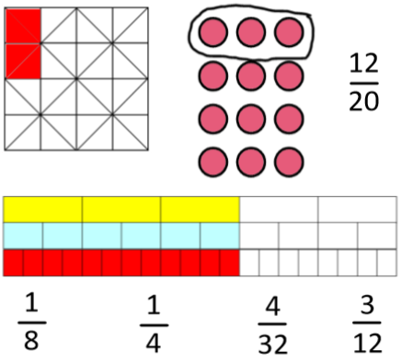
Revision: equivalent fractions
Match the fractions to the pictures?
What could be the missing fraction(s)?

Slide 4
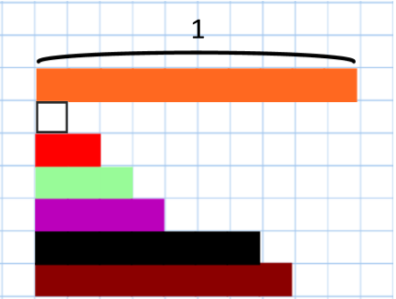
New learning: common multiples
Identify the length of these rods if the orange rod has length one.

Slide 5
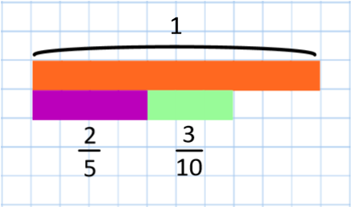
New learning: common multiples
What does this show?
How would you represent this on a number line?
Which is the correct answer? Why?

Slide 6
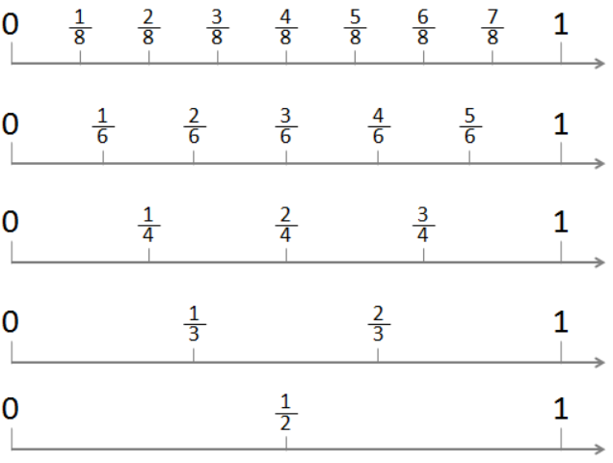
New learning: common multiples
Use the number line to solve:
⅜ + ¼
⅙ + ⅔
½ + ⅝

Slide 7
Develop learning:
common multiples
Where possible: 1) sketch a bar model 2) draw a number line, and 3) write the fact families for these questions:
One quarter add one half
Two quarters add one eighth
Three sixth add one third

Slide 8
Develop learning:
common multiples
Where possible: 1) sketch a bar model 2) draw a number line, and 3) write the fact families for these questions:
Four fifths add two tenths
Three quarters subtract one eighth
Is there a quick way (mental) to find equivalent fractions?

Slide 9
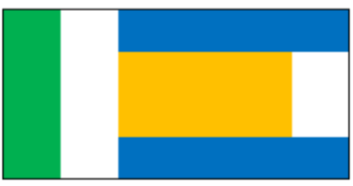
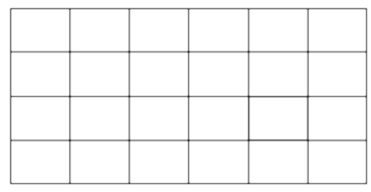
Independent task
Use the grid to describe the fraction of the flag that is each colour
Source of all images : Mr Kelsall or Oak National Academy

