Slide 1
Creative Writing (poetry): Writing Poetry
Lesson 5 of 5
English
Sarah Krzebietka

Slide 2
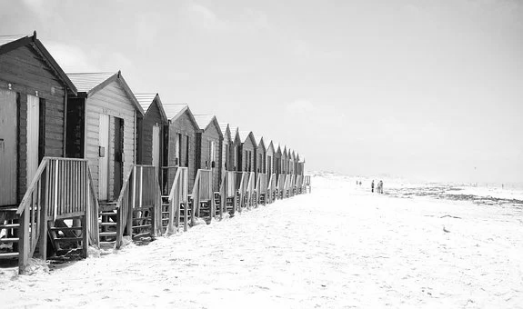
Stuck with opening lines or stanzas? Remember these? You can use parts of these poems to help you write your own stanzas.
Ball Stadium by Jarmoluk (Pixabay)
Zoom! Into the top corner of the net, A
The keeper had no chance once my aim was set. A
Crowds roared and cheered aloud, B
Mum, is that you? You look so proud! B
Waves smashing, voices clashing, A
The sun breaking through the clouds. B
Kites swooshing, wind crashing, A
Winding my way through the crowds. B
Beach Beach Hut by Pexels (Pixabay)

Slide 3
Need some further inspiration?
Onomatopoeic Words
Personification:
Could your beach huts be smiling?
Might the sea be whispering?
Could the sand be comforting?
Might the football, tennisball, basketball be clever? Mocking?
Could the stadium be welcoming?
Might the grass be proud?
Simile and Metaphor (possible comparisons)
The sea or crowd could embrace you like a good friend.
The feeling in the air could be electric.
The smell of doughnuts could be dragging you towards them.
The excitement could feel like Christmas morning.
Bang
Bark
Boo
Brrng
Bump
Buzz
Cackle
Chatter
Cheer
Clap
Clank
Click
Crackle
Crash
Crunch
Honk
Howl
Hush
Jingle
Jangle
Knock
Plop
Poof
Pop
Pow
Ring
Roar
Rustle
Rumble
Sizzle
Slap
Smash
Smack
Squish
Swoosh
Thud
Thump
Whisper
Whimper
Zip
Zoom

Slide 4
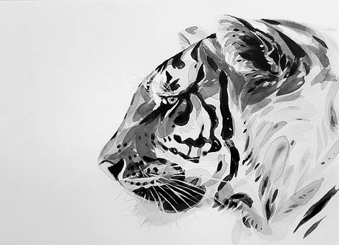
Use my example to help you to write your first stanza.
Tiger Animal Martina_bulkova (Pixabay)
Stanza 1: Describe the way a tiger looks.
Covered in lightning strikes of orange and black, A
Amber eyes alert and ready to attack! A
Paws pad softly through the grass and sand, B
As silent as a thief prowling across the land. B
Did I stick to my plan? Read through my opening stanza again.
Have I described the way a tiger looks? Yes.
Can you identify an AABB rhyming pattern? Yes.
Which figurative techniques can you spot? Simile and metaphor.
Do I have four lines of poetry in this stanza? Yes.

Slide 5
Use my example to help you to write your second stanza.
Tiger Animal Martina_bulkova (Pixabay)
Stanza 2: Describe the way a tiger moves.
At first, each step is steady and slow, A
Winding through the trees, knowing where to go. A
Ears prick up, the tiger’s lips curl into a smile, B
Quick as a flash he reaches his prey, that will fill him for a while. B
Did I stick to my plan? Read through my second stanza again.
Have I described the way a tiger moves? Yes.
Can you identify an AABB rhyming pattern? Yes.
Which figurative techniques can you spot? Simile and personification.
Do I have four lines of poetry in this stanza? Yes.

Slide 6
Now have a go at writing your third stanza on your own.
Remember to keep looking back at your plan to guide you!

Slide 7
Give yourself some feedback
I am so proud of the way I have used ...
My favourite line of my poem is … because …
I enjoyed writing this poem because…
Hints:
Have you used rhyme? Personification? Metaphor? Onomatopoeia? Which of these do you think you have done the best job of using in your poem?
Try to find the line in your poem that you think creates a really powerful picture for your reader.
What have you enjoyed the most about writing your poem? Being creative? Having a chance to explore your thoughts and feelings? Using techniques you haven’t used before?

Slide 8
Helpful Prompts
I am so proud of the way I have used simile and metaphor to create powerful pictures for my reader.
My favourite line of my poem is ‘As silent as a thief prowling across the land’ because it uses a great simile to describe the tiger’s movements.
I enjoyed writing this poem because it helped me to express my thoughts and feelings about tigers.

