Slide 1
Find the gradient of a line
Maths
Mr Clasper

Slide 2
Find the gradient of a straight line
Work out the gradient of each line
2. On a squared grid draw a line with a gradient of 3 and a line with a gradient of -3
What is the same and what is different about your lines?

Slide 3
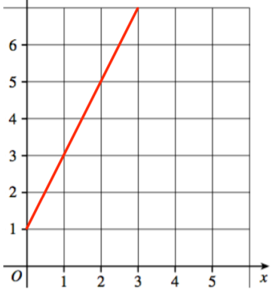
Find the gradient of a straight line
3. Work out the gradient of each line.
a)
b)

Slide 4
Find the gradient of a straight line
4. A is the point with coordinates (1, 4)
B is the point with coordinates (7, 22)
Find the gradient of AB.
5. Work out the gradient of the line passing through the points (3, 2) and (7, 20)

Slide 5
Answers

Slide 6
Find the gradient of a straight line
Work out the gradient of each line
2. On a squared grid draw a line with a gradient of 3 and a line with a gradient of -3
What is the same and what is different about your lines?
e.g.

Slide 7
Find the gradient of a straight line
3. Work out the gradient of each line.
a)
b)
gradient = 2
gradient = -2

Slide 8
Find the gradient of a straight line
4. A is the point with coordinates (1, 4)
B is the point with coordinates (7, 22)
Find the gradient of AB.
5. Work out the gradient of the line passing through the points (3, 2) and (7, 20)
gradient = 3
gradient = 4.5

