Slide 1
Angles in Polygons. Downloadable Resource – Exterior angles.
Mathematics
Mr. Thomas

Slide 2
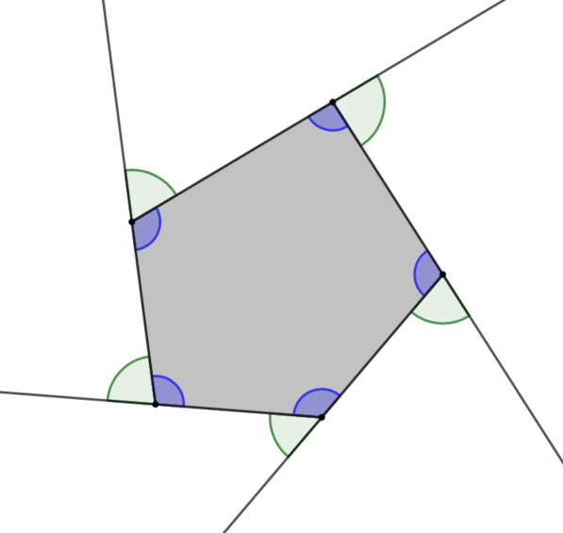
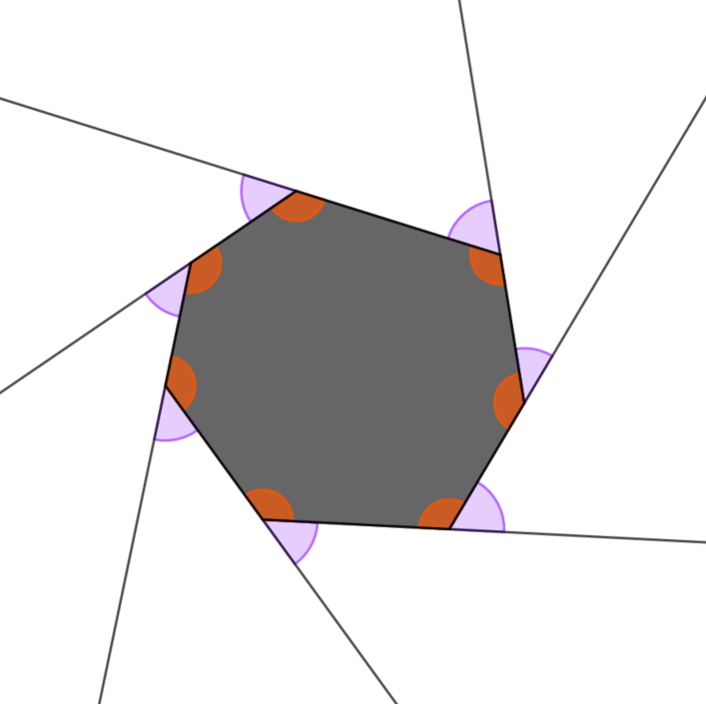
Try this
What angle facts can you give about these shapes?
Some ideas… The sum of the blue angles are ______
The sum of an adjacent pair of orange and purple angles is ________

Slide 3
Connect
Exterior angle – The angle between a side of a polygon and an adjacent side extended outward.
Let’s see what is special about exterior angles…
International GeoGebra Institute, 2013
Notes:
I will go to GeoGebra to use their tool on how to demo that the total exterior angles of a polygon sum to 360 degrees

Slide 4
Independent Task
Find the missing exterior angles in these polygons.
b°
h°
g°
a°
81°
135°
145°
122°
i°
104°
m°
111°
135°
117°
e°
135°
c°
l°
124°
122°
f°
j°
d°
k°

Slide 5
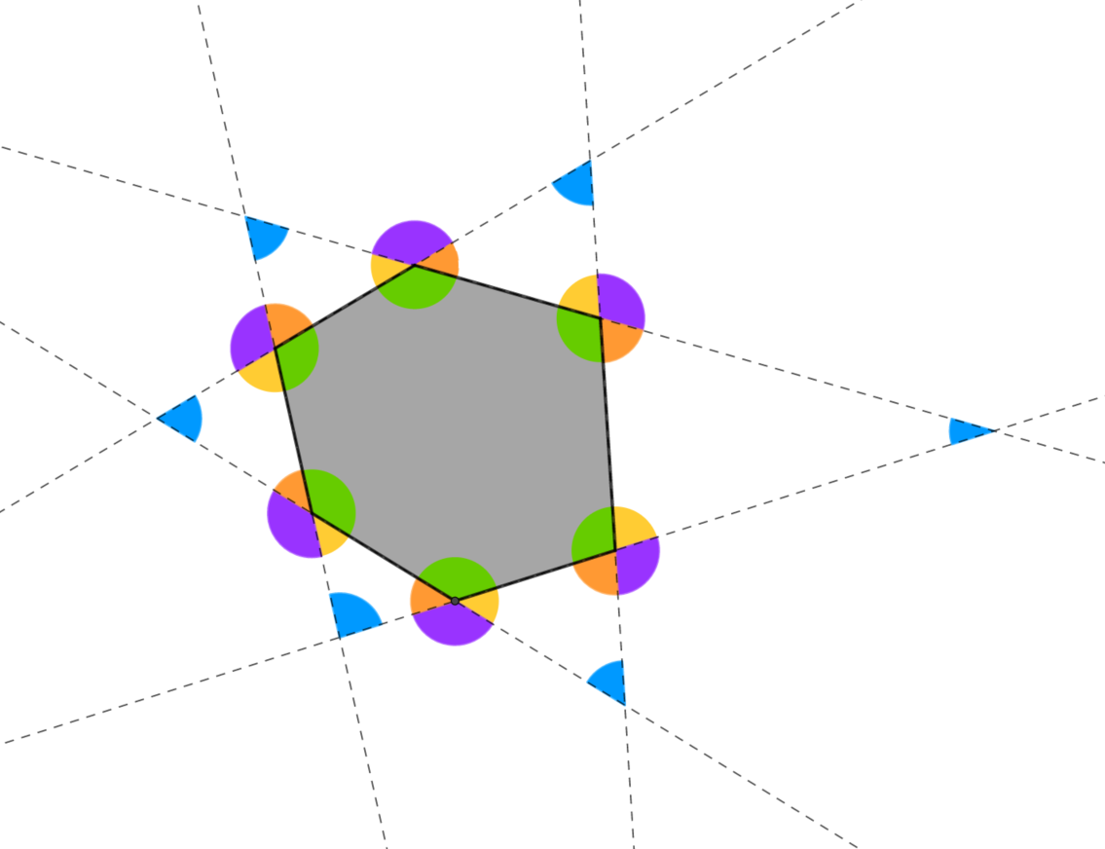
Explore
What statements can you make about these angles?

