Slide 1
Multiply 2-digit numbers by 8 using the partitioning method
Maths
Miss Brinkworth

Slide 2
Part A - Use partitioning and area models to solve these questions using the 8 times table
45 x 8 =
83 x 8 =
x 8 = 560
8 x = 800
Extension -
Abdul multiples 22 by 8 and gets 1616, is he correct?
If not, what mistake do you think he has made?

Slide 3
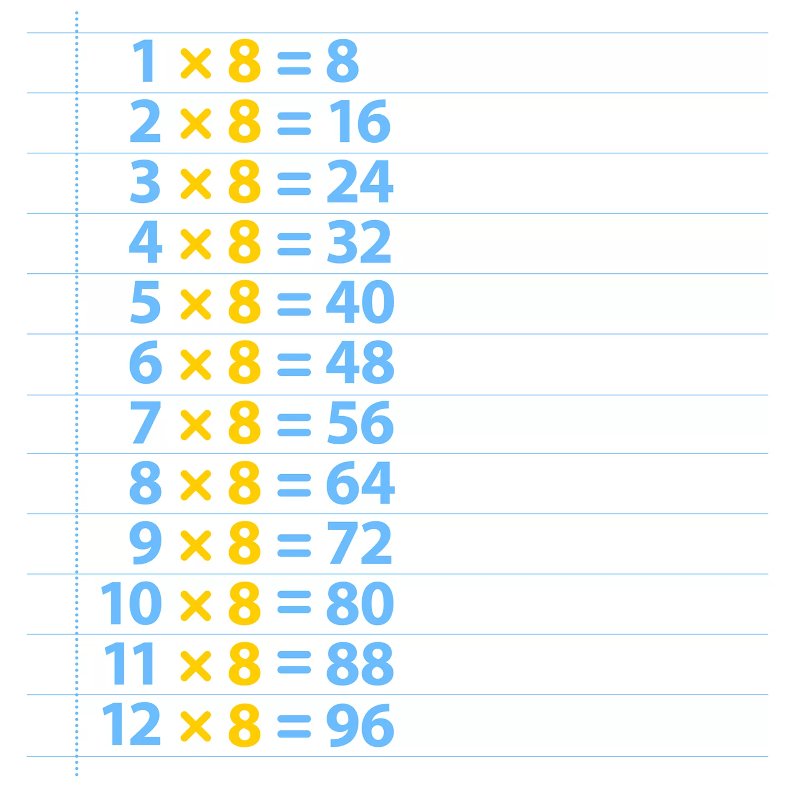
Part B -
8 x 4 =
8 x 40 =
8 x 400 =
(Challenge - can you try this with another number? e.g. 12, 120, 1200)
2) Which of these numbers is a multiple of 8?
How do you know?
160 | 240 | 4000 | 85 | 20 | 96 | 100

Slide 4
Part C
There were some octopuses and starfish in a rock pool; octopuses have 8 arms and starfish have 5 arms.
Altogether there are 73 arms in the rock pool.
How many octopuses and starfish could there be?
How do you know?
Is there more than one answer?

