Slide 1
Finding double of a number up to five
Mathematics Independent Task
Miss Robson

Slide 2
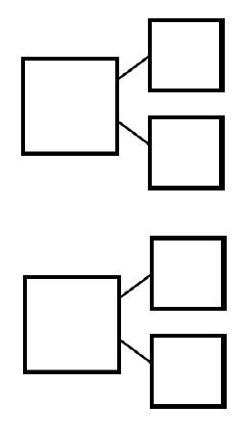
Activity
Use the ladybirds and part whole models to represent double numbers up to five.

