Slide 1
Fraction of an amount
Maths
Mr Chan

Slide 2
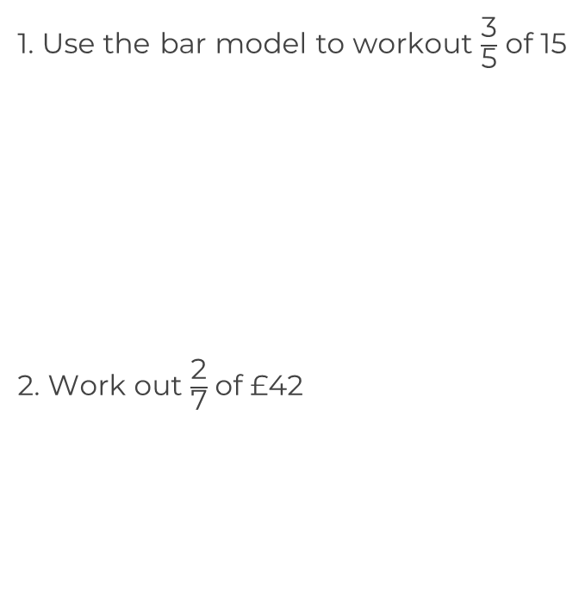
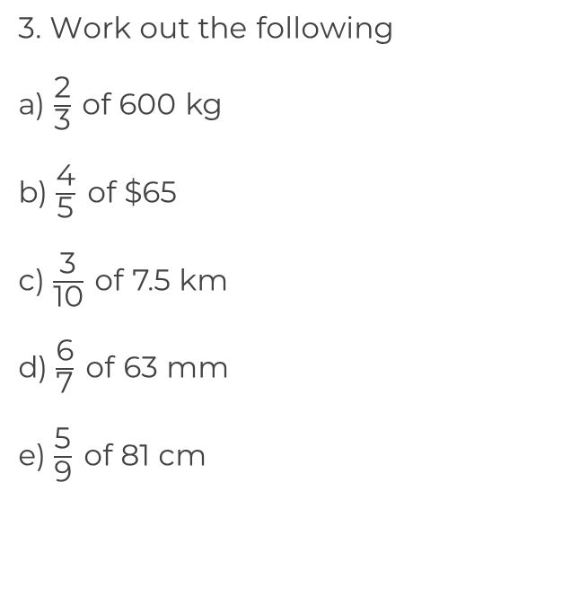
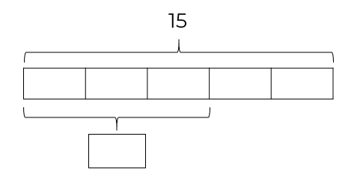
Fraction of an amount

Slide 3
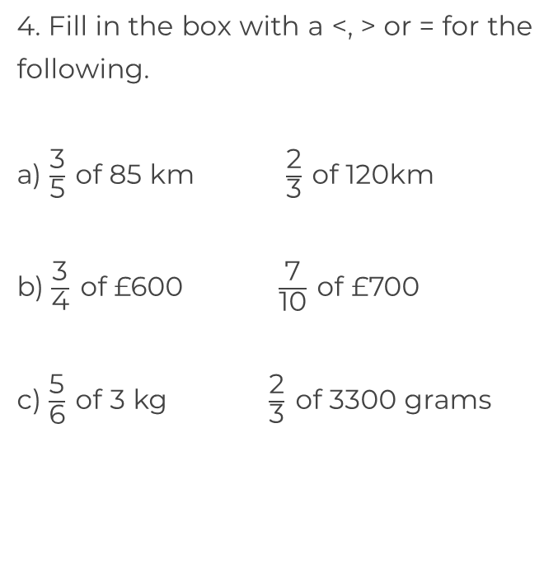
Fraction of an amount

Slide 4
Answers

Slide 5
Fraction of an amount
400 kg
3
3
3
3
3
$52
9
2.25 km
54 mm
£12
45 cm

Slide 6
Fraction of an amount
<
<
He has divided by the numerator and not the denominator.
>
25

