Slide 1
Mathematics
Finding a percent of a quantity
Mr Kelsall

Slide 2
New learning: percent
Work out fractions of quantities and record as multiplication calculations. Explain your answers
Notes:
READ SLIDES

Slide 3
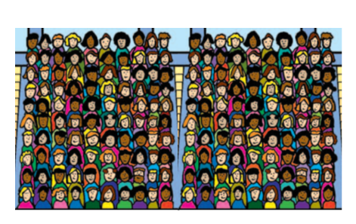
New learning: percent
There are 200 people in a section of a stadium.
10% of them are supporting China
How many people is this?
Notes:
READ SLIDES

Slide 4
New learning: percent
There are 200 people in a section of a stadium.
Can you find 50% (½)?
Can you find 25% (¼)?
Can you find 75% (¾)?
Can you find 10%
Can you find 20%
Can you find 30%
Can you find 5%
Can you find 15%
Notes:
READ SLIDES

Slide 5
Develop learning: percent
If the whole bead string represents 500
Can you find 50%?
Can you find 25%?
Can you find 75%?
Can you find 10%
Can you find 20%
Can you find 30%
Can you find 5%
Can you find 15%
Notes:
READ SLIDES

Slide 6
Develop learning: percent
Amanda has a fitness tracking device and she has set a target of running 6 km. The device beeps to let her know she has run 50% of this distance. How far has she run?
6km (or 6000m)
Notes:
READ SLIDES

Slide 7
Develop learning: percent
Johan jumps 70% of the total length of the sand pit. If the pit is 10 m long, how far did he jump?
10m
Notes:
READ SLIDES

Slide 8
Independent task
Draw the bar model and solve these questions
Source of all images : Mr Kelsall or Oak National Academy
Notes:
READ SLIDES

