Slide 1
Stopping Distance
Combined Science - Physics - Key Stage 4 - Forces
Mr Saville
Miss Whittick

Slide 2
Warm up
What is the equation linking acceleration, force and mass?​
What is the equation linking acceleration, final velocity, initial velocity and time?​
A car is travelling at 20 m/s when the lights turn to red. It takes 3.2 seconds to stop the car. Calculate the deceleration. Give the unit​
The car has a mass of 22,000Kg. Calculate the force needed to stop the car. Give the unit.

Slide 3
Independent Practice
Thinking distance | Braking distance
Distractions, drugs, condition of brakes, wet/icy roads, condition of tyres, alcohol, eye sight, tiredness, age, road condition
Notes:
Separate these 10 factors into either thinking distance, or braking distance.

Slide 4
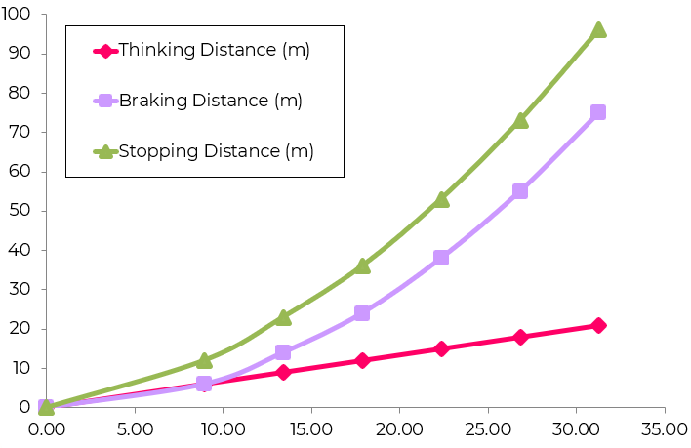
Independent Practice
1. Use the graph to describe the pattern shown in the data. (hint: talk about both thinking and braking distance, then stopping distance)
2. What is the additional stopping distance when increasing speed from 10 to 20 km/hr.
3. Why does it take a larger force to stop a vehicle moving faster?
4. Why are large decelerations dangerous?
Speed (km/hr)
Distance (m)

Slide 5
Independent Practice
Describe the factors that affect the stopping distance of a vehicle. In your answer explain the difference between thinking distance, braking distance and stopping distance, how they are related and factors which affect their lengths. (6)

