Slide 1
Mathematics
Combining Reflections Worksheet
Mrs Buckmire

Slide 2
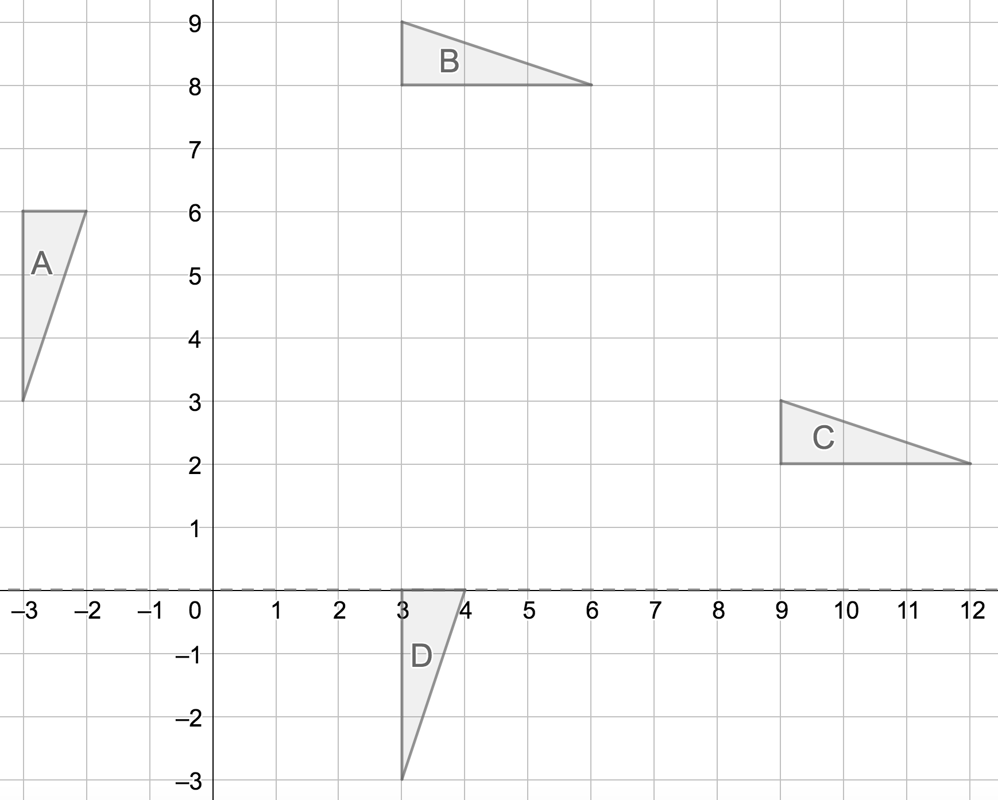
Try this

Slide 3
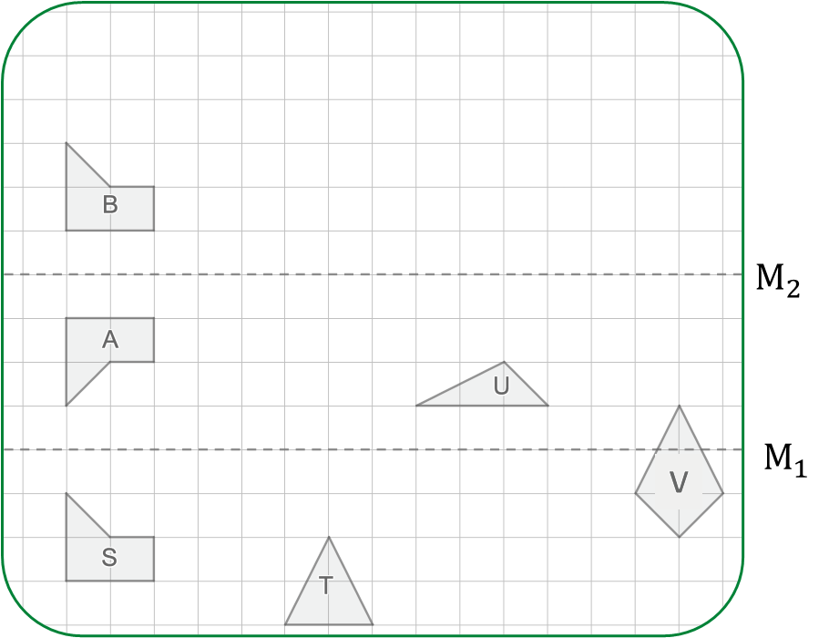
Connect
We can sometimes describe the effect of combining transformations using a single transformation.
Explore the effect of this combination of reflections for: T, U and V.

Slide 4
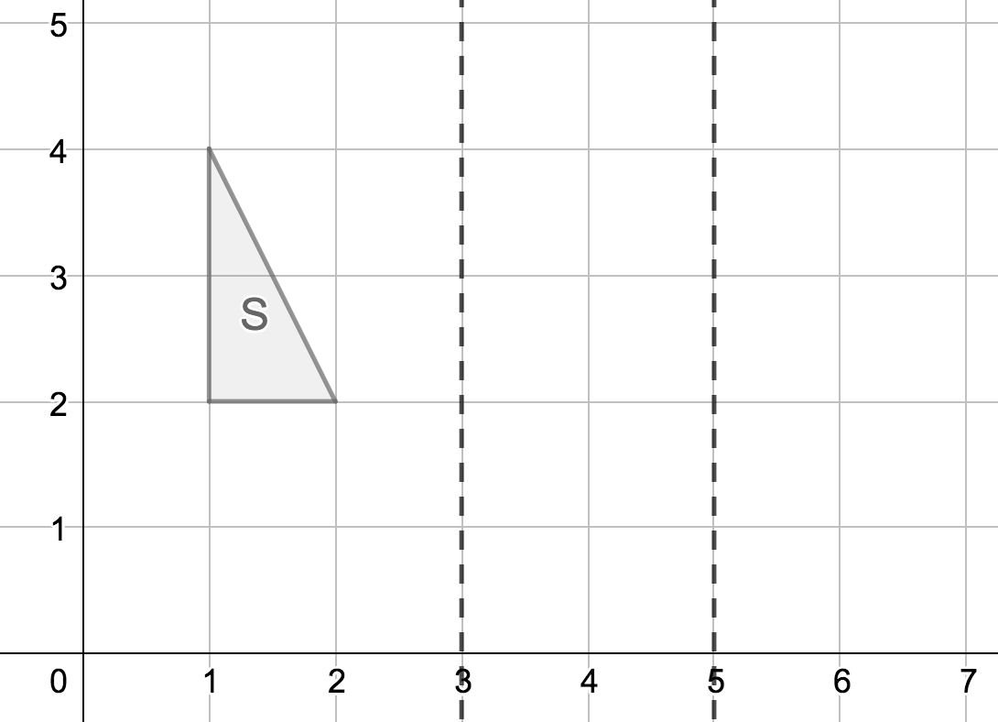
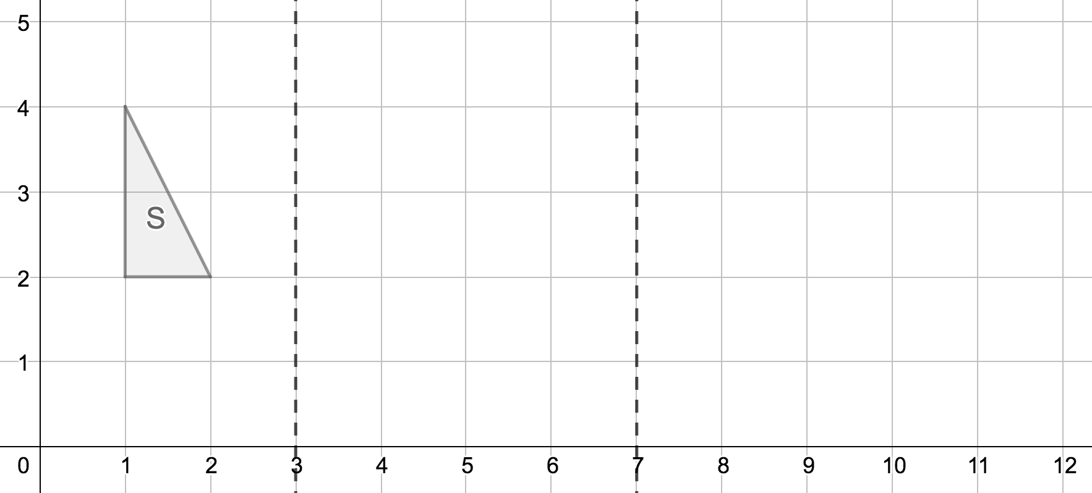
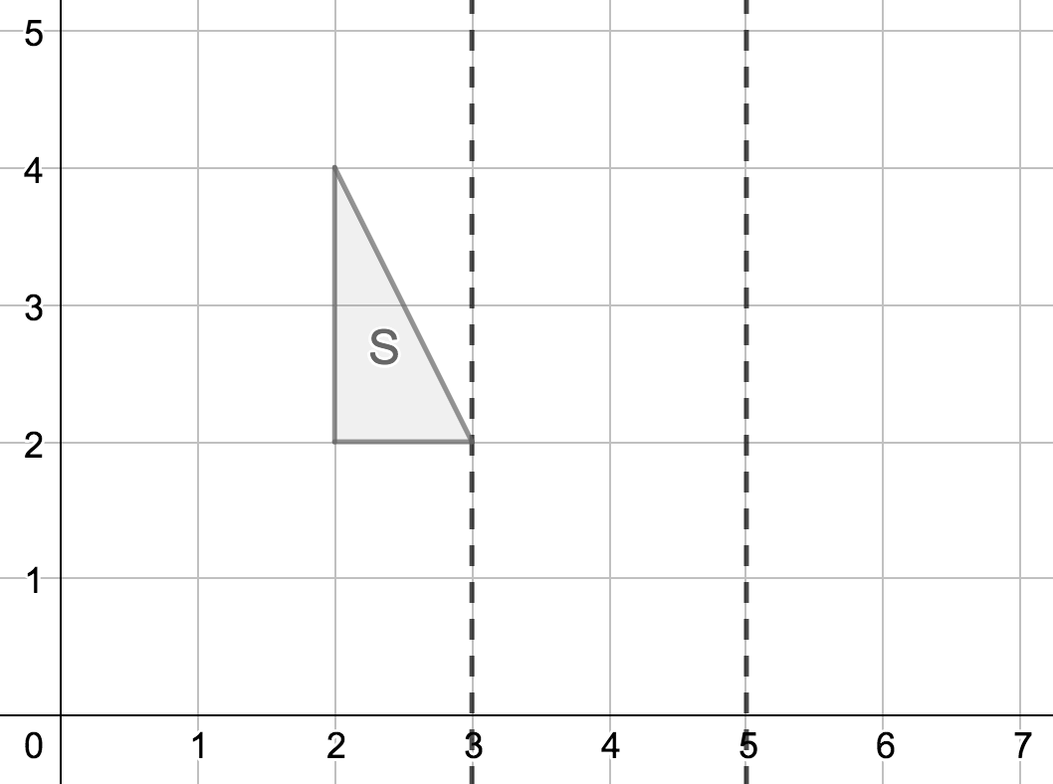
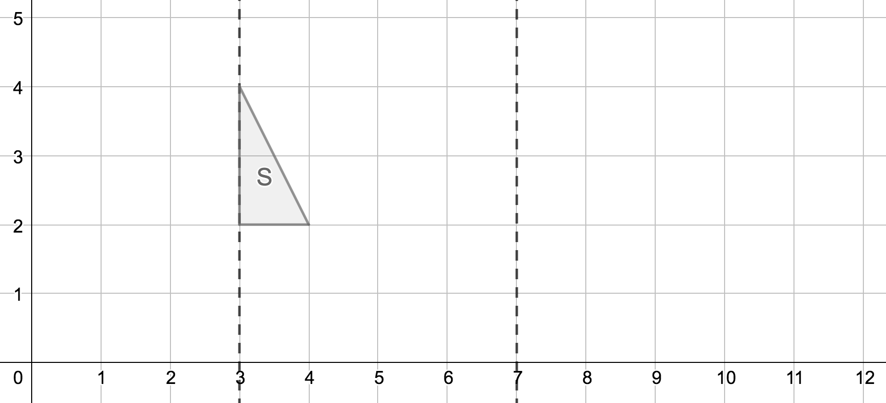
Independent task

Slide 5
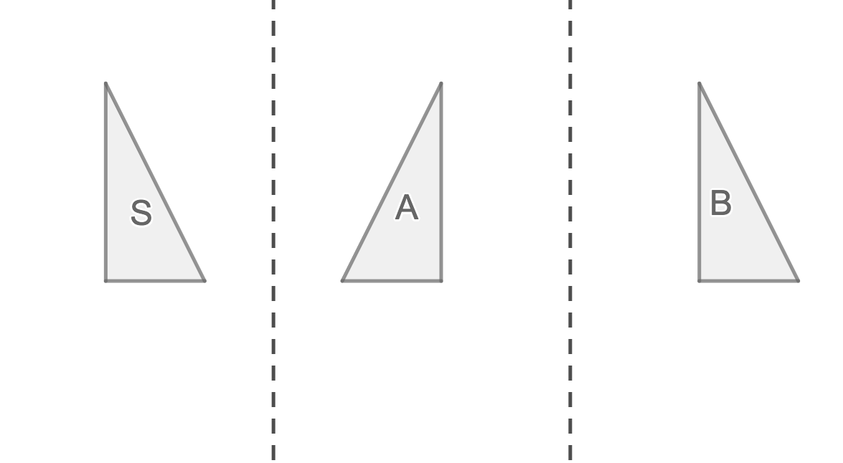
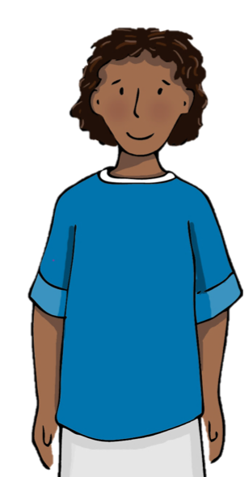
Explore
I am going to specialise by looking at an example

