Slide 1
German
Describing People and Discussing Friendships [3 / 3] - Possessive Adjectives - Modal Verbs
Frau Driver

Slide 2
Describing people and using possessive adjectives
your understanding of the near future tense.
Phonics focus ([u] [ü])
Introducing new vocabulary
Grammar: Adjective endings – nominative / accusative cases
Reading: Describing friendships
Revision vocabulary
Grammar: Modal verbs
Writing activity
Speaking Activity
Summarising learning
Notes:
The plan for today’s lesson is as follows. Press return if you haven’t done the quiz, please do it now.
Bist du fertig? (bereit)? Los geht’s!

Slide 3
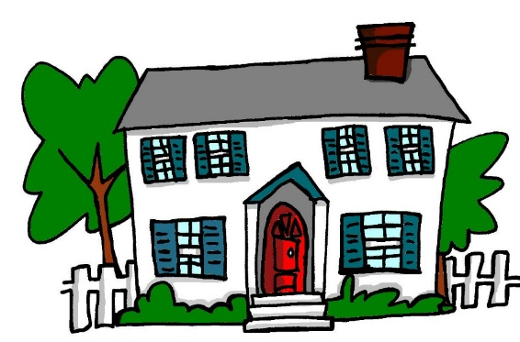
au
genau
auch
Haus
glauben
auf
ausgehen
Rachel Hawkes
Notes:
Without audio or pictures for students to produce.

Slide 4
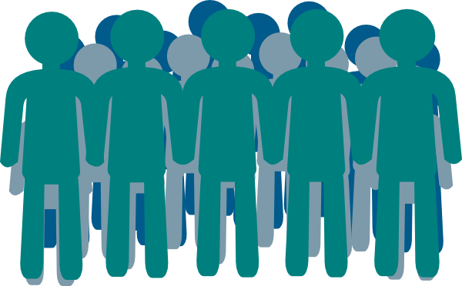
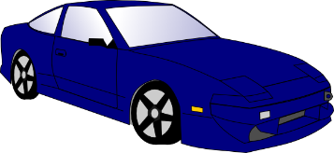
eu
Euro
heute
Deutschland
Freund
Leute
neu
Rachel Hawkes
Notes:
Introduce and elicit the pronunciation of the individual SSC ‘eu’ and then the source word again (with gesture, if using). Then present and elicit the pronunciation of the five cluster words. The cluster words have been chosen for their high-frequency, from a range of word classes, with the SSC (where possible) positioned within a variety of syllables within the words (e.g. initial, 2nd, final etc.). Additionally, we have tried to use words that build cumulatively on previously taught SSCs (see the Phonics Teaching Sequence document) and do not include new SSCs. Where new SSCs are used, they are often consonants which have a similar symbol-sound correspondence in English.
Word frequency rankings (1 is the most common word in German): Deutschland [N/A proper noun]; Euro [333] heute [121]; Freund [327]; neu [80]; Leute[163]. Source: Jones, R.L. & Tschirner, E. (2006). A frequency dictionary of German: core vocabulary for learners. Routledge

Slide 5
menschlich | humane
die Beziehung | relationship
befreundet | friendly
die Eigenschaften | characteristics
wichtig | important
reden | to talk / talkin
verbringen | to spend time / spending time
vertrauenswürdig | trustworthy
die Leute | people
die Hausaufgaben | homework
Notes:
Min font size = 28 for the words on the slide. Nothing below the acorn.
On the screen, you can see the new vocabulary together. Now, I’ll say the German again, but I will say them out of order. You say the correct translation out loud. If you want to challenge yourself - close your eyes, focus on what I’m saying and say the correct translation out loud.
unterstützen, die Geduld, die Freundschaft, müssen, denken, die gleichen Interessen, immer, koennen, duerfen,

Slide 6
Adjective endings with the definite article
Do not add endings to adjectives on their own (usually with the verb ‘to be’) – Meine Mutter ist intelligent.
Adjectives used with the definite article (der / die / das) take the nominative case if they are the subject of the clause and the accusative case if they are the object of the clause.
 | Nominative Case | Accusative Case
Masc. | der fleiβige Mann | den fleiβigen Mann
Fem. | die fleiβige Frau | die fleiβige Frau
Neut. | das fleiβige Mädchen | das fleiβiges Mädchen
Plural | die fleiβigen Frauen | die fleiβigen Frauen
Notes:
Style guide advice.
Optimum use of lesson time and key to learning/consolidation

Slide 7
Adjective endings with the indefinite article
Adjectives used with the indefinite article (ein / eine / ein) take the nominative case if they are the subject of the clause and the accusative case if they are the object of the clause.
Possessive adjectives (mein / dein / sein / ihr / unser) and the negative (kein) follow the same pattern
 | Nominative Case | Accusative Case
Masc. | ein fleiβiger Mann | einen fleiβigen Mann
Fem. | eine fleiβige Frau | eine fleiβige Frau
Neut. | ein fleiβiges Mädchen | ein fleiβiges Mädchen
Plural | meine fleiβigen Frauen | meine fleiβigen Frauen
Notes:
Style guide advice.
Optimum use of lesson time and key to learning/consolidation

Slide 8
Modal Verbs
Modal verbs are irregular. They work with another verb in the infinitive form – the infinitive goes at the end of the clause.
 | müssen (to have to / must) | können (to be able to / can) | dürfen (to be allowed to / may)
ich | muss | kann | darf
du | musst | kannst | darfst
er / sie / es / man | muss | kann | darf
Notice the 1st and 3rd person singular is the same.
Use ‘darf nicht’ to say ‘not allowed to / shouldn’t’
Notes:
Style guide advice.
Optimum use of lesson time and key to learning/consolidation

Slide 9
Summarising Learning
your understanding of the near future tense.
Modal verbs are irregular. They always work with another verb. The other verb is used in the infinitive form at the end of the clause.
müssen – to have to / must
können – to be able to / can
dürfen – to be allowed to / may
Adjective endings:
Do not add endings to adjectives on their own (usually with the verb ‘to be’)
Adjectives take the nominative case if they are describing the subject of the clause and the accusative case if they are describing the object of the clause.
Ein guter Freund / Eine gute Freundin muss Geduld haben.
Peter ist intelligent
Mein bester Freund hat zwei Brüder.
Mein Bruder hat keinen besten Freund.
Notes:
müssen
können
dürfen

