Slide 1
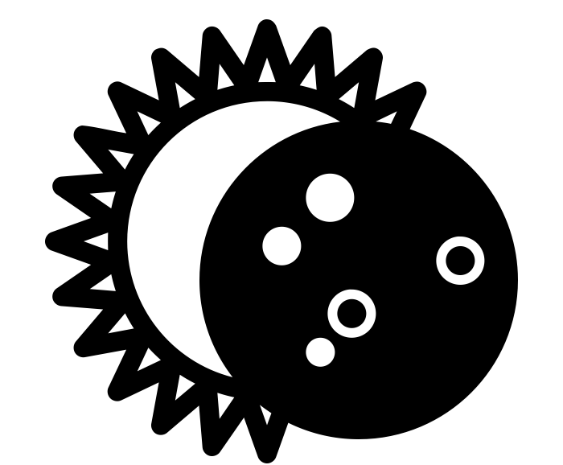
What are solar and lunar eclipses?
Science - Space
Solar Eclipse by art shop from the Noun Project
Lunar Eclipse by Claire Jones from the Noun Project
Miss Hummel
Notes:
Hi everyone! My name is Miss Hummel and together, we will be answering the question: What are solar and lunar eclipses?
In this lesson, we will learn about the Sun, the Earth and the Moon. We will also learn about satellites, including natural and artificial satellites. We will discuss the lunar phases and finally we will learn about solar and lunar eclipses.

Slide 2
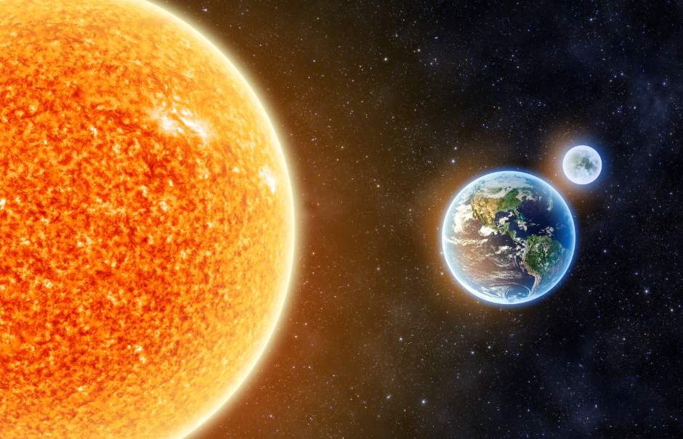
Label the Earth, the Sun and the Moon in this picture:
Earth and the Sun - Elements of this Image Furnished By NASA, By Aphelleon, In License with Shutterstock
Notes:
Image from Oak illustrator
I would now like you to pause the video to answer these questions
What is a simple machine?
What are the three types of simple machines we need to know?
Resume once you are finished answering the questions.

Slide 3
Complete this sentence:
The ___________ orbits the Earth and the ___________ orbits the Sun.
🌣
🌎 🌑
Notes:
Image from Oak illustrator
I would now like you to pause the video to answer these questions
What is a simple machine?
What are the three types of simple machines we need to know?
Resume once you are finished answering the questions.

Slide 4
Answer these questions:
🌑🛰
What is a satellite?
Write your answer with the correct option:
The moon is an example of a natural/artificial satellite.
The International Space Station is an example of a natural/artificial satellite.
Notes:
You are now going to pause the video to label the diagram with the parts of the lever.

Slide 5
Use the diagram we just saw to write down what the moon looks like from the north part of the Earth at each of the following points in its cycle (colour in the parts you wouldn’t be able to see):
First Quarter | Full Moon | Third Quarter | New Moon
Notes:
Image from Oak illustrator
I would now like you to pause the video to answer this question
What are three examples of things that use pulleys?
Resume once you are finished answering the question.

Slide 6
Answers:
First Quarter | Full Moon | Third Quarter | New Moon
🌓 | 🌕 | 🌗 | 🌑
Notes:
Image from Oak illustrator
I would now like you to pause the video to answer this question
What are three examples of things that use pulleys?
Resume once you are finished answering the question.

Slide 7
Fill in the gaps below:
A Solar Eclipse happens when the __________ comes in between the Sun and the _____________. This casts a shadow over the __________.
A Lunar eclipse happens when the __________ comes in between the Sun and the _____________. This casts a shadow over the __________.
Notes:
Image from Oak illustrator
I would now like you to pause the video to answer this question
What are three examples of things that use gears?
Resume once you are finished answering the question.

Slide 8
Thinking Task:
Why do we have to be very careful about staring at a Solar Eclipse directly?
Notes:
Image from Oak illustrator
I would now like you to pause the video to answer this question
What are three examples of things that use gears?
Resume once you are finished answering the question.

