Slide 1
Number Talk Worksheet
Mathematics
Mr Coward

Slide 2
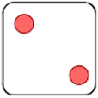
Try this
Copy and fill in the gaps in the calculations below so that each represents the total of 42 dots.
Notes:
Copy and complete the pyramids.
How many solutions can you find for the final pyramid?

Slide 3
Independent task
1) Use the axioms to find an efficient strategy to work out these calculations. Is there more than one efficient way?

Slide 4
Explore
What calculations would you place in each group?
I would use written multiplication
I would use a different strategy
Write your own examples for calculations that you would place in each group.

