Slide 1
Adding two digit numbers and ones with regrouping
Mathematics
Lesson 2 of 10
Ms.Dobrowolski

Slide 2
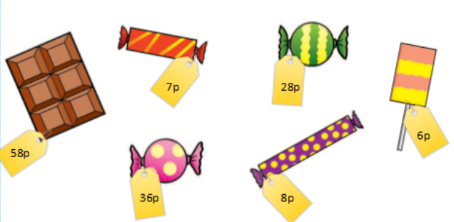
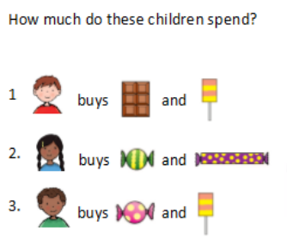
Independent Task
Challenge:
What would you buy?
How much would it cost?
Notes:
Model under visualiser counting on the number line 9+5
Then show using make ten strategy: 1 jump to ten and then 4 more jumps to 14. The number 5 was partitioned into 1 and 4.
Explain that we can make ten not just for the number ten but for any of our tens: 20, 30, 40, 50, 60 etc.
Repeat process of making ten for 19+5 and 29+5
Come back to slide and discuss what’s the same (only 1 away from ten each time, 5 is always partitioned into 1 and 4 because 9 is only one jump away from ten each time) and what’s different (a different ten is made each time, the numbers greater in value)

