Slide 1
Lesson 1: What makes a good website?
Web Page Creation
This DLD contains images necessary for the teaching of the subject, but are very demanding for a printer, please feel free to print in black and white if necessary.
Computing
Jordan Bickel
Materials from the Teach Computing Curriculum created by the National Centre for Computing Education

Slide 2
Task 1: Explore and navigate a website
Go to: oaknat.uk/comp-san-diego-zoo
Navigate through the website to answer the following questions:
What is special about a tiger’s night vision?
In the story, ‘A Flamingo Leg Up’, what is the flamingo’s name?
What habitat does an arctic fox live in?

Slide 3
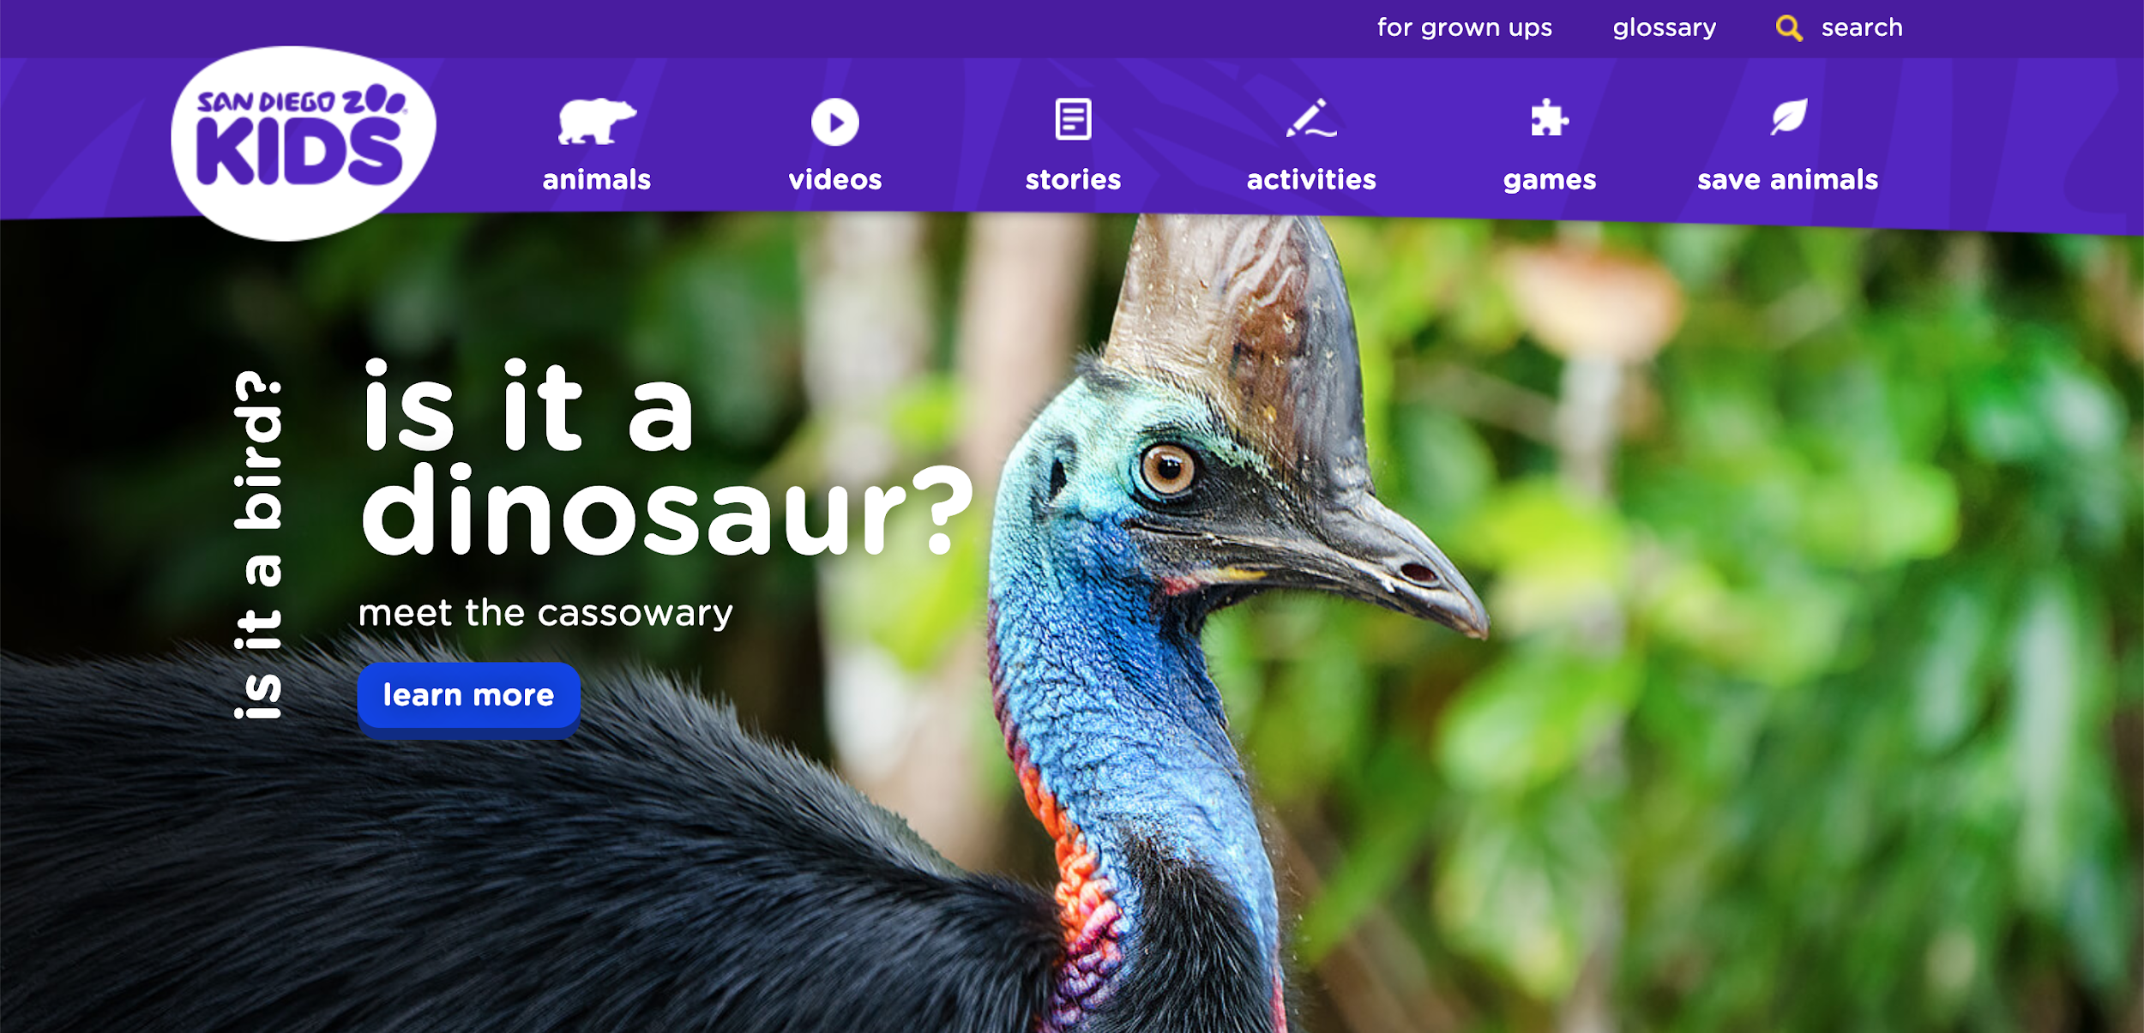
Task 2: Annotate a website
Annotate the screenshot(s) to highlight examples of different types of media and different ways that you can explore the website:
Credit: kids.sandiegozoo

Slide 4
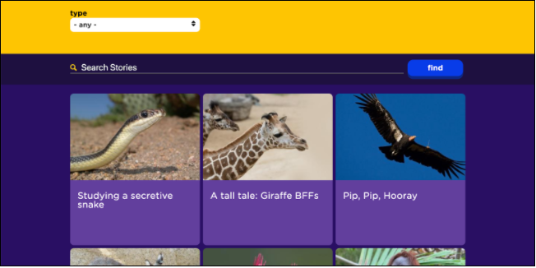
Task 2: Annotate a website
Annotate the screenshot(s) to highlight examples of different types of media and different ways that you can explore the website:
kids.sandiegozoo

Slide 5
Task 3: Access HTML on a website
You can see the code for any website by following these easy steps in Google Chrome:
Go back to: oaknat.uk/comp-san-diego-zoo
Right-click on a section of the website e.g. an image
Click Inspect
Now you can see the HTML code. This defines what the website will look like.

