Slide 1
Subtracting two digit numbers involving regrouping
Mathematics
Lesson 8 of 15
Ms. Dobrowolski

Slide 2
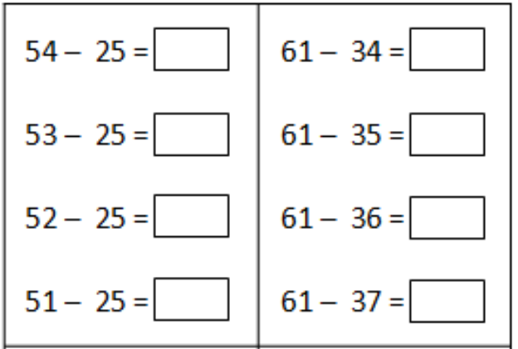
Independent Task

