Slide 1
Angle bisectors
Mathematics
Mr Maseko

Slide 2
Take a piece of paper. Mark 2 adjacent line segments AB and AC.
Measure the angle BAC
Fold the paper so that AB and AC overlap.
What do you notice?
B
A
C

Slide 3
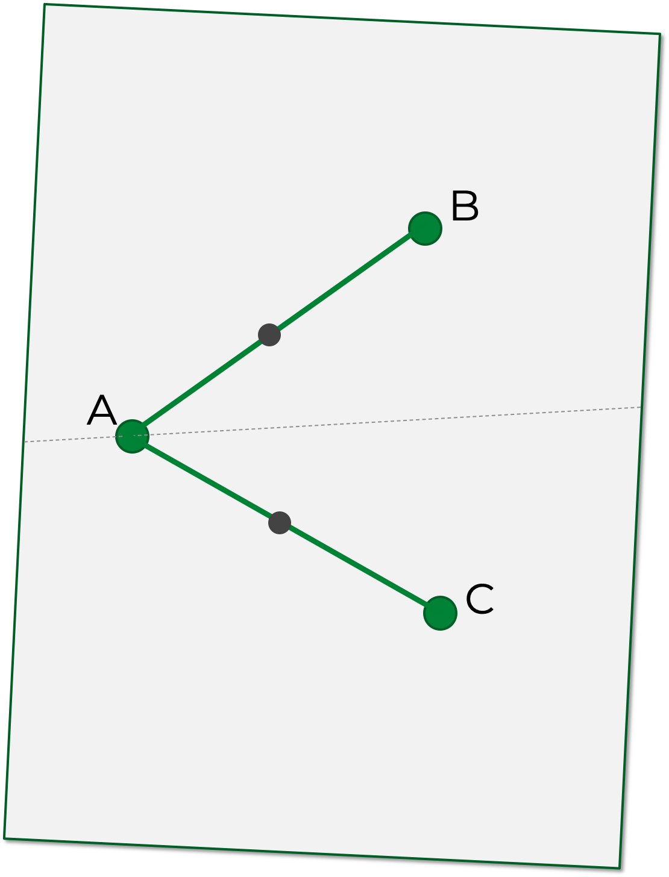
Mark 2 points on AB and AC the same distance from A.
Measure the distance of positions on the fold from these new points.
What do you notice?

Slide 4
An angle bisector is a locus of points that are equidistant between two line segments.
To bisect Angle BAC:
Create two points on the line segments AB and AC that are equidistant from A.
Join the midpoint of these points to A.

Slide 5
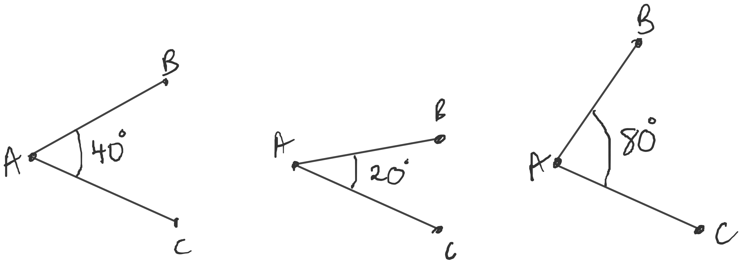
Draw the following angles accurately and bisect them.

Slide 6
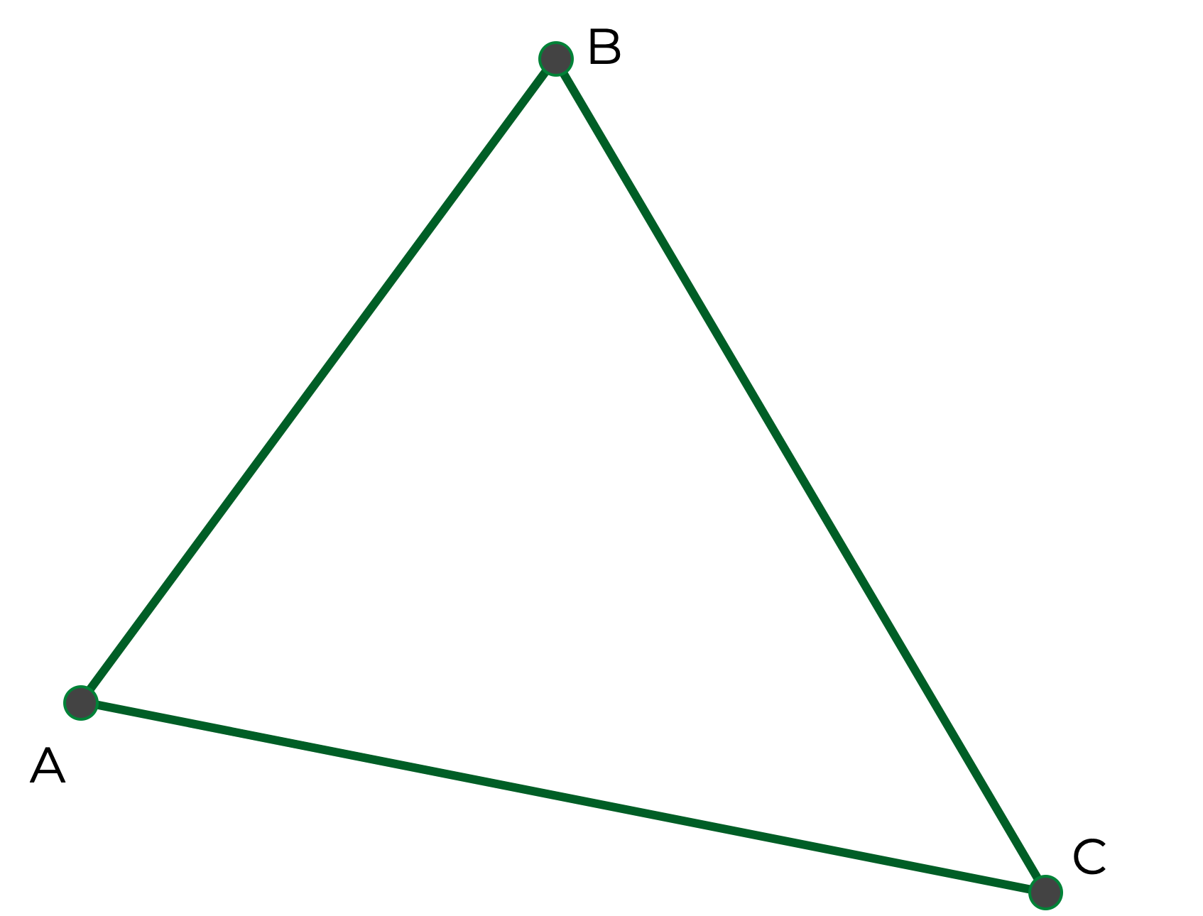
Draw a large random triangle and label the vertices A, B, C.
Draw the angle bisectors of ABC, ACB, BAC.
What do you notice?
Make conjectures and test these on different triangles…

