Slide 1
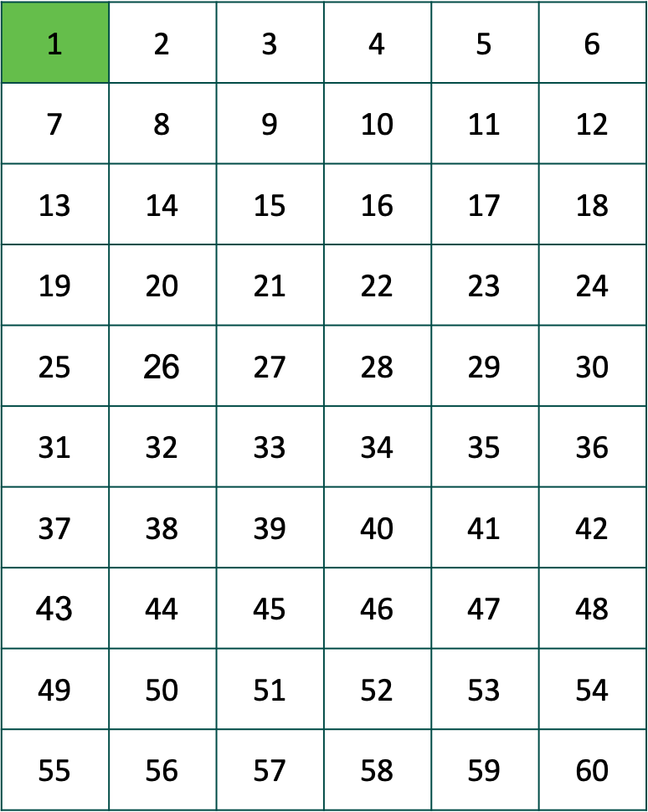
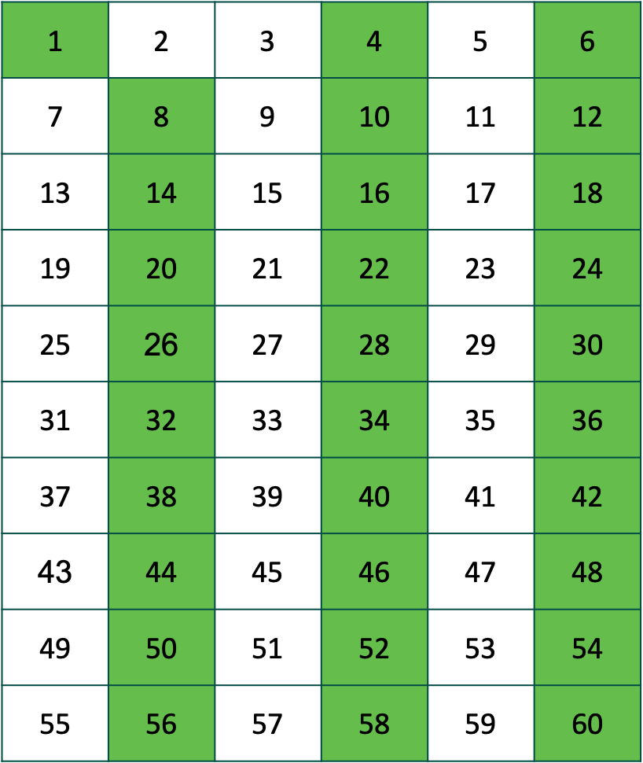
The Sieve of Eratosthenes
Step 1: Cross out 1.
Step 2: Circle the smallest remaining number and cross out all the larger remaining multiples of that number.
Step 3: Repeat step 2
What numbers will be circled?
Notes:
An Algorithm is a sequence of instructions

Slide 2
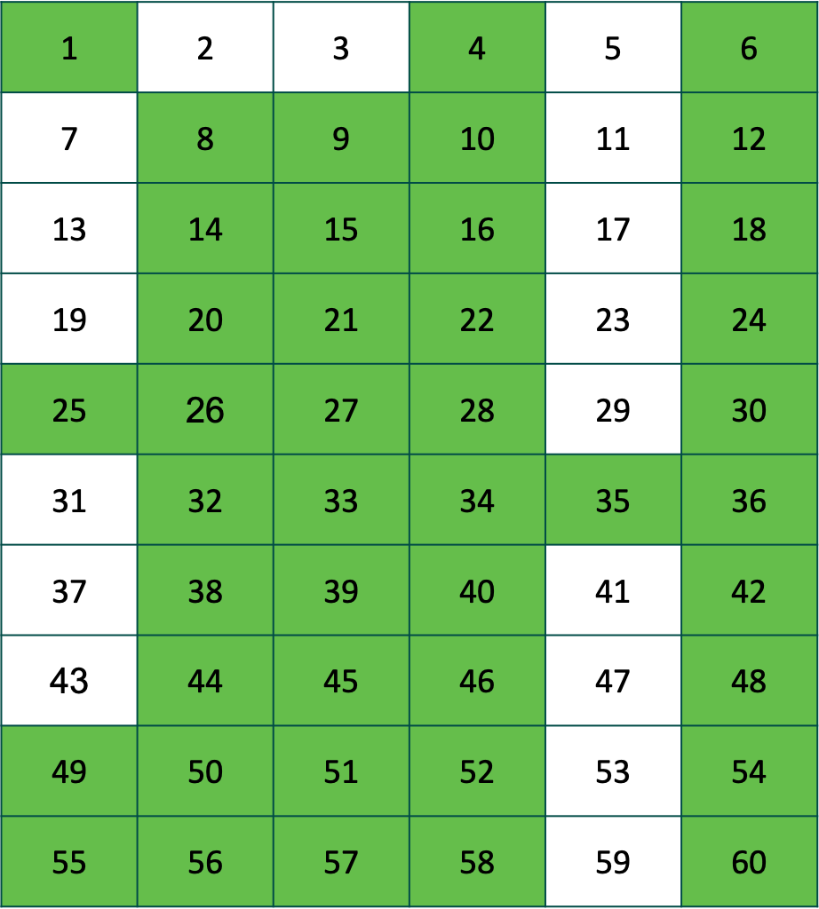
A
B
C
D
Why is the no prime number greater than 3 in columns A, B, C and D?
Notes:
Its called a sieve because all numbers that are not prime numbers are filtered out

Slide 3
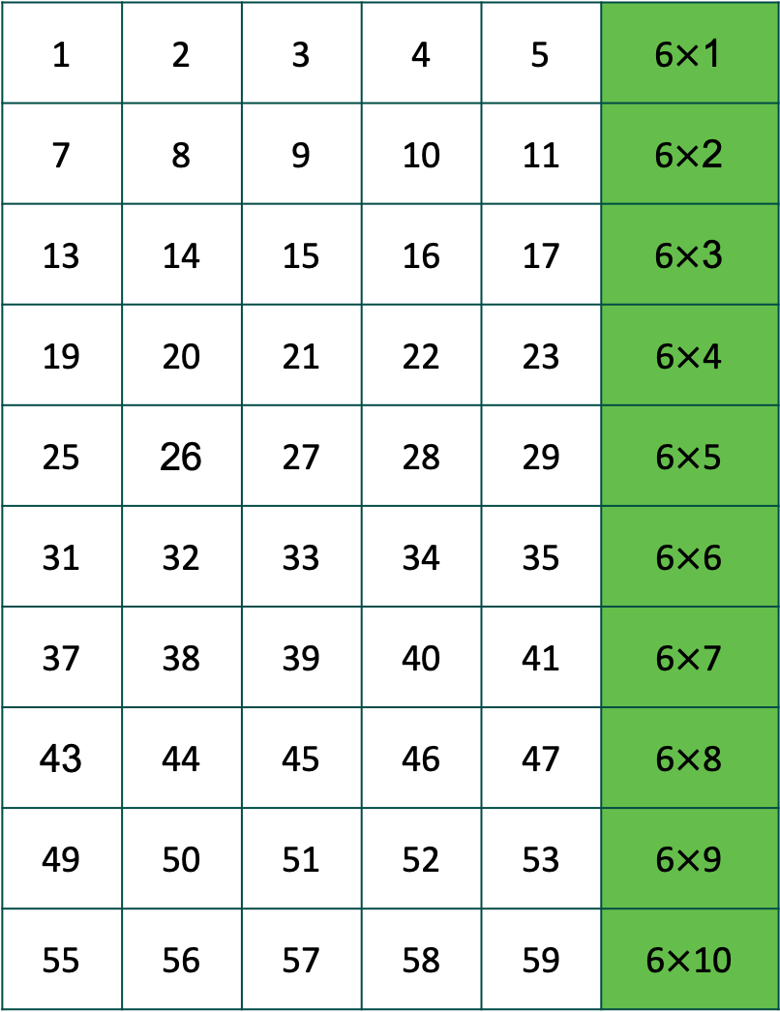
A student highlighted multiples of 6
I can write multiples of 6 as the product of 6 and an integer
Can we generalise the students statement so that we can represent any multiple of 6?
Notes:
You can write this using an expression 6 x m where m is an integer
Why do we have to specify that m is an integer? What happens if m is not an integer?

Slide 4
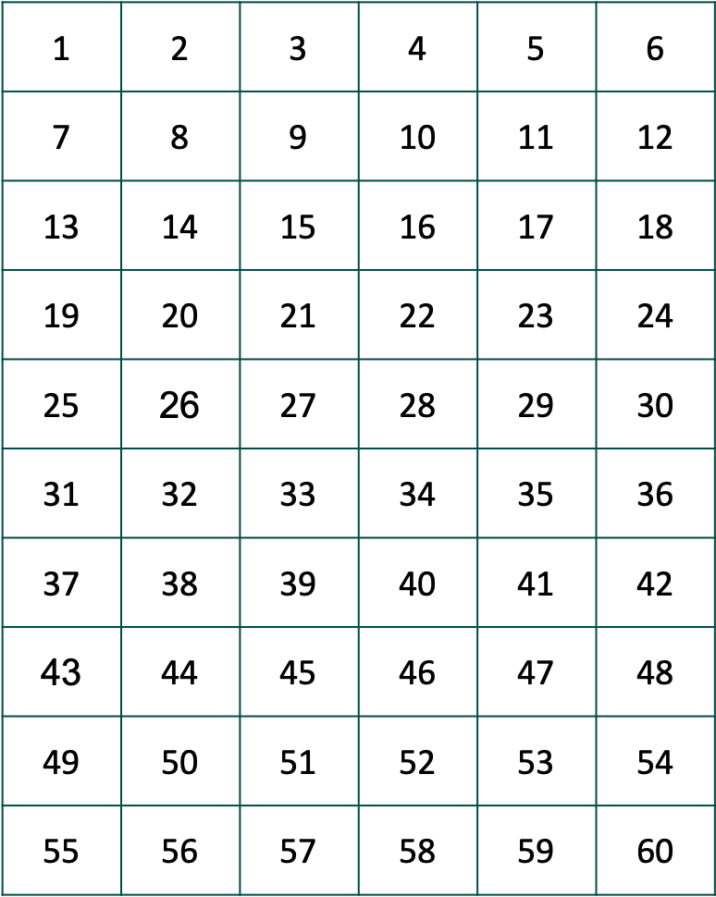
Write an expression to represent all the multiples of the following numbers:
4
5
7
Write an expression to represent all the common multiples of 3 and 4 (use the grid to help you)

Slide 5
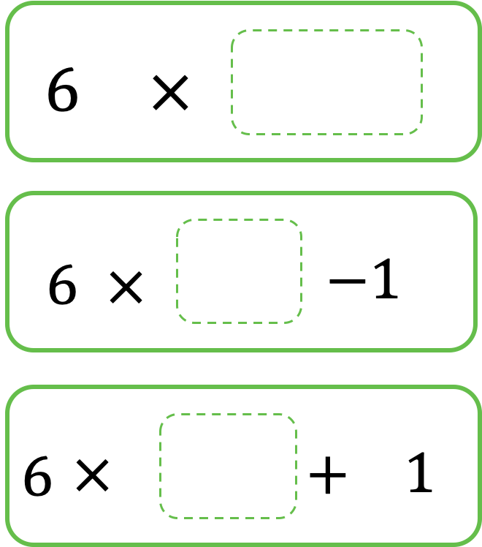
Generalising
Which of the numbers in the table can you find by substituting positive integers into the following expressions?
How would you write each expression using algebraic notation?

