Slide 1
Numeracy: Time - Building Understanding
Lesson 1: Understanding day and night through a sensory story
Lesson 1 of 4
Helen

Slide 2
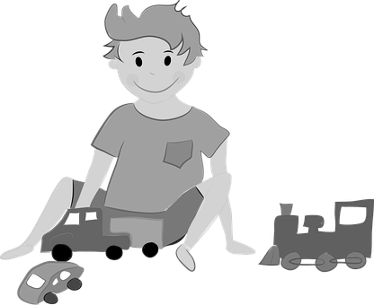
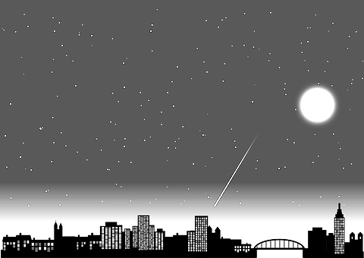
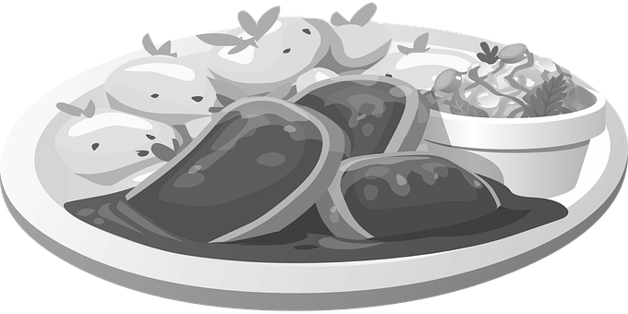
Sorting Activity
What happens during the day?
What happens during the night?
We play with our toys
We can see the moon and stars in the sky
It is dark outside
The sun is in the sky
It is light and bright outside
We go to sleep
We eat meals
Images from Pixabay

