Slide 1
Reading and Understanding Pictograms
Worksheet
Mathematics
Miss Brinkworth

Slide 2
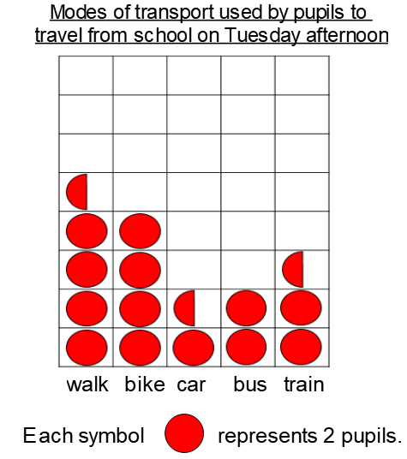
Main task Part A
True or false?
3 people travelled by car
Bus is the least popular mode of transport
6 people travelled by train
1 more person walked than went by bike
2 more people went by train than by bus
Double the number of people went by bike than by bus
Challenge -
How many people were surveyed?
Why do you think most people walk to this school?

Slide 3
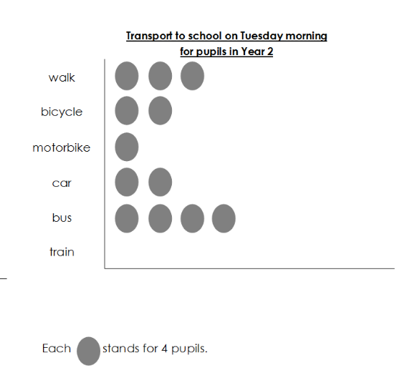
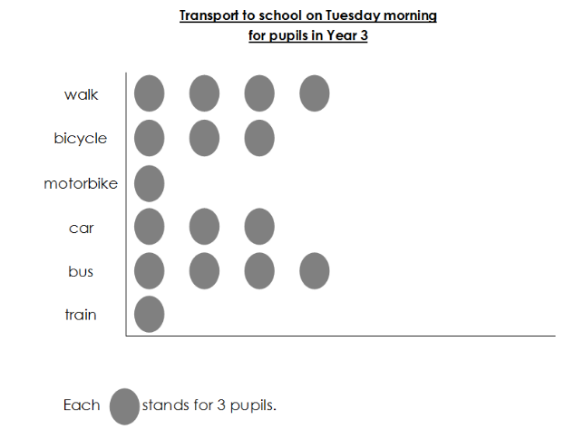
Main task part B

Slide 4
Main task part B
Questions
How many pupils in total came by bus?
Did more pupils walk from year 2 or year 3?
How many pupils in year 2 took the train?
The same number of pupils from each year came by motorbike, true or false?
How many more went by bike in Year 3 than in Year 2?
Challenge -
2 children from year 2 got a taxi. How would you represent this?

