Slide 1
To compare numbers to 20
Mathematics
Miss Charlton

Slide 2
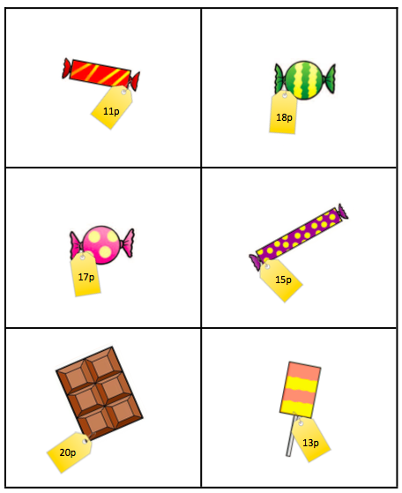
Independent task
‹#›

Slide 3
‹#›

Slide 4
‹#›

