Slide 1
Estimating and measuring in litres
Lesson 2 of 10
Mathematics
Miss Jones

Slide 2
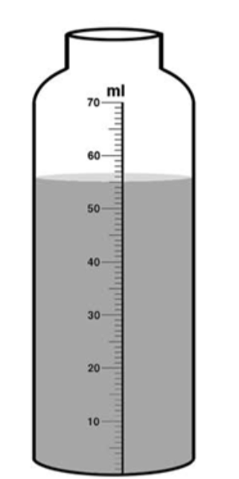
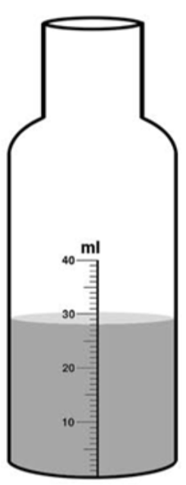
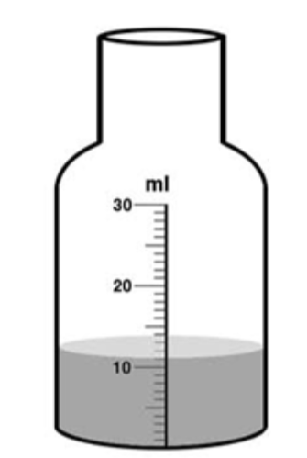
Measure the volume of liquid in the containers by reading the scales.
1.
2.
3.

Slide 3
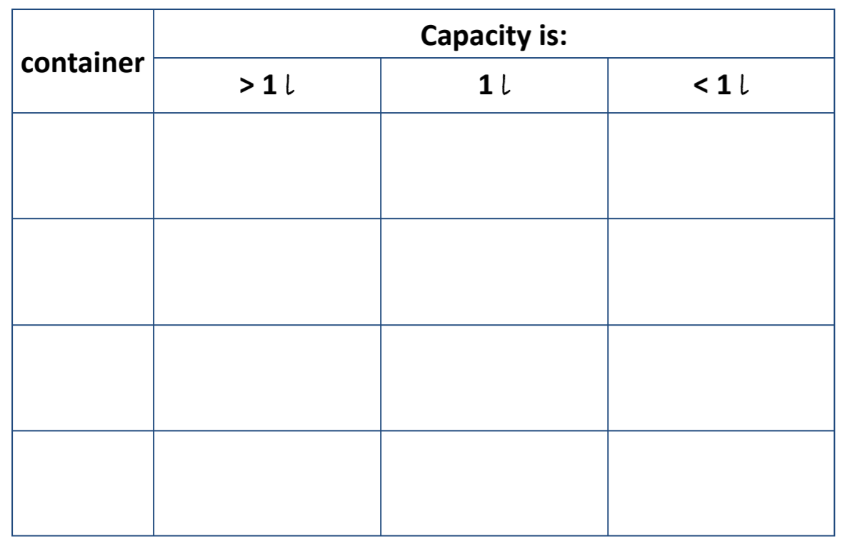
Challenge:
Find different containers which have a capacity of:
-more than one litre
-one litre
-less than one litre.
Record your answers!

