Slide 1
German
Saying what things are [1 / 2]
Capital letters on nouns
Singular definite articles
Frau Johnson

Slide 2
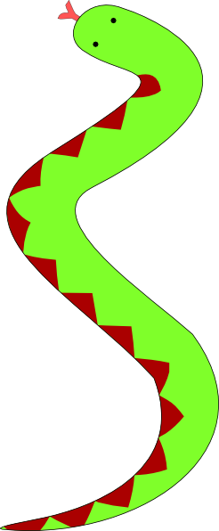
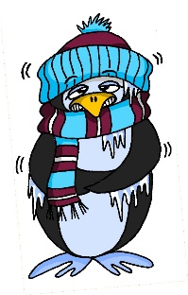
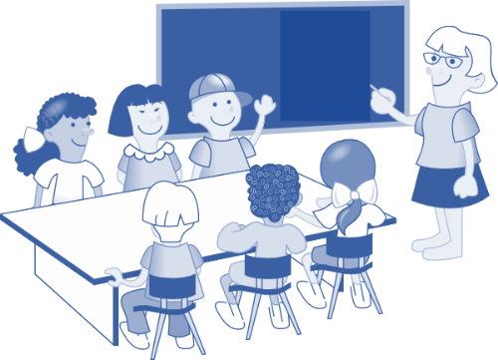
lang
Mann
danke
kalt
Gast
Klasse

Slide 3
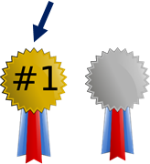
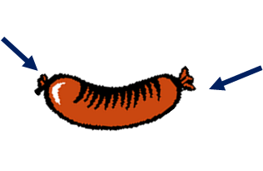
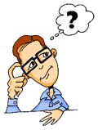
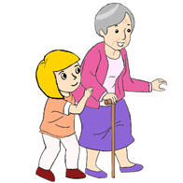
besser
Ende
[e]
helfen
Bett
denken

Slide 4
der Tisch | the table
der Kuli | the pen
der Mann | the man
der Tag | the day
die Flasche | the bottle
die Klasse | the class
die Tafel | the board
das Paar | the pair
das Heft | the exercise book
das Fenster | the window

Slide 5
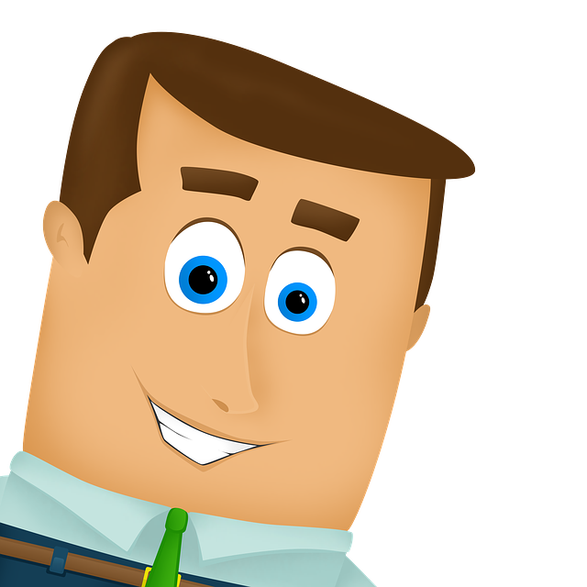
Capital Letters
In German all nouns have capital letters. They keep a capital letter no matter where they are in a sentence.
Der Mann ist kalt.
The man is cold.
Wo ist der Mann?
Where is the man?
Which nouns do this in English?

Slide 6
der, die, das
German has 3 words for the:
Masculine Feminine Neuter
der Tisch die Flasche das Fenster
This is a bit tricky because English only has one.
Every noun in German has a gender. You will need to learn these when you learn new vocabulary and practise them when you practise the nouns.

Slide 7
Definite articles in the nominative
Let’s look at our vocabulary for this lesson and which gender the words are.
masculine
feminine
neuter
der Tisch
der Kuli
der Mann
der Tag
die Flasche
die Klasse
die Tafel
das Paar
das Heft
das Fenster

Slide 8
Capital letters and singular definite articles:
In German there are 3 words for the.
Every noun in German has a gender and a capital letter.
The three different words for the are der, die and das.
They represent masculine, feminine and neuter.

