Slide 1
Applying Knowledge of Time to Solve Problems
Worksheet
Mathematics
Mrs Behan

Slide 2
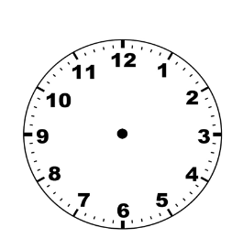
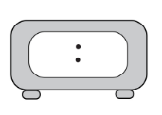
Independent task
The headteacher wanted to know what time the group would leave and return from the trip. Show these times on a digital clock. Remember a.m and p.m.
Have a go at solving some more of Mr Slade’s problems.
The group took a guided tour around Buckingham Palace.
The tour started at 03:20pm and finished at 04:05pm.
How long was the tour?
The group see a poster for the musical Matilda. It starts at 07.30pm and finishes at 10:15pm. How long does the show last?
It had been 45 minutes since Big Ben had chimed twice. What time was it?

