Slide 1
Find a particular value of f(x)
Maths
Mrs Dennett

Slide 2
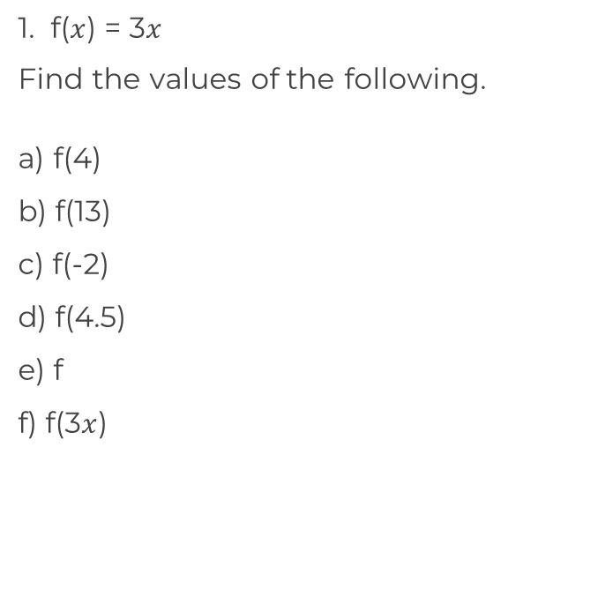
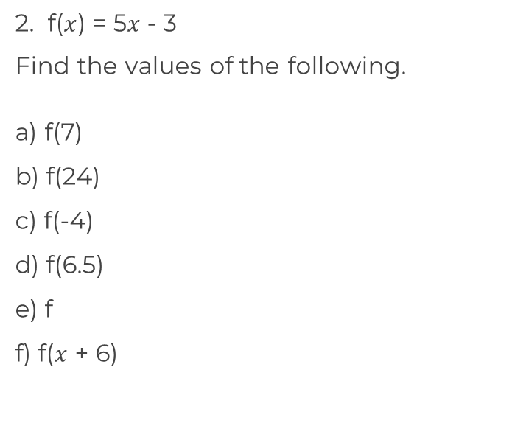
Find a particular value of f(x)
‹#›

Slide 3
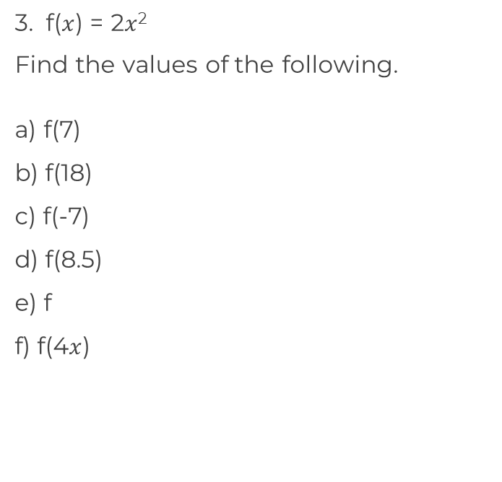
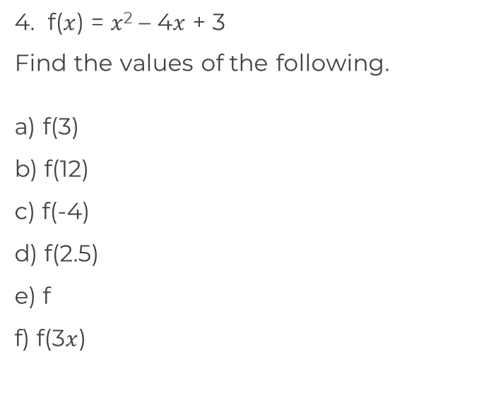
Find a particular value of f(x)
‹#›

Slide 4
Answers

Slide 5
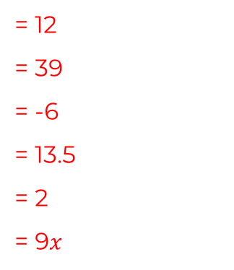
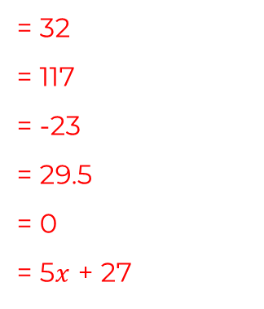
Find a particular value of f(x)
‹#›

Slide 6
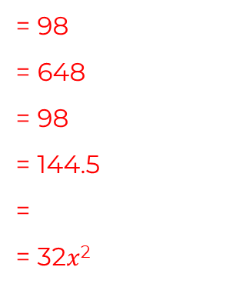
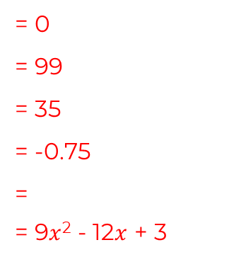
Find a particular value of f(x)
‹#›

