Slide 1
Decimal multipliers
Mathematics
Mr Millar

Slide 2
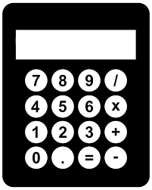
Write down the calculation required, and the result, when finding...
40% of 70
20% of 17
43% of 725
6% of 500
35.7% of 480
145% of 94

Slide 3
How many different ways can you work out 25% of 300?
I can draw 25% of 300 as a bar model and do 300÷____…
To work out 25% of 300 I use a decimal multiplier…
To work out 25% of 300 I start by calculating
10%...

Slide 4
Answers
Answers

Slide 5
Write down the calculation required, and the result, when finding...
40% of 70
20% of 17
43% of 725
6% of 500
35.7% of 480
145% of 94
0.4 x 70 = 28
0.2 x 17 = 3.4
0.43 x 725 = 311.75
0.06 x 500 = 30
0.357 x 480 = 171.36
1.45 x 94 = 136.3

Slide 6
How many different ways can you work out 25% of 300?
I can draw 25% of 300 as a bar model and do 300÷4…
300
75
75
75
75
To work out 25% of 300 I use a decimal multiplier…
To work out 25% of 300 I start by calculating
10%...
10% = 30
20% =60
5% = 15
25% = 75
0.25 x 300 = 75

