Slide 1
Timetable Questions
Worksheet
Mr Ward

Slide 2
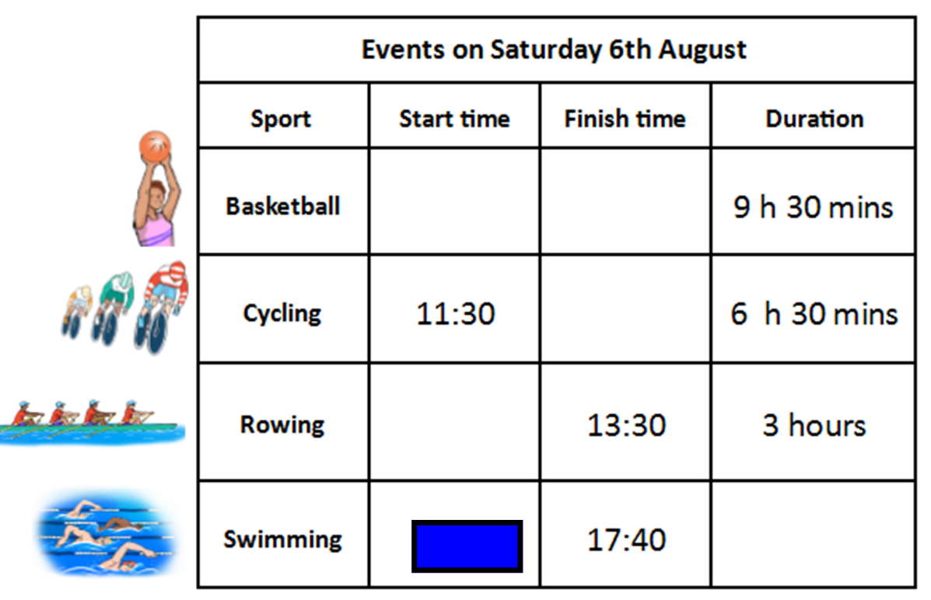
Let’s refresh our skills on finding time intervals!
Complete the missing information for timetable below
20:15
13:55

Slide 3
Let’s refresh our skills on finding time intervals!
Answers - Mental arithmetic or number lines?
10:45
20:15
18:00
10:30
13:55
3 h 45 mins

Slide 4
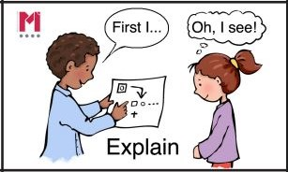
Talk Task - Train timetable
What question could be asked to result in the number line given?
The number line starts at 10.40 which I identified as being Train B from London Paddington. It also ends at 15.49 which I identified as being the final stop in Penzance. The total travel time shown on the number line is 5 hours 9 minutes.
So my question is this:
“How long does it take for Train B to travel from London Paddington to Penzance?”

Slide 5
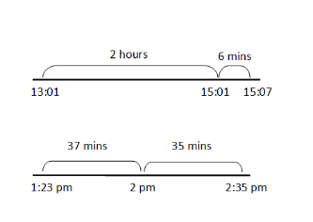
Talk Task - Train timetable
What question could be asked to result in the number line given?

Slide 6
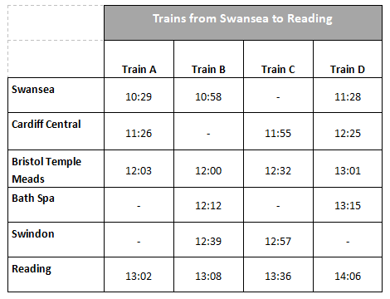
Use the timetable below to answer the questions carefully
Try to provide your answers in full sentences please.
a) How long does each train take to travel from Bristol to Reading?
b) Jasmine needs to be in Bristol by 12:30 p.m. What time must she depart from Swansea to arrive in time?
c) Sacha wants to take the train from Bristol to Swindon and arrive by 1 p.m. What are his options?
d) Claire is travelling from Bristol to Reading at midday, is train B her best choice?
e) Adam gets the fastest train from Cardiff to Bristol, which train does he get?

Slide 8
a) How long does each train take to travel from Bristol to Reading?
b) Jasmine needs to be in Bristol by 12:30 p.m. What time must she depart from Swansea to arrive in time?
c) Sacha wants to take the train from Bristol to Swindon and arrive by 1 p.m. What are his options?
d) Claire is travelling from Bristol to Reading at midday, is train B her best choice?
e) Adam gets the fastest train from Cardiff to Bristol, which train does he get?

Slide 9
Challenge Slide
Lucy says using column subtraction never works when using time intervals.
Ben disagrees because he says it always works for him.
Khalid finds time intervals difficult but is good at column subtraction. He is hoping Ben is right!
Who is right? Show evidence in your reasoning and explanations.
What advice would you give to each pupil?

