Slide 1
The rule of four Lesson 4 of 8
Mathematics
Miss Kidd-Rossiter

Slide 2
 | × 2 | × 8
3 × | 6 | 24
6 ×
 | × 3 | × 9
2 × | 6
8 ×
 | × 5 | × 10
3 × | 15
9 ×
Complete these ‘times tables’ grids.
What multiplicative relationships can you see between rows?
What multiplicative relationships can you see between columns?
 | 20 | 100
 | 30
 | 60 | 12
 |  | 4
 | 24

Slide 3
A greengrocer makes bags of red and green apples.
There are the same amount of red apples in each bag, and the same amount of green apples in each bag.
She then puts some bags into a box and gives them to schools.
 | Number in bag | Number in box
Green | 2 | 60
Red | 6
 | Number in bag | Number in box
Green | 3 | 27
Red | 5
 | Number in bag | Number in box
Green |  | 33
Red | 6
Notes:
Fill in the tables, some tables you can complete in more than one way

Slide 4
To make large volumes of different shades of purple paint, I mix different amounts of red paint and blue paint.
Complete these tables:
 | Mix | Volume
Red | 5 | 15 litres
Blue | 1
 | Mix | Volume
Red | 3
Blue | 4 | 20 litres
 | Mix | Volume
Red | 4 | 3.2 litres
Blue | 12
 | Mix | Volume
Red | 8 | 10 litres
Blue | 28
Which did you find the easiest to work out? Explain your choice.

Slide 5
Two bottles of drink taste the same.
Fill in the grid.
What is the ratio of squash to water?
How much bigger is bottle 2?
 | Squash | Water
Bottle 1 | 20 cl
Bottle 2 | 60 cl | 45 cl

Slide 6
Below is a ratio table.
Gemma says that the missing number is 35.
Ed says that the missing number is 19.
Who do you agree with, why?
What mistake has been made by the person who is wrong?
 | Group | Bag
Pink | 3 | 15
Grey | 7 | ?

Slide 7
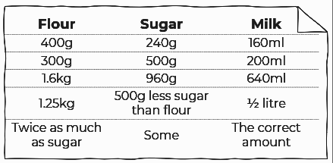
To make delicious muffins, the ratio of flour : sugar : milk should be 5 : 3 : 2.
Which of these mixes will make delicious muffins?
I want to make as many delicious muffins as I can. I have 2kg of flour and 1kg of sugar.
How much milk will I need?

