Slide 1
Measures:
Differentiating between heavier and lighter
Mathematics Lesson 4 of 10
Miss. Molnar

Slide 2
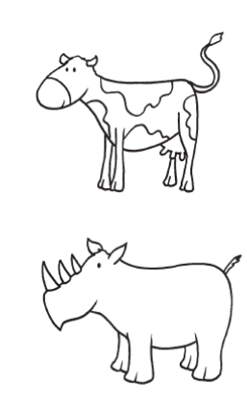
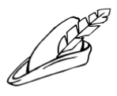
Can you sort the objects from heavy and light? Which do you think would be the heaviest? Lightest? Why?

Slide 3
Heavy
Light

