Slide 1
Mathematics
Representing Probability
Downloadable Resource
Mr Langton

Slide 2
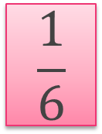
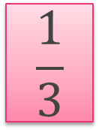
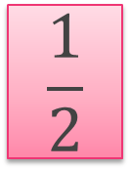
Representing Probability
1. For each of these statements, state whether you agree or disagree. If you disagree, then re-write it.
If I hear thunder outside, then it will certainly be raining.
If I roll a dice, I have an even chance of rolling a square number.
It is impossible to toss a coin ten times and get a head every time.
2. Match the statements to the probability.
Getting a head when coin is tossed
Throwing a three on a six-sided dice
Throwing an even score on a six-sided dice
Tomorrow is Friday if today is Thursday
Throwing a 7 on a six-sided dice

