Slide 1
Oak Specialist
Independent Living Personal Care
Building Understanding

Slide 2
Unit 2- Personal Care
Lesson 1- Five a day
Lesson 2- Morning hygiene routine
Making a healthy smoothie using five fruit and vegetables.
Identifying morning hygiene activities and creating a routine.
Option 3
Lesson 4- Fine/gross motor circuit
Lesson 3- Turn taking
Option 4
Games and activity suggestions to encourage turn taking.
Activity suggestions to encourage development of fine and gross motor skills
Lesson 5- Managing emotions
Option 3
Option 4
Lesson 6- How to relax
Recognising familiar emotions and identifying strategies to manage these.
Activity suggestions to learn how to relax and self regulate.
Notes:
Depending on how many lessons for each unit, there could be a 2nd page for lesson 5…etc

Slide 3
Lesson 4- Fine/gross motor circuit

Slide 4
Teacher notes- Fine/gross motor circuit
Learning Intention: To develop fine and gross motor skills.
Three fine motor activities which can be completed one after another. These activities develop different types of hand grip.
Three gross motor activities which can be completed one after another in a physical circuit.
Resources- pegs, card, two bowls, dry ingredients such as rice, spoon, playdough or blu tack, spaghetti, hoola hoops or cheerios
Notes:
This is the equivalent to a loose lesson plan/overview for teachers before starting the lesson.

Slide 5
Safety notice
Some of the activities suggested in this lesson involve physical activity. Before beginning these activities, ensure the area is safe and that your learner is feeling fit and well to take part in the activity. Please also check your learner is wearing the right clothes for physical activity.

Slide 6
Personal Care
Fine/gross motor circuit
Building Understanding

Slide 7
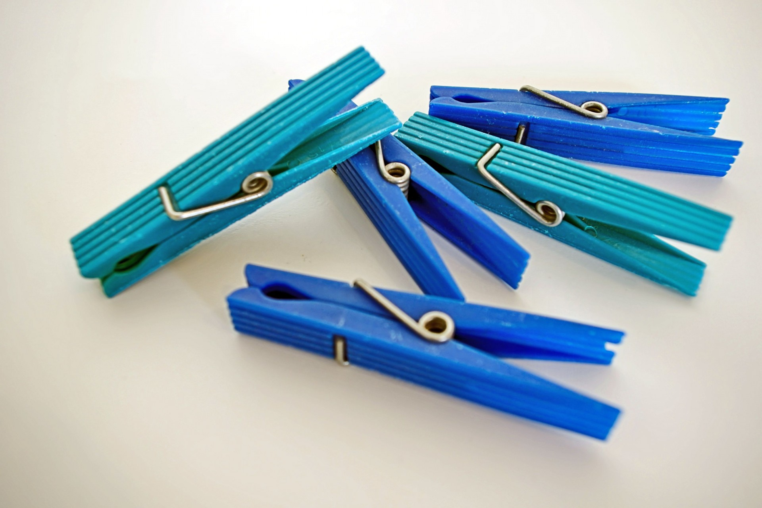
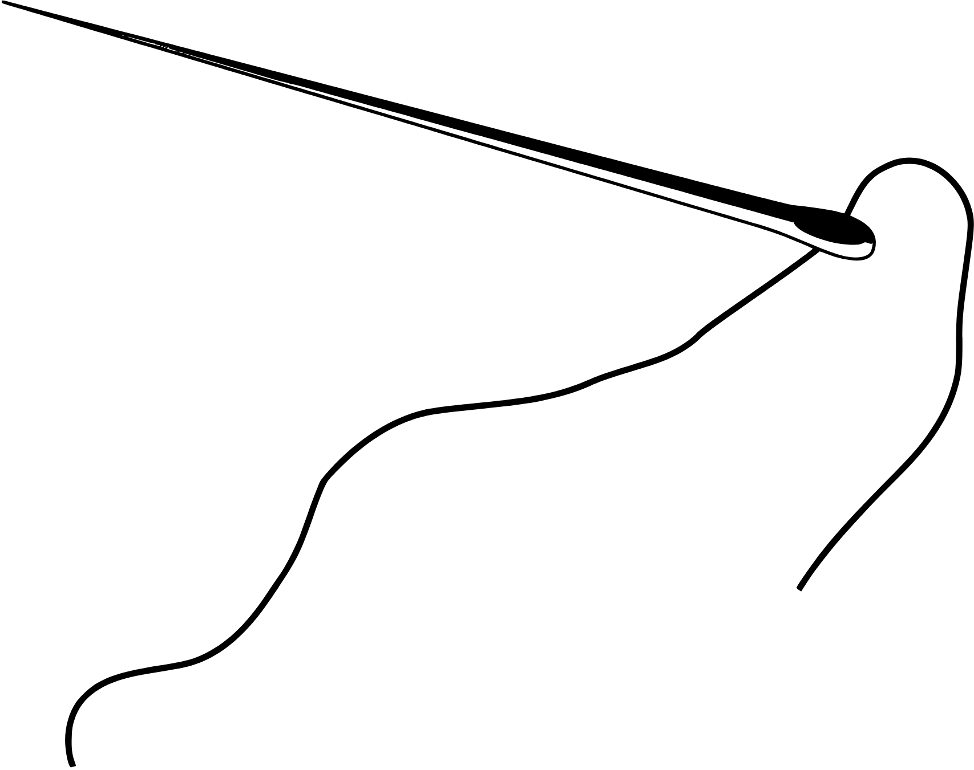
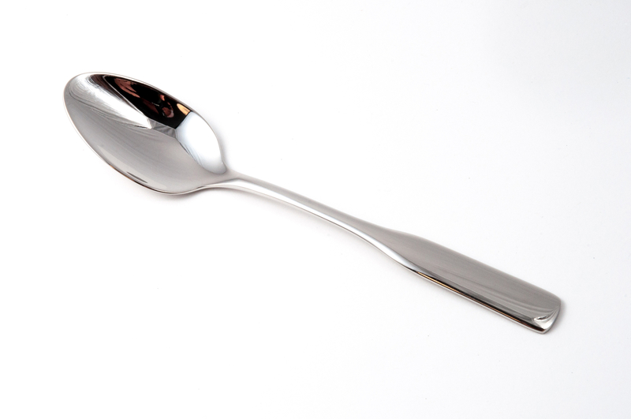
Fine motor circuit
Using pegs
Spooning dry ingredients
Threading
Notes:
Here are three fine motor activities. Present them at a clear table or workspace suitable for your learner.

Slide 8
Activity - Using pegs
Here is an example of how you can use pegs to develop fine
motor skills:
Clip the pegs onto the card one by one - try and fit as many on the card as possible.
What you need: Clothes pegs and squares of card.

Slide 9
Spooning dry ingredients
Here is an example of how to develop fine motor skills by
transferring ingredients with a spoon:
Transfer the dry ingredients from one bowl to the other using the spoon.
What you need: Dry ingredients, such as rice, two bowls and a spoon.

Slide 10
Pasta and Playdough threading
Here is an example of how to use spaghetti and playdough to
develop fine motor skills:
Roll the playdough into a ball and place it on the table in front of you.
Pick up the spaghetti from the table and push it into the playdough.
Adaption: break the spaghetti in half to make this activity easier.
Things you will need: Dry spaghetti and playdough.

Slide 11
Gross motor circuit
Clear a space either outside or inside
Set each activity up before you start
Spread the activity stations out so that you can travel between them
Model each activity at each step

Slide 12
Gross motor circuit
1. Pick a card!
Move like an animal
REPEAT
4. Bend down & postcards
2. Follow the lines
3. Pick a card!
Do alphabet action
Notes:
This is where slides will increase to include the content of the lesson as usual.

Slide 13
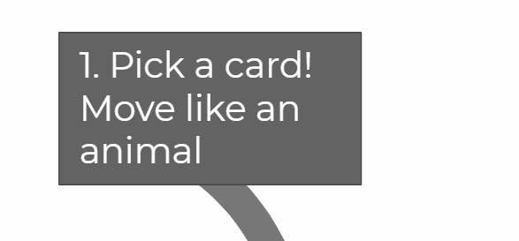
Pick a card and move like an animal
The first station of the circuit is to pick a card and copy the movement.
Make a range of animal cards by cutting paper or card into squares and drawing/writing an animal movement. See examples online or on next page.
Copy the movement before carrying the card to the next station of the circuit!
Notes:
This is where slides will increase to include the content of the lesson as usual.

Slide 14
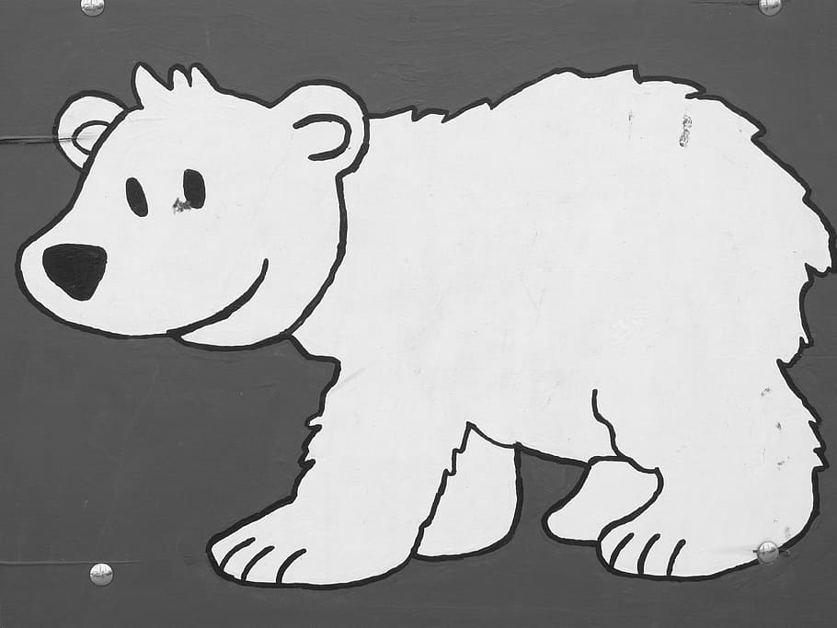
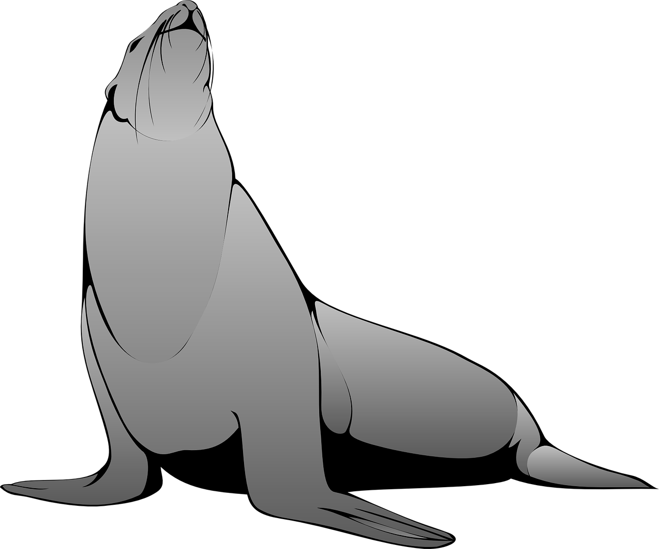
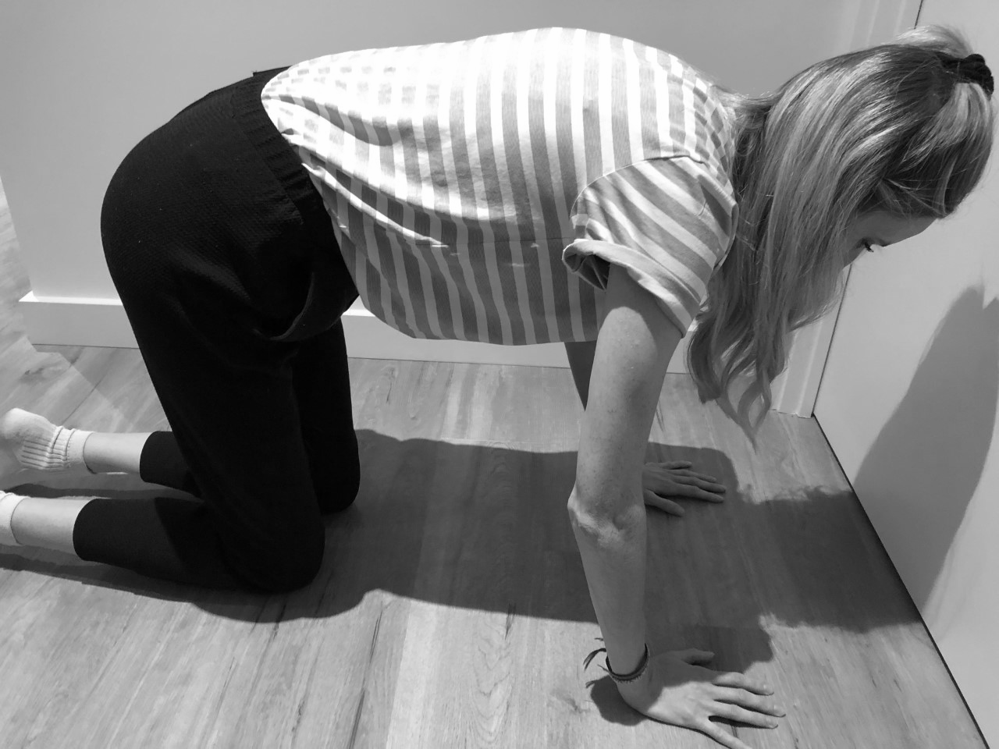
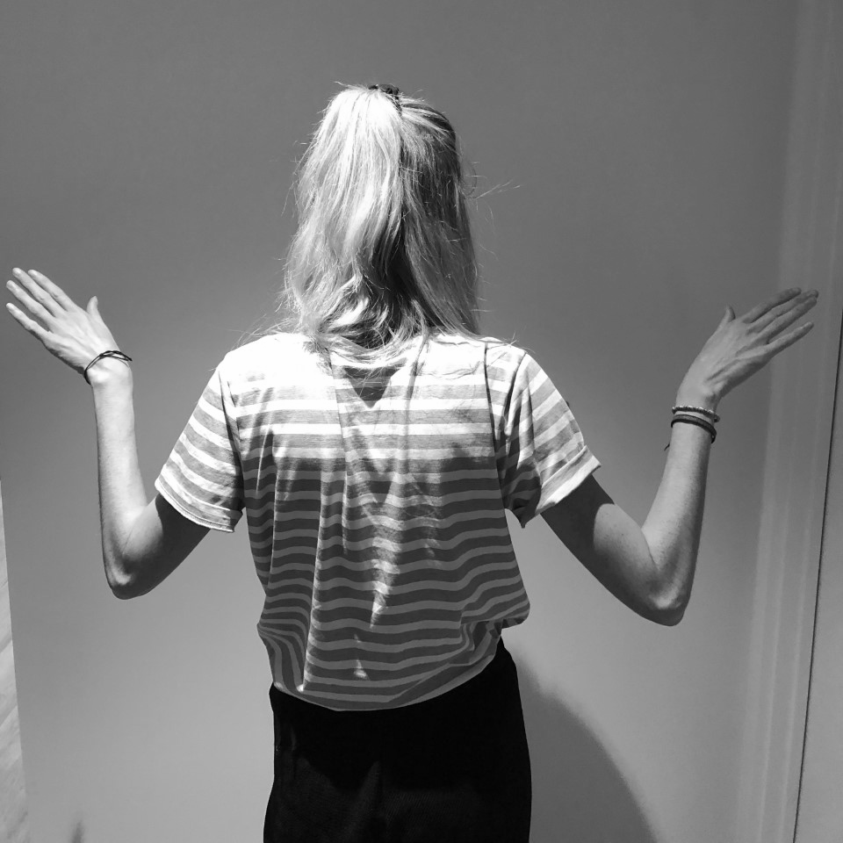
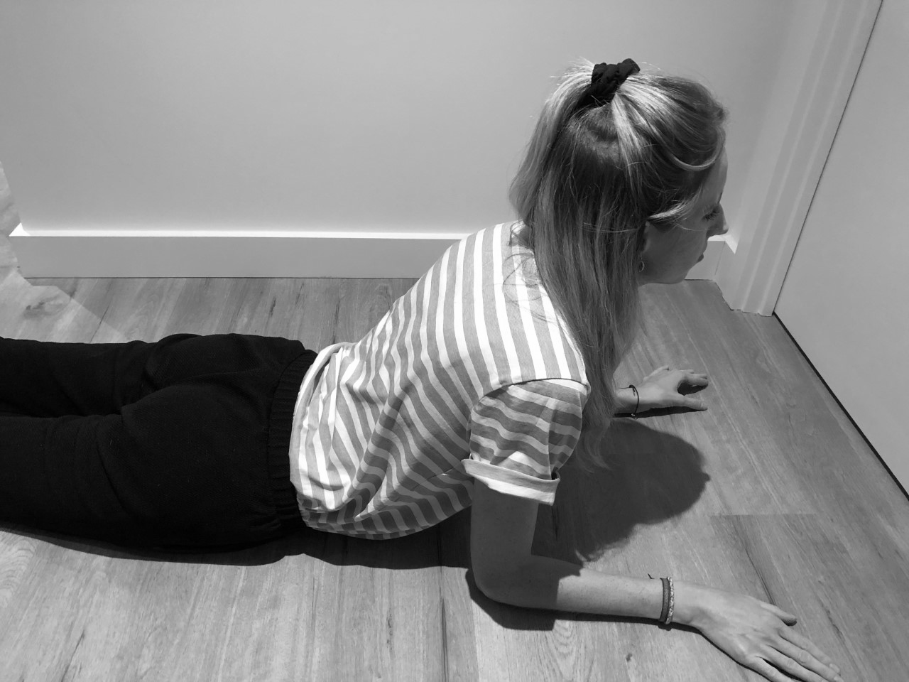
Animal cards examples
Move like a
BEAR
Move like a
BIRD
Move like a
SEAL

Slide 15
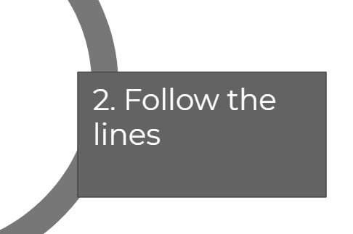
2. Follow the lines
The second station of the circuit is to follow the
lines on the floor.
Create lines with chalk (if outside) or a dressing gown tie (if inside) or anything that you can make a line with to follow.
Create a pattern in the line to walk along or follow to the third station.
Notes:
This is where slides will increase to include the content of the lesson as usual.

Slide 16
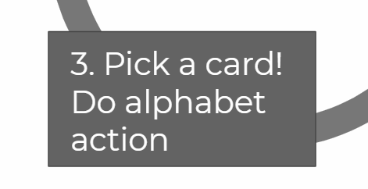
3. Pick a card and do alphabet action
The third station of the circuit is to pick a card and copy the action.
Make a range of alphabet action cards by cutting paper or card into squares and drawing/writing a letter and corresponding action. See examples online or on next page.
Do the action before carrying both cards (from station 1 and 3) to the next station of the circuit!
Notes:
This is where slides will increase to include the content of the lesson as usual.

Slide 17
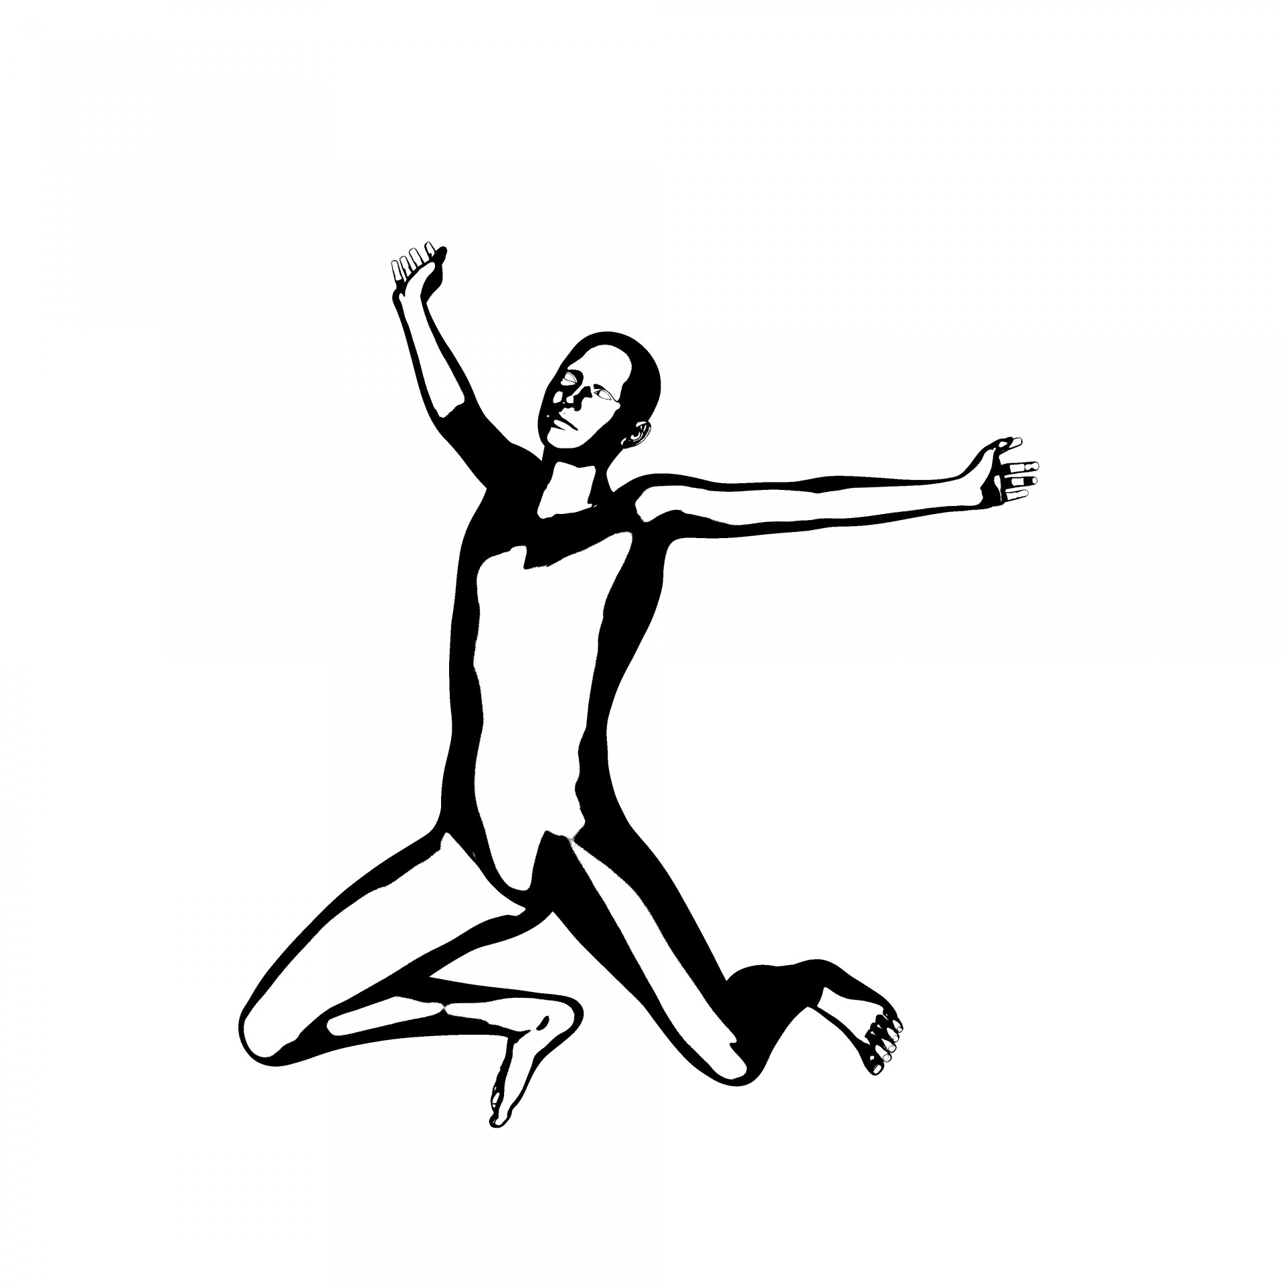
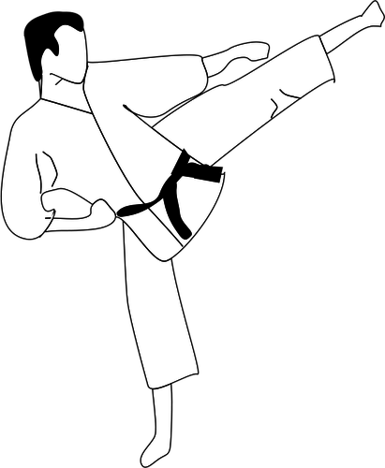
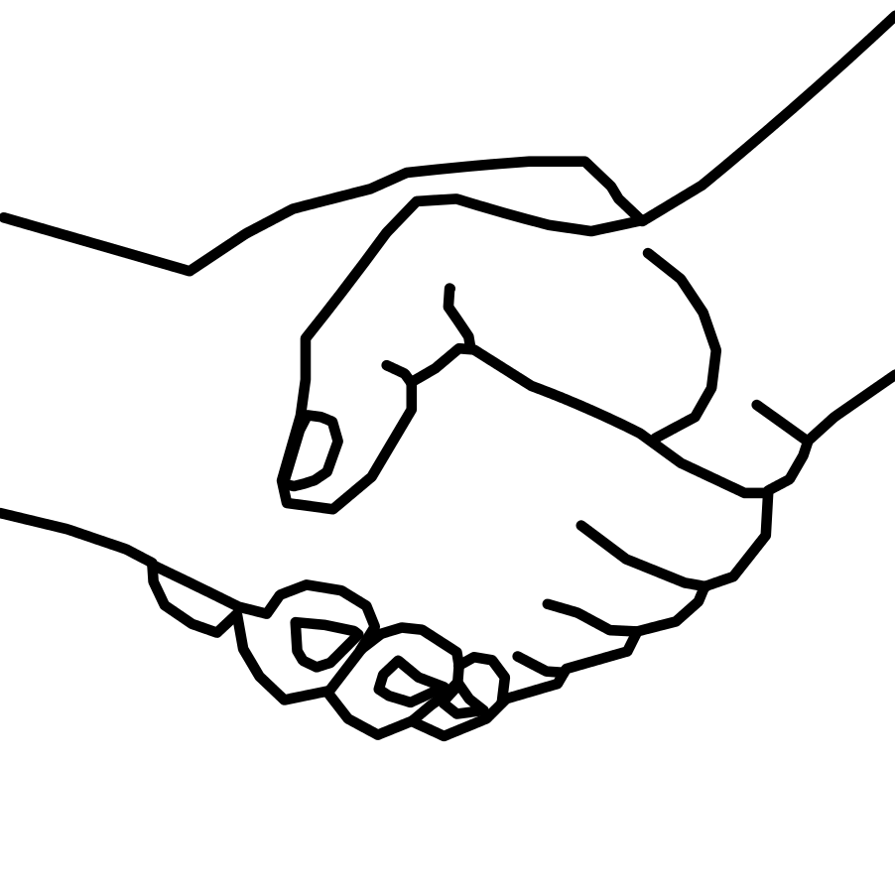
Alphabet action examples
Jump
J
Kick
K
Shake
S

Slide 18
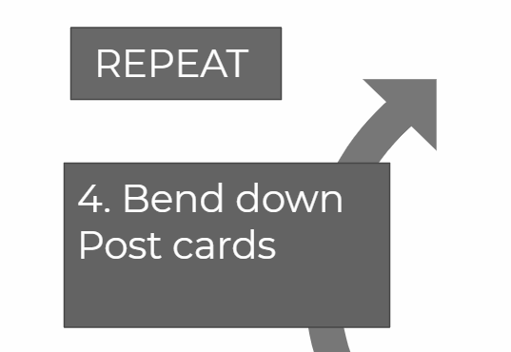
4. Bend down and post cards in box
The final station of the circuit is to bend down to post the
cards into a box.
Create a post box by cutting a slit in a cereal box or old delivery box. Make sure it is low so that your learner has to bend down to post the cards.
After posting, repeat the circuit again starting back at the first station.
Repeat until all the cards have finished!
Notes:
This is where slides will increase to include the content of the lesson as usual.

Slide 19
Independent Living Personal Care
Fine/gross motor circuit
Make it easier
Make it harder
More ideas
Pick one activity from each circuit and develop skills in that area.
Design your own activities to increase the circuit. If you have extra space, increase the movements.
Talk to an Occupational Therapist or Physiotherapist for specific activities and exercises.
Notes:
Final slide of the lesson. Suggest adaptations for teachers/parents.

Slide 20
Further Learning with Oak National
Independent Living:
Building Understanding- How to relax (Unit 3)
Building Understanding- Turn taking games (Unit 3)
Physical Development:
Movement and Balance (Unit 1)
Target Sports and Games (Unit 4)
Occupational Therapy:
Gross Motor Skills (Unit 1)
Fine Motor Skills (Unit 2)

Slide 21
References
Slide 7- Clothes pegs, Publicdomainpictures / Needle, Pixabay / Spoon, Silberfuchs, Good Free Photos
Slide 14- Cartoon bird, NaomiBooth, Pixabay / Snowbear, Wallpaper Flare / Seal head raised, Needpix
Slide 17- Jumping man, Publicdomainpictures / Handshake1, Tommyv580, Wikimedia Commons / Man in karate pose, Publicdomainvectors
Notes:
Insert info for subject/lesson name/stage (if appropriate)

