Slide 1
Ordering Fractions
Downloadable Resource
Mathematics
Miss Jones

Slide 2
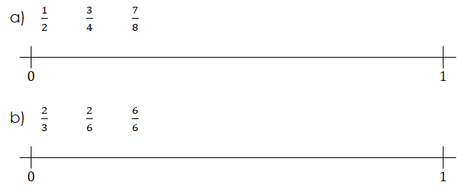

Slide 3
