Slide 1
Add and subtract two column vectors to give a resultant vector
Miss Davies
Maths
‹#›

Slide 2
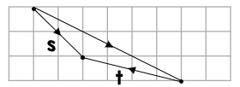
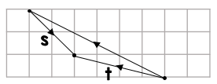
Add and subtract two column vectors
B
C
A
‹#›

Slide 3
Add and subtract two column vectors
‹#›

Slide 4
Answers
‹#›

Slide 5
Add and subtract two column vectors
B
C
A
‹#›

Slide 6
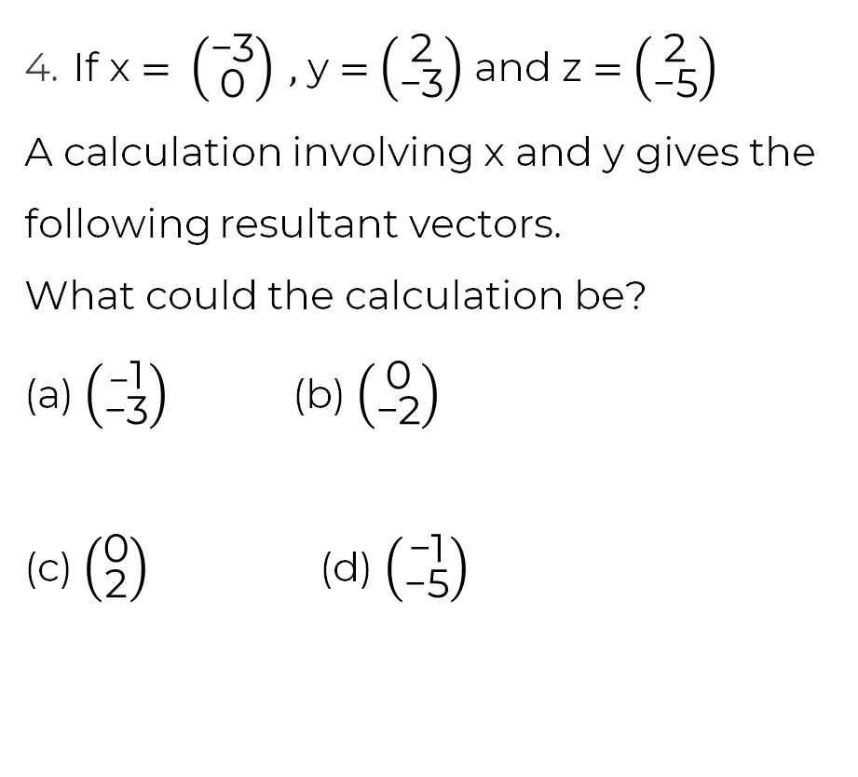
Add and subtract two column vectors
x + y
or y +x
z - y
y - z
x + z
‹#›

