Slide 1
Lesson 2: Bare Bones
Physical Computing
Computing
Allen Heard
Materials from the Teach Computing Curriculum created by the National Centre for Computing Education

Slide 2
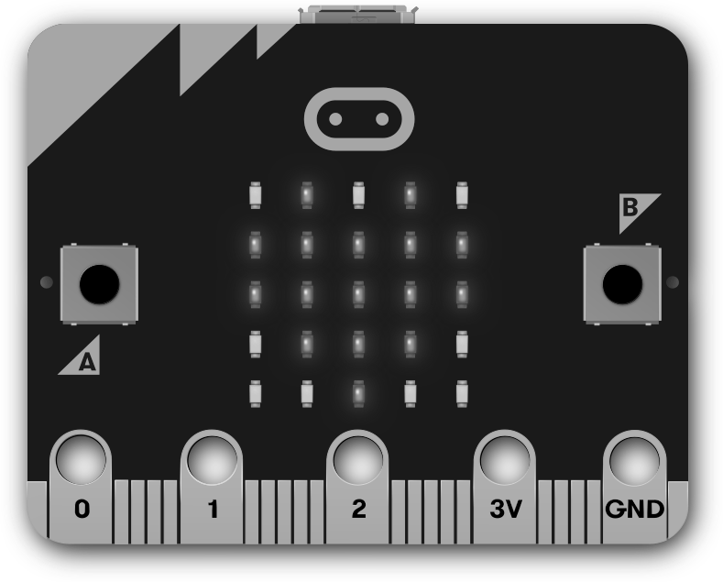
Task 1 - Output - part 1
In lesson 1, we used the LEDs to display a messages and images.
In this task, you will display images using a loop.
Credit: micro:bit Foundation

Slide 3
Task 1 - Output - part 1
Replace the three blocks in lines 2, 3, and 4 with images such as HAPPY, SAD, MEH.
You can find the complete list by searching on the internet for micro:bit images.
Then add the correct variable name to line 6.
In your development environment, complete the program below, so that the list of images contains three built-in images of your choice.
Don’t forget to flash your program.
1
2
3
4
5
6
from microbit import *
images = [ ,
,
]
for image in images:
display.show( )

Slide 4
Task 1 - Output - part 2
In part 1, the micro:bit displays the images so fast that you only get to see the last image in the list.
Add the line opposite to your program, to introduce a delay between displaying the images in the list.
Tip: You may need to indent the new line.
+
sleep(1000)
Note: The sleep function on the micro:bit takes a number of milliseconds as an argument. Therefore, a 1000 milliseconds is a delay of 1 second. Also, you don’t need to import any module to use the sleep function.

Slide 5
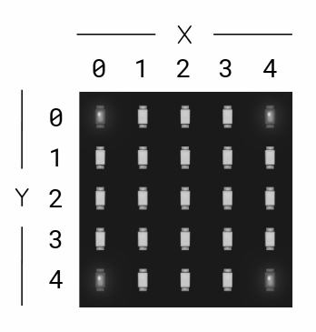
Task 2 - Controlling individual LEDs - part 1
Complete the program below to light up the top right pixel. You can use the image opposite to work out the x and y coordinates or experiment!
Then, using the worksheet, complete the rest of the parts to this task.
1
2
3
4
from microbit import *
delay = 100
# top right
display.set_pixel( , , 9)

Slide 6
Task 2 - Controlling individual LEDs - part 2
Add the lines below to your program to light up the bottom right pixel.
+
+
+
+
sleep(delay)
display.clear()
# bottom right
display.set_pixel( , , 9)

Slide 7
Task 2 - Controlling individual LEDs - part 2
Repeat part 2, in order to light up the bottom left and top left pixels (in that order).
Then, nest all of your code in a while loop, so that four pixels keep lighting up, one after another forever.
while True:
………………………..

Slide 8
Task 3 - Controlling individual LEDs - part 1
What values would be required to produce the star output shown opposite?
And what other code would you need to add to make it work?
Replicate the image below by filling in the appropriate values for column, row, and brightness.
star = Image("?????:"
"?????:"
"?????:"
"?????:"
"?????")
Flash your program to see you results, you may have to adjust your values slightly to make it look the same.

Slide 9
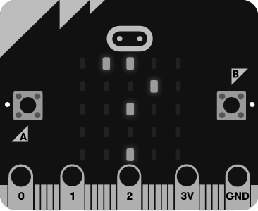
Task 3 - Controlling individual LEDs - part 2
Create a new program to create your own image.
Flash the program to your micro:bit, to see your image displayed.
Credit: micro:bit Foundation

Slide 10
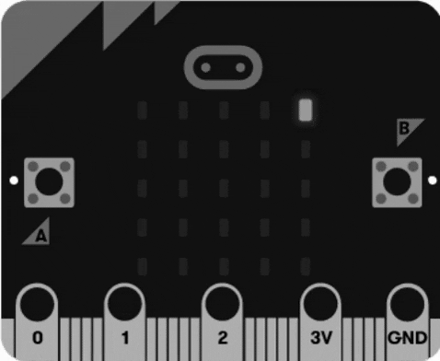
Task 4 - Sparkle challenge
Complete the program below to set random pixels to a random brightness level and create a sparkling effect on the micro:bit display.
from microbit import *
from random import randint
while True:
x = randint(?,?)
y = randint(?,?)
brightness = randint(?,?)
display.set_pixel(x, y, brightness)

