Slide 1
Sequencing events in chronological order.
Mathematics
Mrs Bramble and Miss Sidhu

Slide 2
First choose a routine to draw and label.
Morning
Afternoon
Evening
Notes:
For the independent task, you need to have a go at creating your own routine, it could be during the morning like we’ve just done together, or it could be part of your afternoon or even your bedtime routine. You can use these time adverbials to help you describe the events in chronological order and you can draw what the event is in these boxes here.

Slide 3
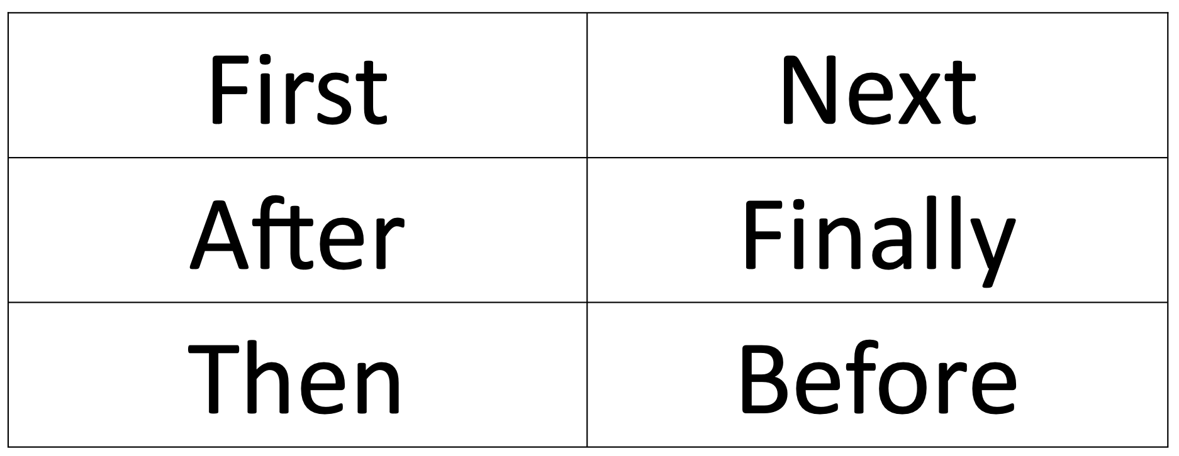
Next, pick four words from these time adverbials to use to order your events.
Notes:
For the independent task, you need to have a go at creating your own routine, it could be during the morning like we’ve just done together, or it could be part of your afternoon or even your bedtime routine. You can use these time adverbials to help you describe the events in chronological order and you can draw what the event is in these boxes here.

Slide 4
Finally, draw images to show the activities you do in order.

