Slide 1
What is a habitat?
Science
Miss Simkin

Slide 2
MRS NERG
M_______
R_______
S_______
N_______
E_______
R_______
G_______

Slide 3
✍A habitat is the natural _________ of an __________.

Slide 4
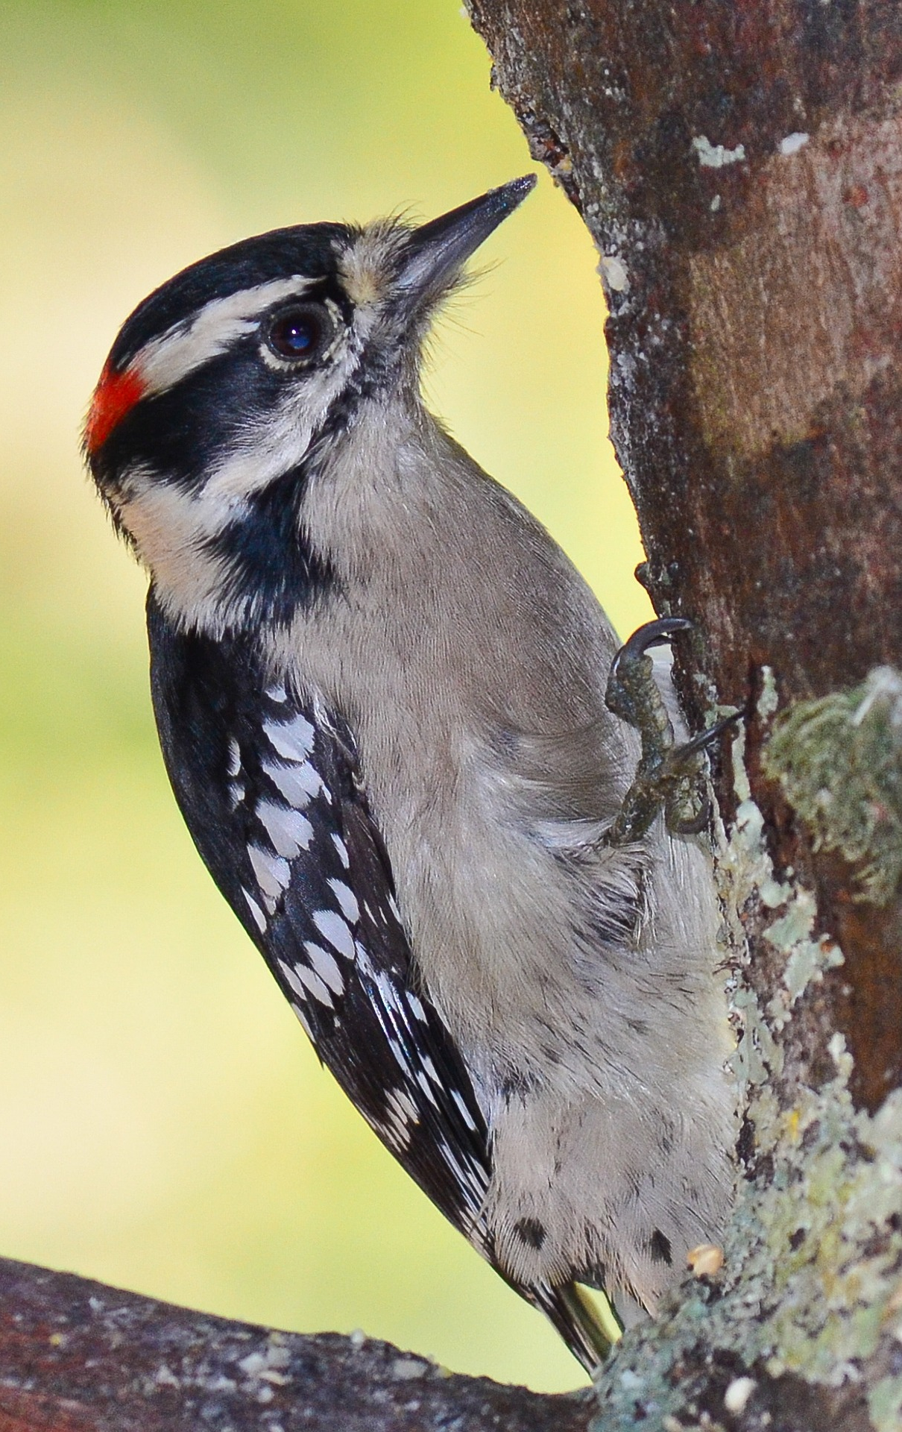
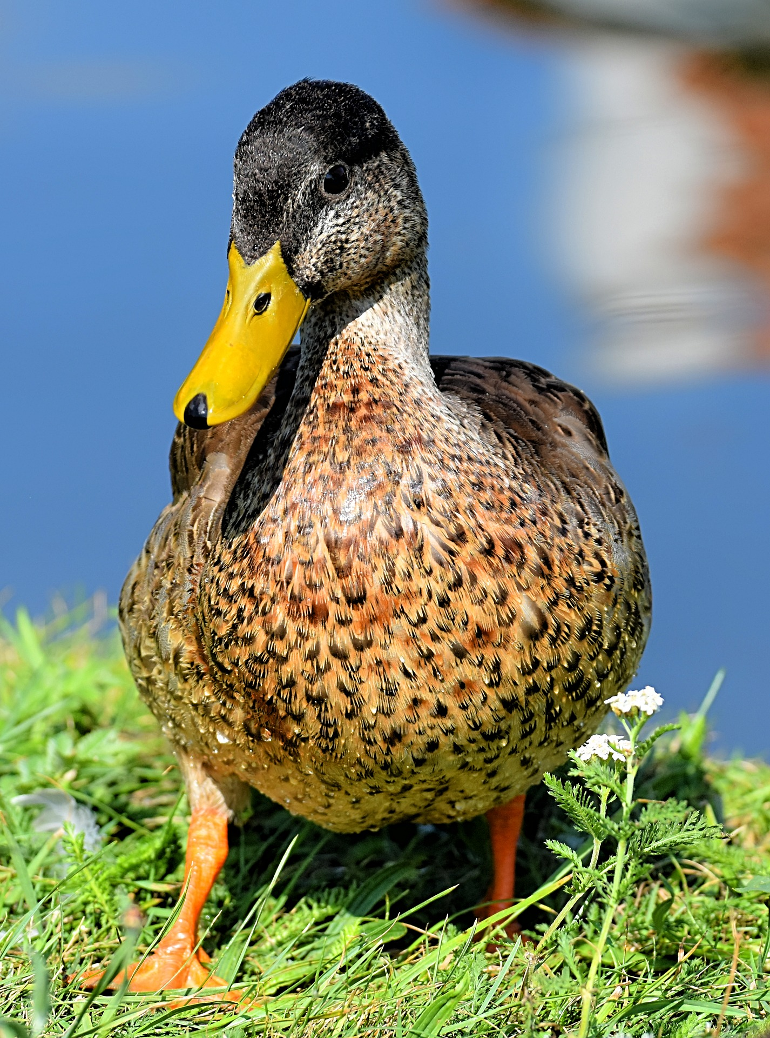
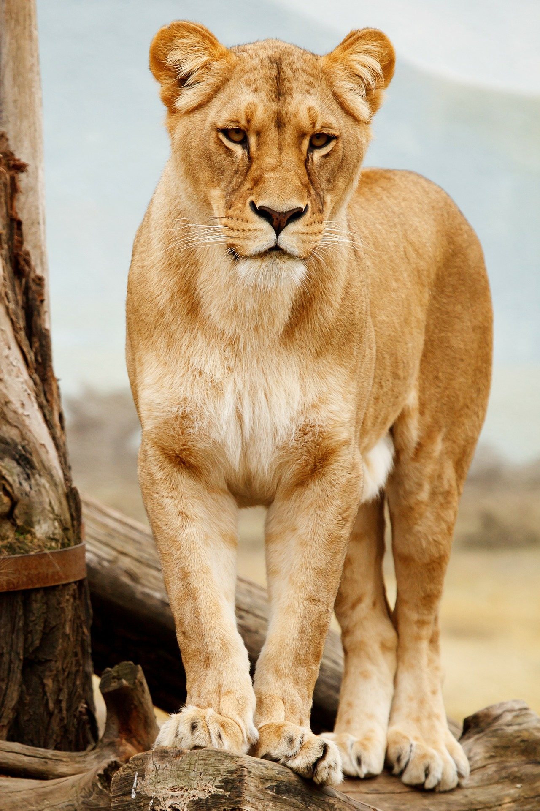
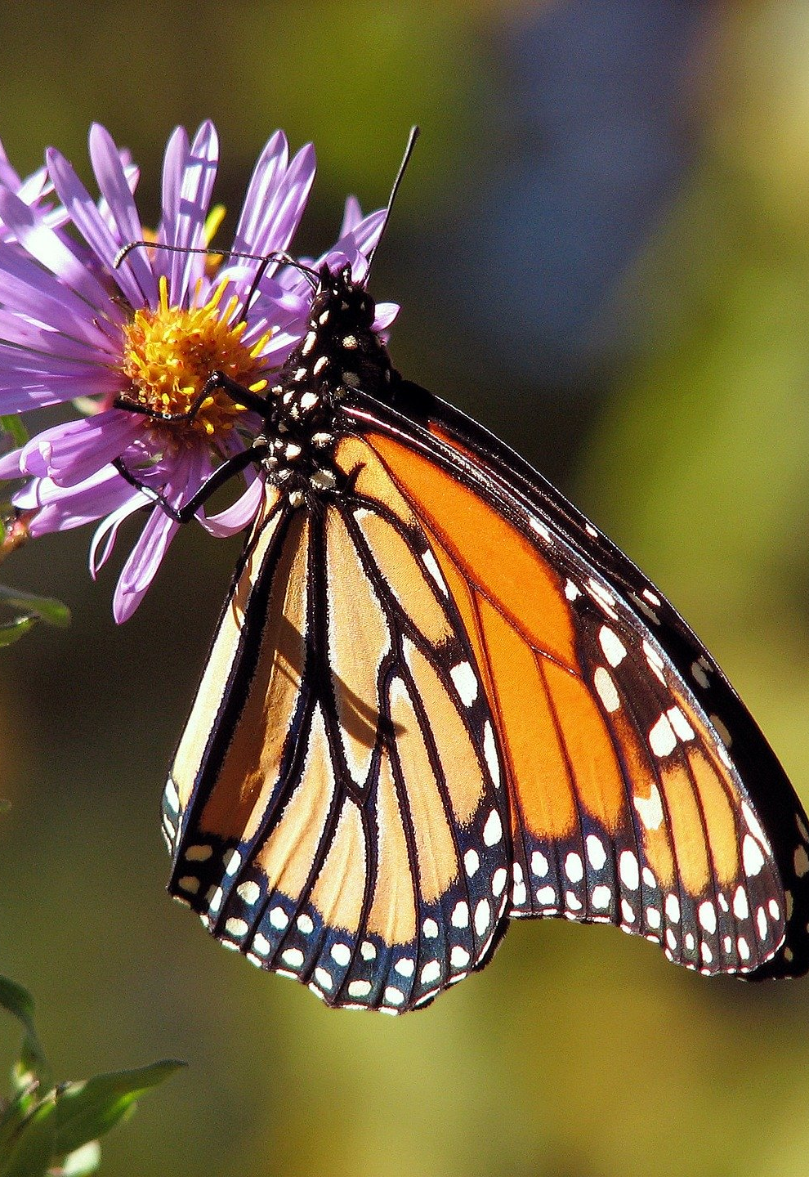
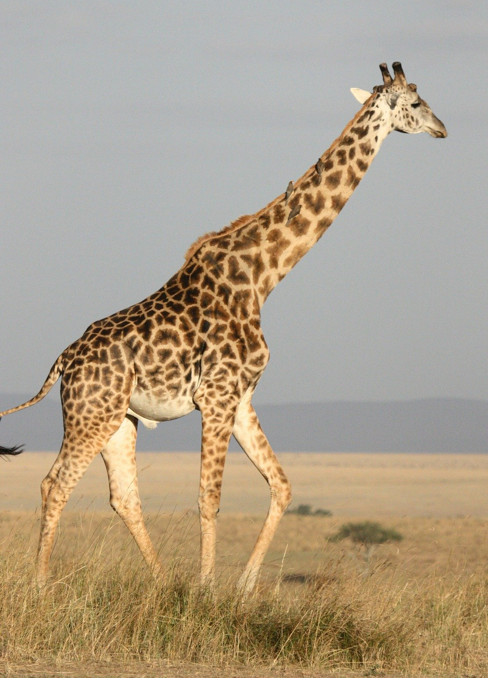
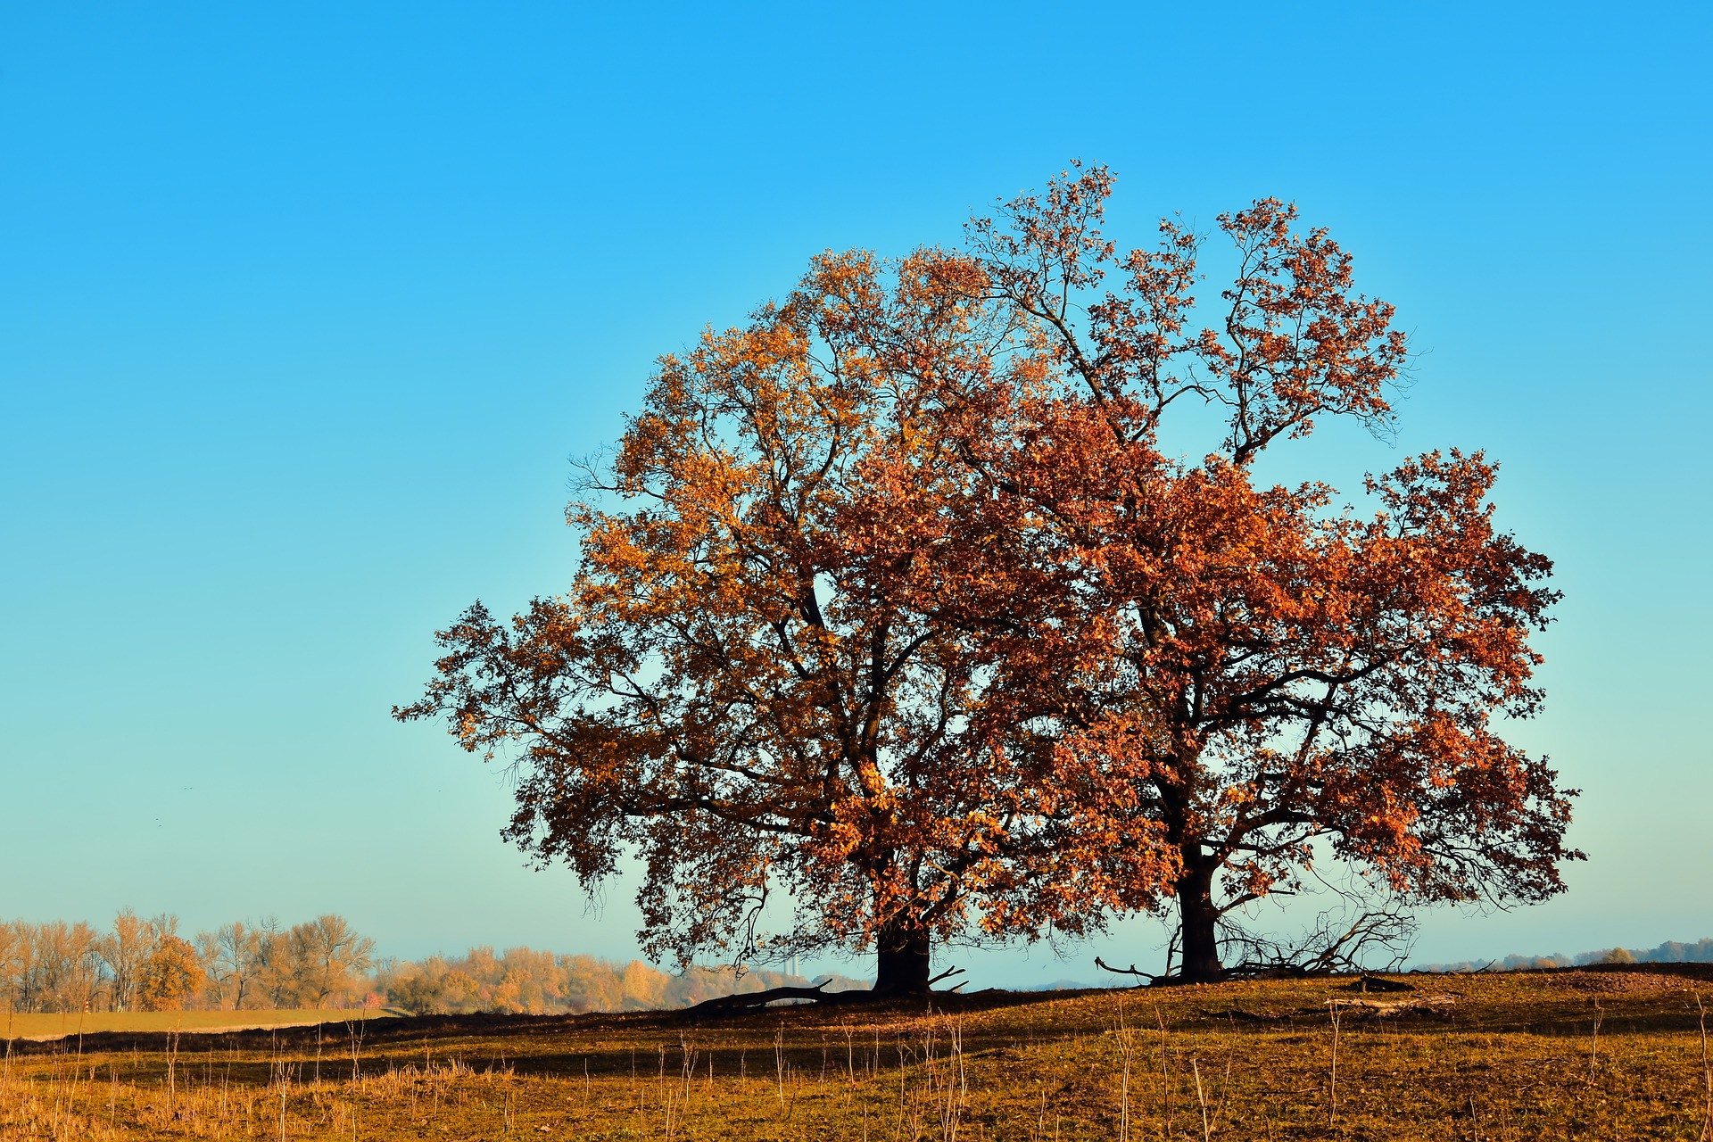
✍ Which habitat does each organism belong to?
Woodland:
Pond:
Savannah:
Images from Pixabay.

Slide 5
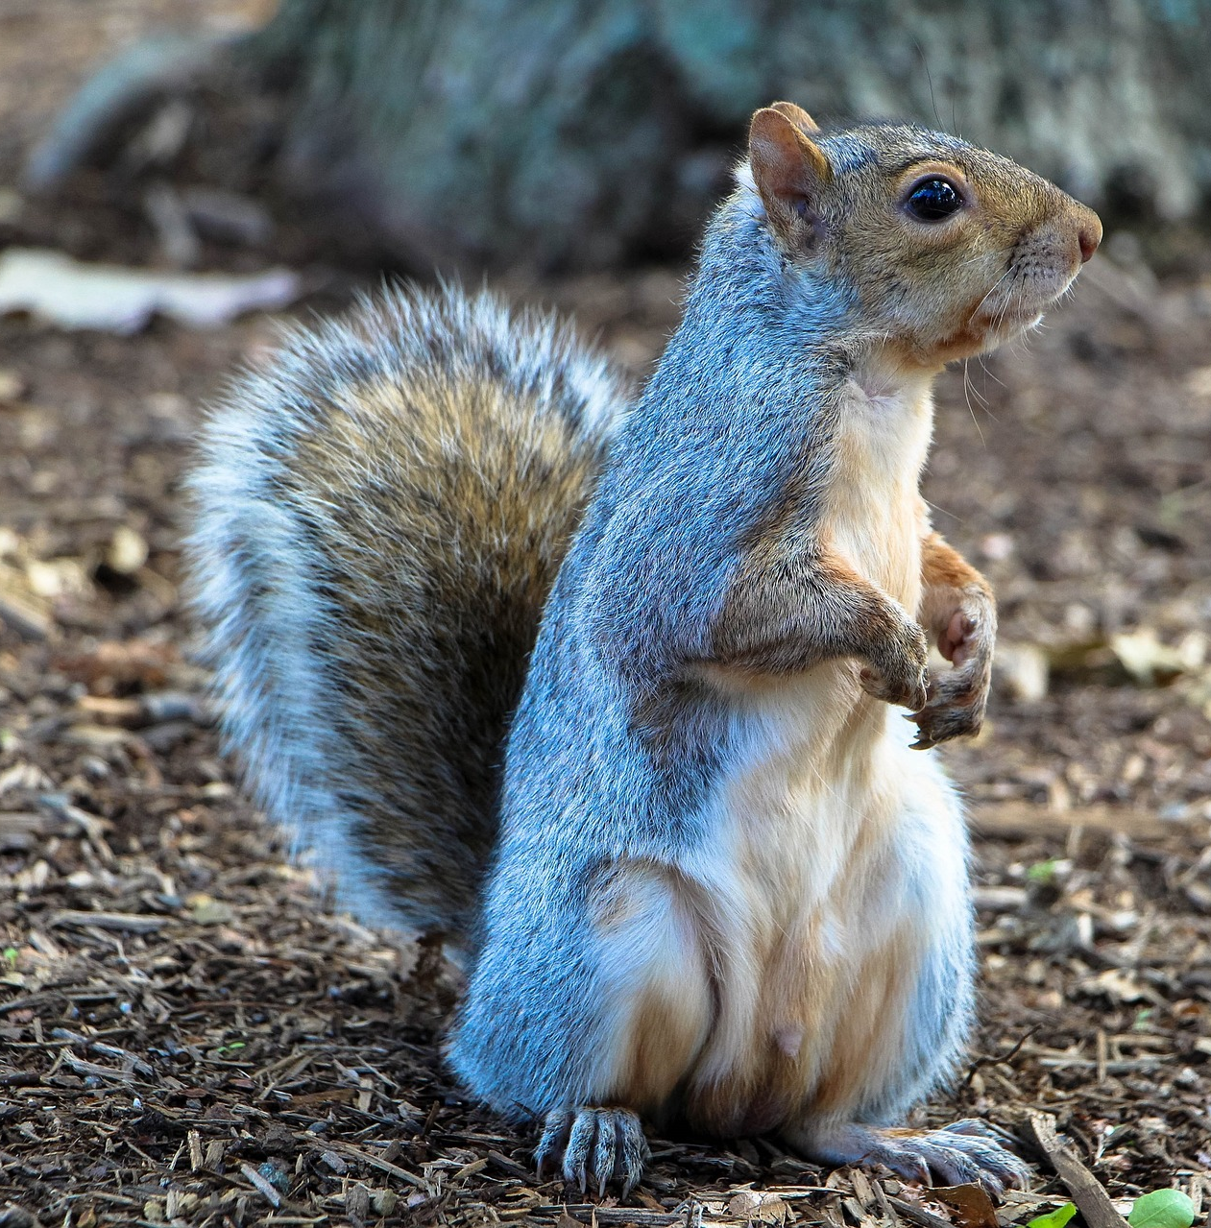
Woodland
✍ Can you draw the food chain for this habitat?
Images from Pixabay.

Slide 6
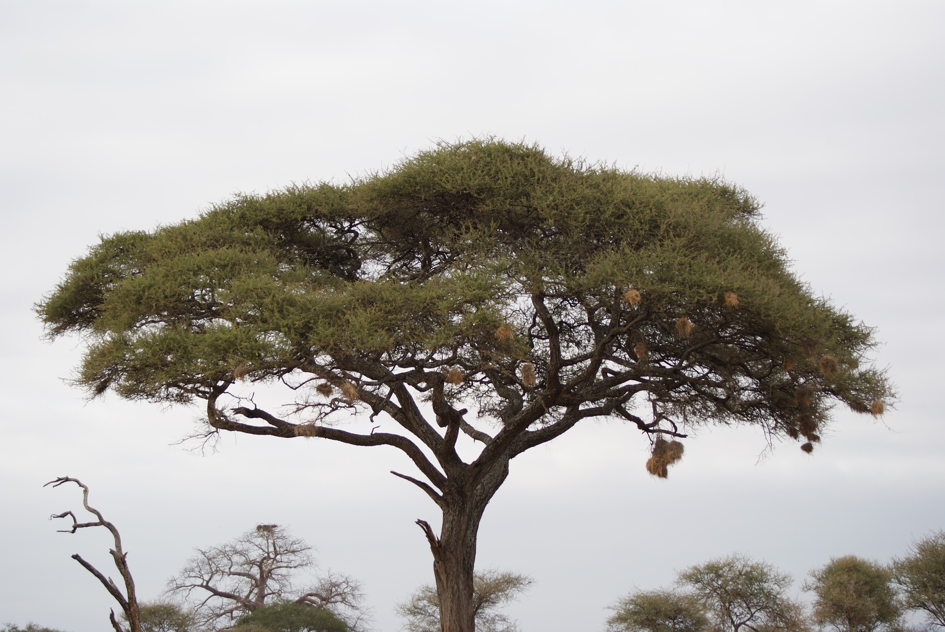
Savannah
✍ Can you draw the food chain for this habitat?
Images from Pixabay.

