Slide 1
Unit 8: Decimals
Multiplying and Dividing by 10
Independent Task
Mathematics
Lesson 12 of 15
Mr Whitehead
Author’s name goes here

Slide 2
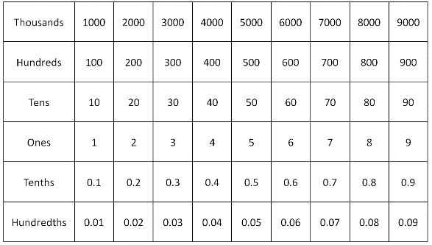
Use the chart to make up 5 sets of instructions.
Example: I start with 3. I add 2. I multiply by 10. I add 30. I divide by 10. I subtract 1. I divide by 10. I subtract 0.1 - what number have I landed on?
Rules
You can use addition, subtraction and multiplication/division by 10.
Through your instructions, move up/down and left/right only.
Notes:
Key Vocabulary: tenth, hundredth, decimal point, multiply, divide
Independent Task
Introduce the Gattegno chart to pupils. Discuss the relationship between rows and columns. Give pupils their own Gattegno chart and a counter. Model using the chart, giving instructions and asking pupils to follow the instructions on their chart with a counter. I start with the number 3. I add 2. I multiply by ten. I add 30. I divide by ten. I subtract one. I divide by ten again. I subtract 0.1. What number have I landed on? For the Independent Task, pupils use the Gattegno charts to come up with their own set of instructions using addition, subtraction, and multiplying and dividing by ten. Ensure pupils only use instructions to move up/down and left /right and don’t move diagonally, for example avoid instructions such as ‘plus 55’ Pupils then test out their instructions with other pupils.

