Slide 1
Solubility Practical
Chemistry - Key Stage 3
Particles - Lesson 14
Mrs Wolstenholme

Slide 2
What is solubility?
How does increasing temperature affect solubility?

Slide 3
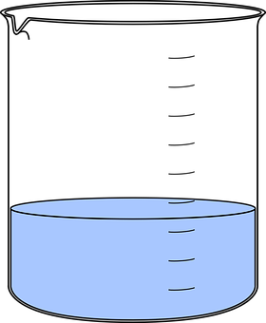
How does the temperature of solvent affect the mass of solid that dissolves?
Task: Identify the independent, dependent and control variables.
Mass of solid that dissolves
Temperature of solvent
Volume of solvent
Time stirring
Solid substance
Solvent
Credit: Pixabay
Notes:
Let’s go back to out previous experiment.

Slide 4
How does the solid substance affect the mass of solid that dissolves?
Task: Write down all the variables in this experiment
Credit: Pixabay
Notes:
Let’s go back to out previous experiment.

Slide 5
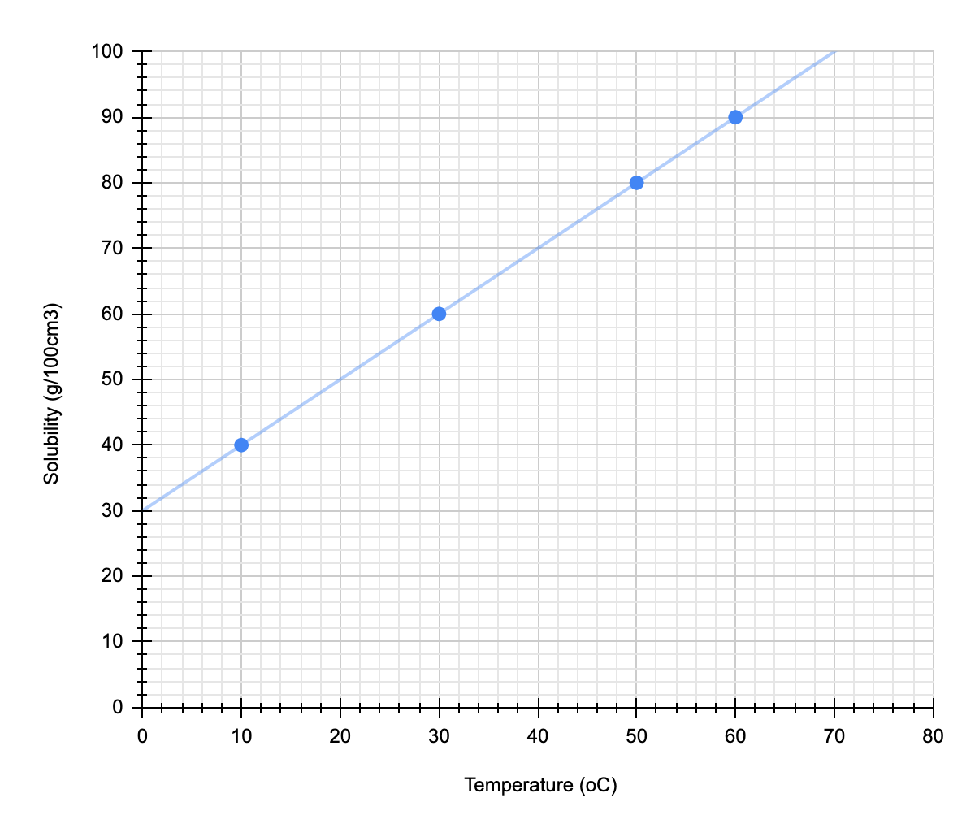
Temperature (ºC) | Solubility (g/cm³)
10 | 40
20 | ?
30 | 60
40 | ?
50 | 80
60 | 90

Slide 6
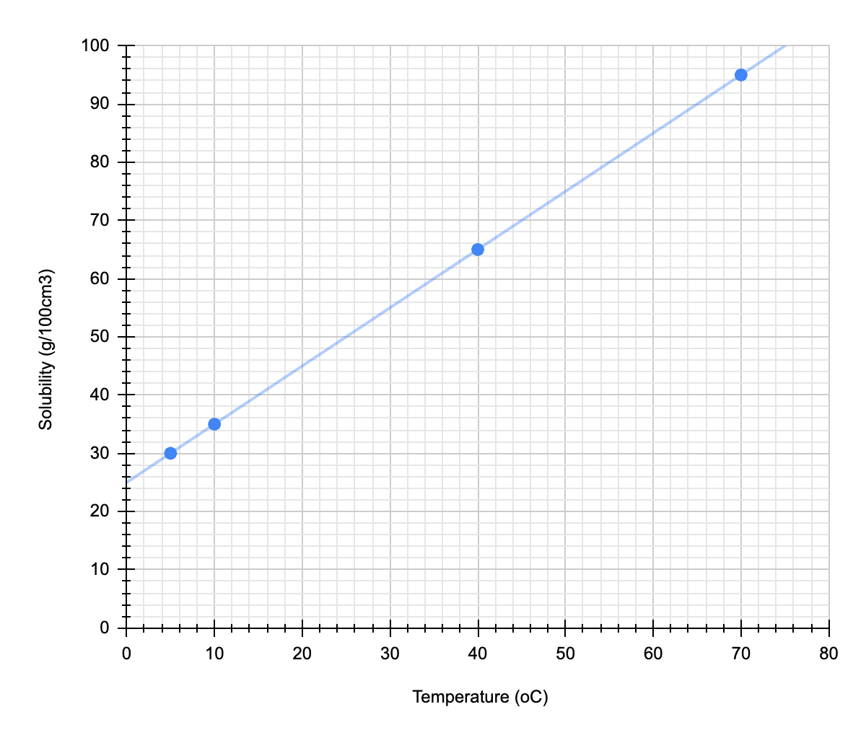
What is the solubility at:
65 ºC?
30 ºC?
15 ºC?
At what temperature is the solubility:
60 g/100cm³?
85 g/100cm³?
75 g/100cm³?

