Slide 1
Unit 6: Fractions and Decimals
Improper fractions
Independent Task
Mathematics
Lesson 9 of 15
Mr Whitehead

Slide 2
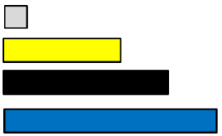
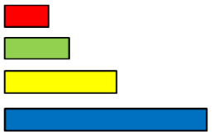
What the other rods in the groups worth?
=
=
1
3
=
= 1
=
=
=
=
=
=
Record as an improper fraction, mixed number and a decimal number.
= 1
=
=
=

