Slide 1
Making arrangements to go out [3/3]
Using verb + infinitive
French
Mr Hodgson

Slide 2
[ eu ]
deux

Slide 3
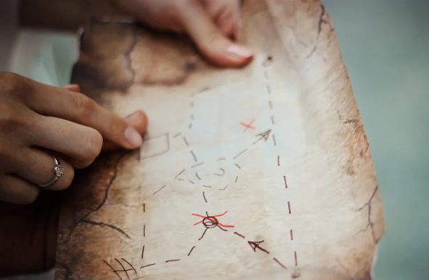
[ eu ]
un peu
jeu
[a little]
lieux

Slide 4
[ eu ]
un peu
jeu
[a little]
lieux

Slide 5
[ ou ]
nous

Slide 6
[ ou ]
trouver
toujours
jouer
[always; still]

Slide 7
[ ou ]
trouver
toujours
jouer
[always; still]

Slide 8
[ eu ]
[ ou ]
deux
nous

Slide 9
faire | to do
les magasins | the shops
voir | to see
un spectacle | a show
venir | to come
chez moi | to/at my house
rendre visite à | to visit (for a person)
visiter | to visit (for a location)
aller en ville | to go to town
pratiquer | to practise

Slide 10
Rendre visite à vs visiter
Je veux rendre visite à mes parents
Je veux visiter le château
I want to visit my parents
I want to visit the castle

Slide 11
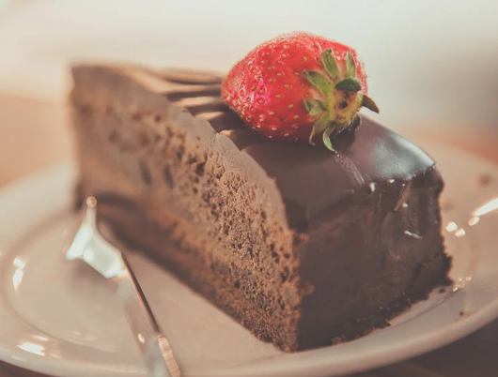
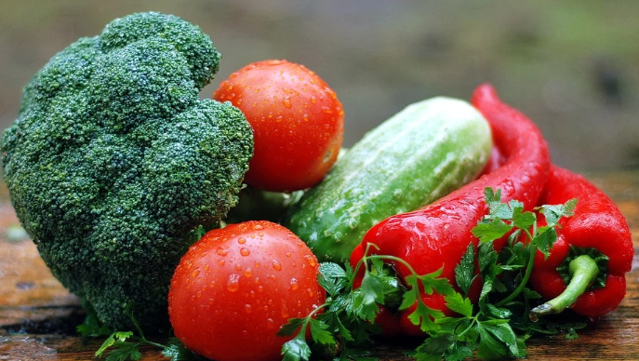
Using verb + infinitive constructions
Aller + infinitive = I’m going to ___
Vouloir + infinitive = I want to ___
Je vais manger = I’m going to eat
Je veux manger = I want to eat
The infinitive is the -er, -ir or -re version of the verb.
It means ‘to _____’ or ‘_____ing’.

Slide 12
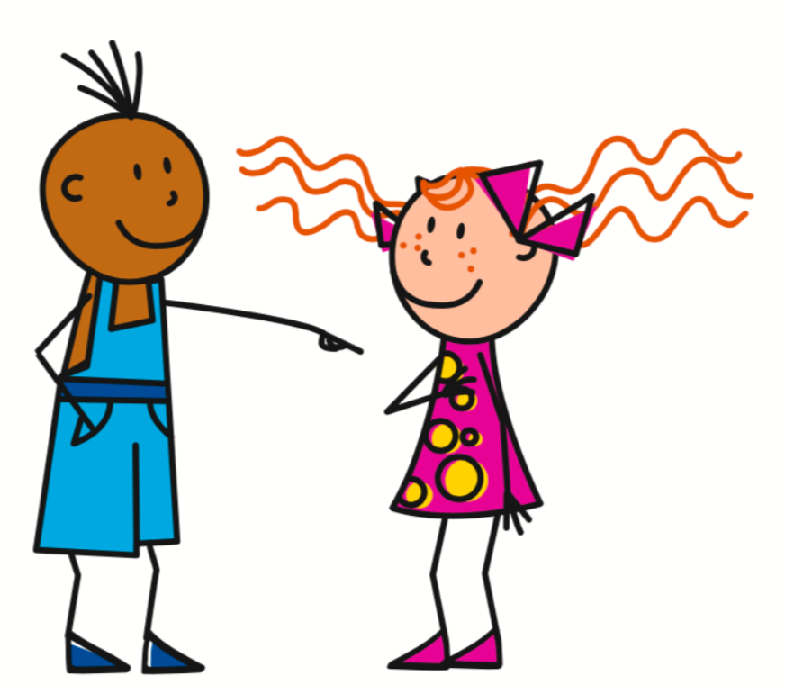
Using verb + infinitive constructions
Aller + infinitive = I’m going to ___
Vouloir + infinitive = I want to ___
Je vais = I go/I’m going
Je veux = I want/I’m wanting
Tu vas = You go/You’re going
Tu veux = You want/You’re wanting
Il va = He goes/He’s going
Il veut = He wants/He’s wanting
Elle va = She goes/She’s going
Elle veut = She wants/She’s wanting
On va = You go/You’re going
We go/We’re going
On veut = You want/You’re wanting
We want/We’re wanting

Slide 13
Making arrangements to go out
We use rendre visite à when we are visiting a =
We use visiter when we are visiting a
After ‘je veux’ and ‘je vais’ we use an
An infinitive always ends in
An infinitive means or
person
place
infinitive
-er, -ir or -re
to ________
______ing

