Slide 1
Ratio and proportion in geometry I Lesson 5 of 8
Mathematics
Miss Kidd-Rossiter

Slide 2
Tree A is 1.8m tall.
Its shadow is 2.3m long.
Tree B is 7.2m tall.
How long do you think its shadow will be?
A
B

Slide 3
The triangle with side lengths 6 cm, 8 cm and 10 cm is an enlargement of the triangle with side lengths 4 cm, 5 cm and 3 cm.
The triangle with side lengths 4 cm, 5 cm and 6 cm is an enlargement of the triangle with side lengths
8 cm, 10 cm and 12 cm.
Antoni
Cala
The triangle with side lengths 8 cm, 8 cm and 6 cm is an enlargement of the triangle with side lengths
5 cm, 5 cm and 3 cm.
Who do you agree with? Why?
Binh

Slide 4
Which of these triangles are enlargements of each other?
Work out the constant of proportionality between any pair of enlarged triangles.

Slide 5
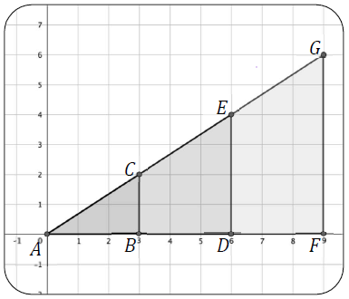
Using the points marked on the grid
Write the coordinates of the points A to G
Find the following ratios between the lengths stated
i) AB:BC ii) AD:DE iii) AB:AF
iv) BC:DE v) AC:AG vi) AB:BF
Find the constant of proportionality between the following pairs of triangles
i) ABC and ADE ii) ABC and AFG
iii) ADE and AFG

Slide 6
Zaki is considering the enlargement of triangles.
He makes the statement below.
Is his statement always true, sometimes true or never true?
When I make the lengths of the sides of a triangle bigger by adding 5 cm to each one, the new triangle is an enlargement of the original triangle.
Zaki

