Slide 1
Adding Two 3-Digit Numbers (Regrouping in More Than One Column)
Worksheet
Mathematics
Mrs Brinkworth

Slide 2
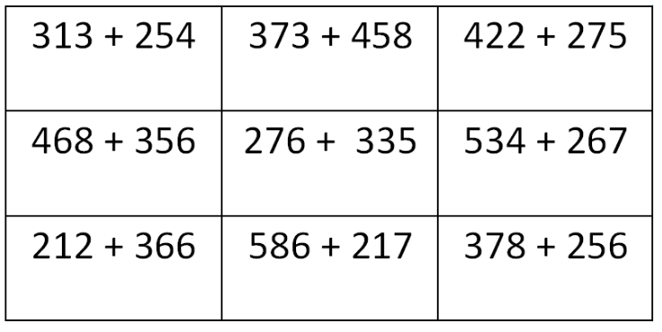
Part A
Use column addition to answer these
(Not all need column addition so look carefully)
Notes:
6 or bigger

Slide 3
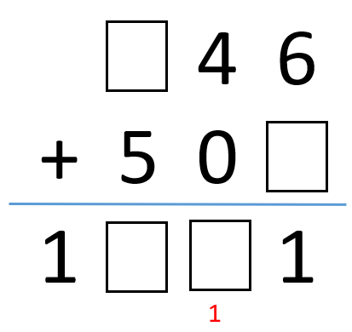
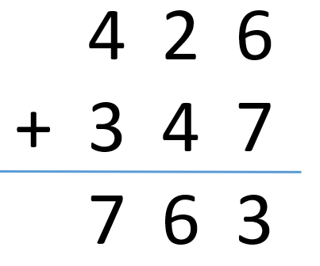
Part B
What could the missing numbers here be?
Are there more than than 1 possibility?
Check this answer carefully
Notes:
6 or bigger

