Slide 1
Balancing Equations - Foundation
Combined Science - Chemistry - Key Stage 4
Quantitative Chemistry
Mrs. Begum

Slide 2
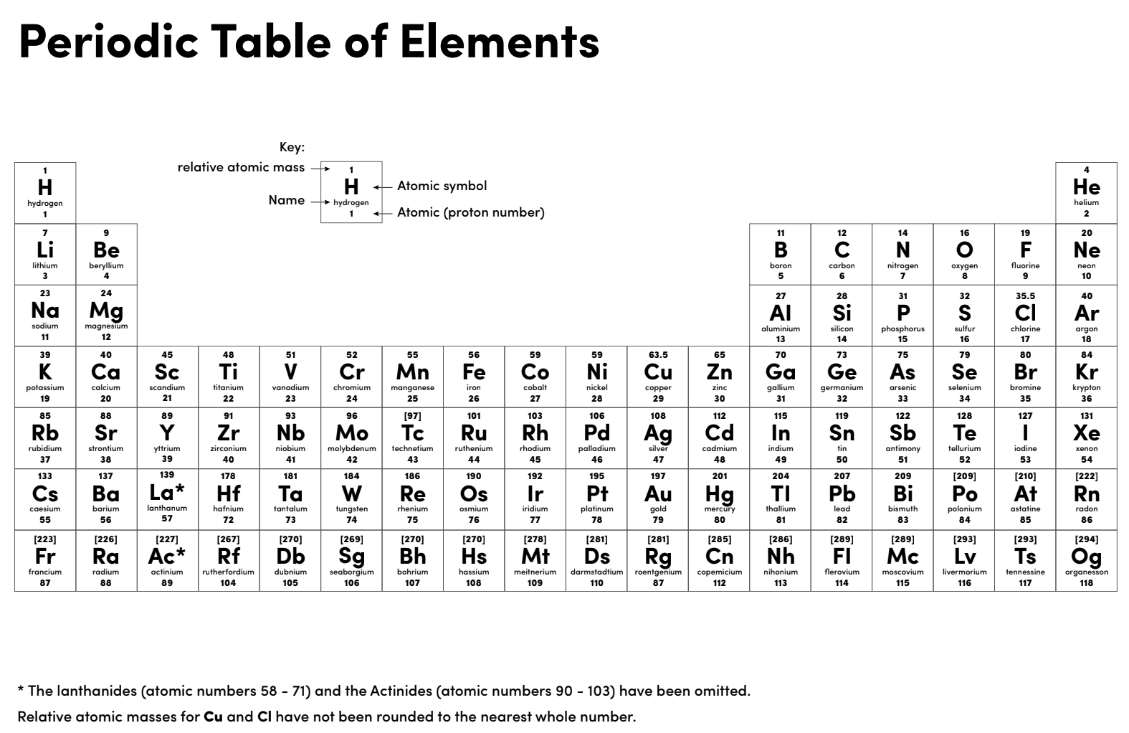

Slide 3
Quick check questions
How many electrons do Group 2 elements have in their outer shell?
How many electrons do Group 7 elements have in their outer shell?
When an atom loses or gains electrons, what do they become?
What is the charge on Group 1 ions?
What is the charge on Group 6 ions?

Slide 4
Independent practice
H₂ + Br₂ HBr
Ca + O₂ CaO
MgCO₃ + HCl MgCl₂ + H₂O + CO₂
Fe + O₂ Fe₂O₃
Fe + Cl₂ FeCl₃

Slide 5
Questions
In a reaction, copper sulfate and sodium hydroxide react together to form copper hydroxide and sodium sulfate.
Write a word equation for this reaction.
Name the reactants and the products.
Write the formulae of the reactants copper sulfate and sodium hydroxide. Ions are Cu²⁺, SO₄²⁻, Na⁺ and OH⁻.
Write a balanced symbol equation for this reaction. Formulae of products are copper hydroxide Cu(OH)₂ and sodium sulfate Na₂SO₄.

Slide 6
Questions
In a reaction, calcium oxide and hydrochloric acid (HCl) react together to form calcium chloride and water (H₂O).
Write a word equation for this reaction.
Name the reactants and the products.
Write the formulae of the reactants calcium oxide and calcium chloride. Ions are Ca²⁺, O²⁻, and Cl⁻.
Write a balanced symbol equation for this reaction.

