Slide 1
Lesson 1 : Net / Racket & Wall Games
Volleyball
Physical Development - Building Understanding
Alistair

Slide 2
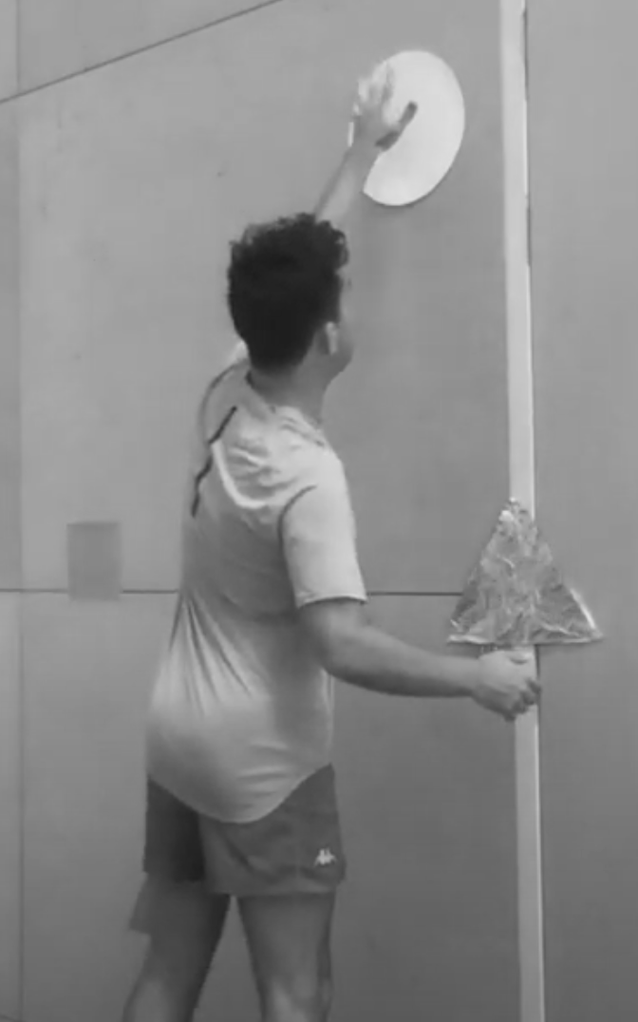
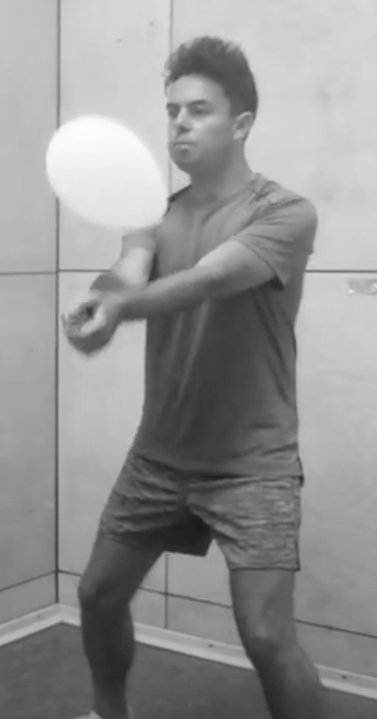
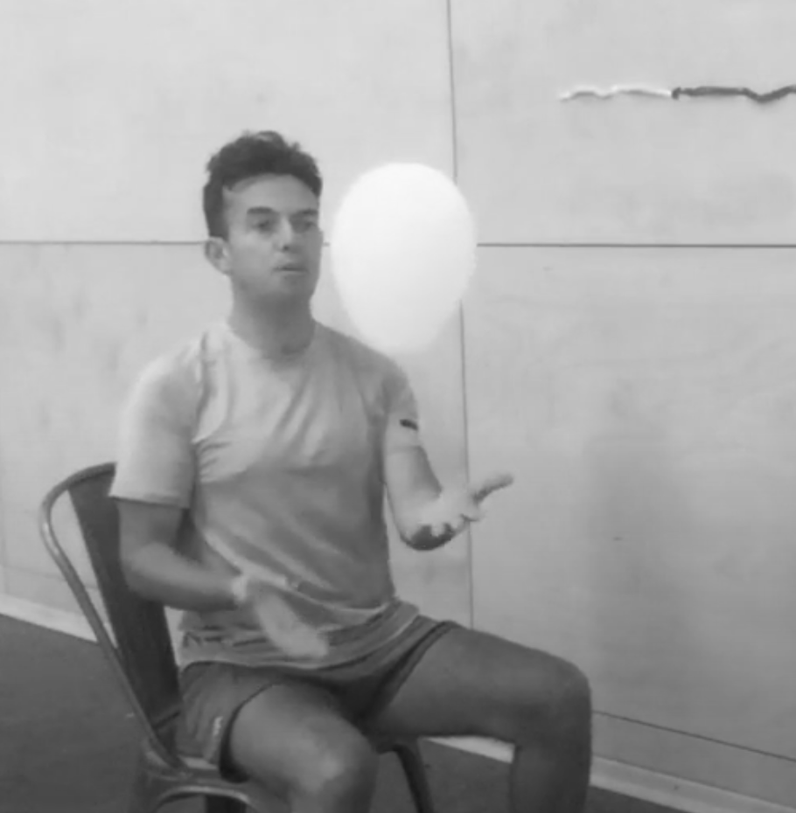
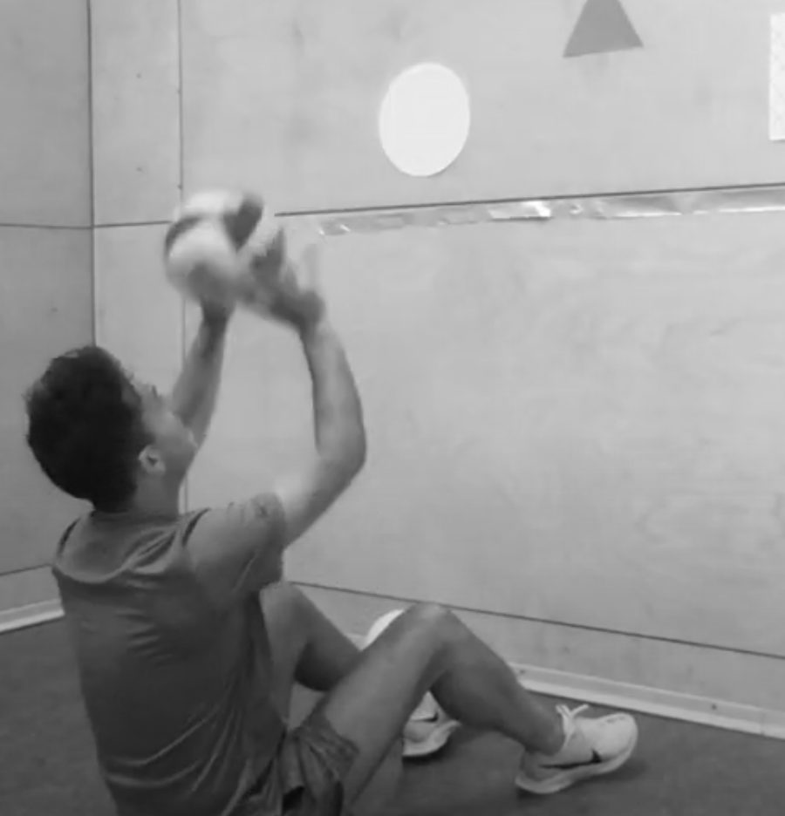
Activity Card
Net/Racket Sports: Volleyball
Move in different directions and at different heights (stretch and crouch).
Use markers on the wall to practise your volleyball movements.
Practise the dig / set and spike shot with a balloon or beach ball.
Refine your volleyball skills and perform with increasing accuracy.
Apply your skills in game / match situations.
Score points, use tactics and work together as a team.
Try to keep a balloon off the floor using your volleyball skills; try to set a high score.
Play a game of seated volleyball against a wall or with a parent / carer or sibling.

