Slide 1
Conversion Graphs
Worksheet
Mr Ward

Slide 2
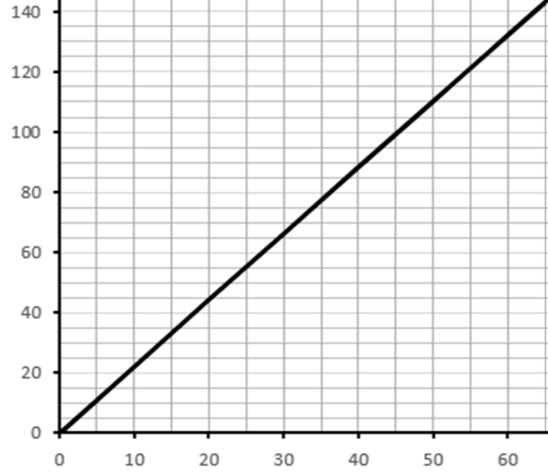
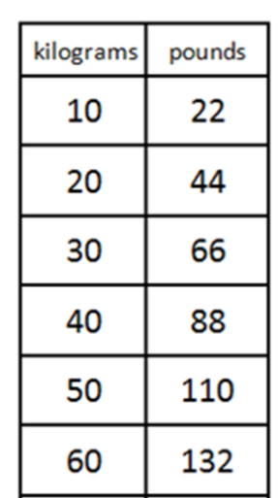
Conversion Graph
Conversion graph kilograms (kg) to pounds (lb)
1kg ≈ 2.2 lb
Can you convert the four missing pounds values?
Pounds (lb)
Kilograms (kg)

Slide 3
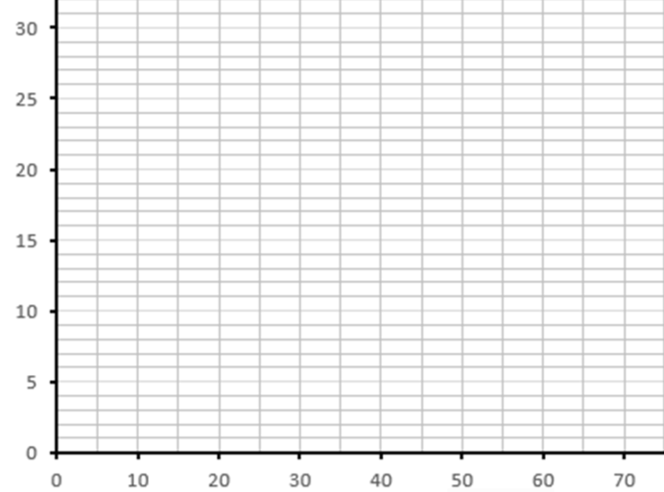
Your Task
Follow the steps provided today to construct a conversion graph for centimetres to inches.
Plot the conversion line using the information below.
10cm ≈ 4 inches
20cm ≈ 8 inches
Use the completed conversion graph to fill in the blanks on the table.
Conversion graph centimetres to inches
inches
centimetres

Slide 4
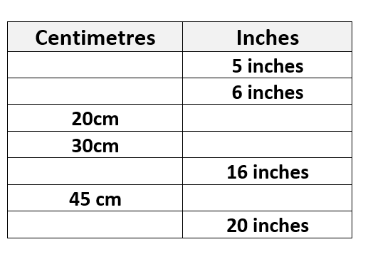
Your Task
Follow the steps provided today to construct a conversion graph for centimetres to inches.
Plot the conversion line using the information below.
10cm ≈ 4 inches
20cm ≈ 8 inches
Use the completed conversion graph to fill in the blanks on the table.

Slide 5
Challenge Slide
Make 24
Using all four numbers 4, 6, 6, 8 only once,
how many different ways can you find to make 24?
Remember to use all four calculations
There are over 60 ways!

