Slide 1
Reading and writing the time to o’clock
Mathematics
Mrs Bramble and Miss Sidhu

Slide 2
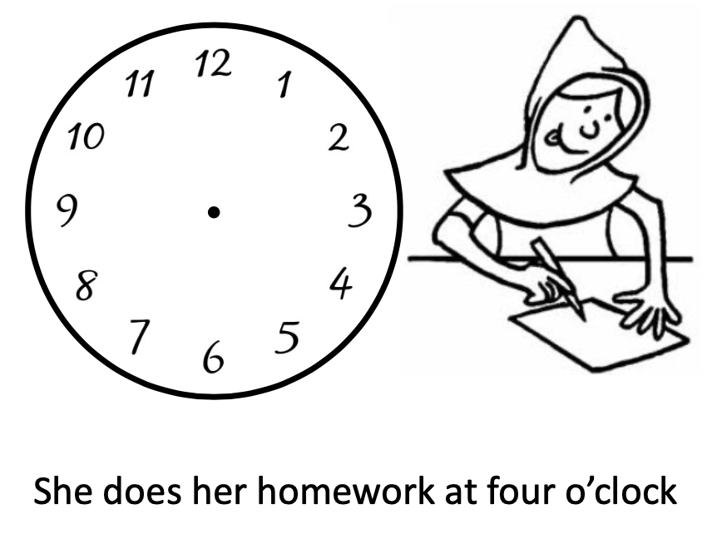
Notes:
For your task, you need to read the time that needs to be on the clock and then draw the clock hands to show that time. Remember, the minute hand is longer than the hour hand.

Slide 3
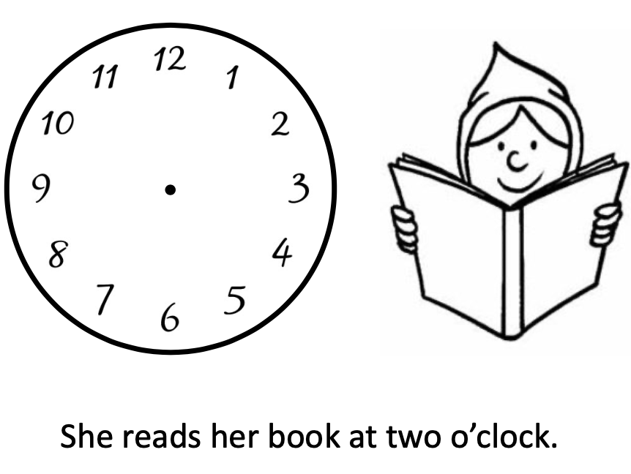
Notes:
For your task, you need to read the time that needs to be on the clock and then draw the clock hands to show that time. Remember, the minute hand is longer than the hour hand.

Slide 4
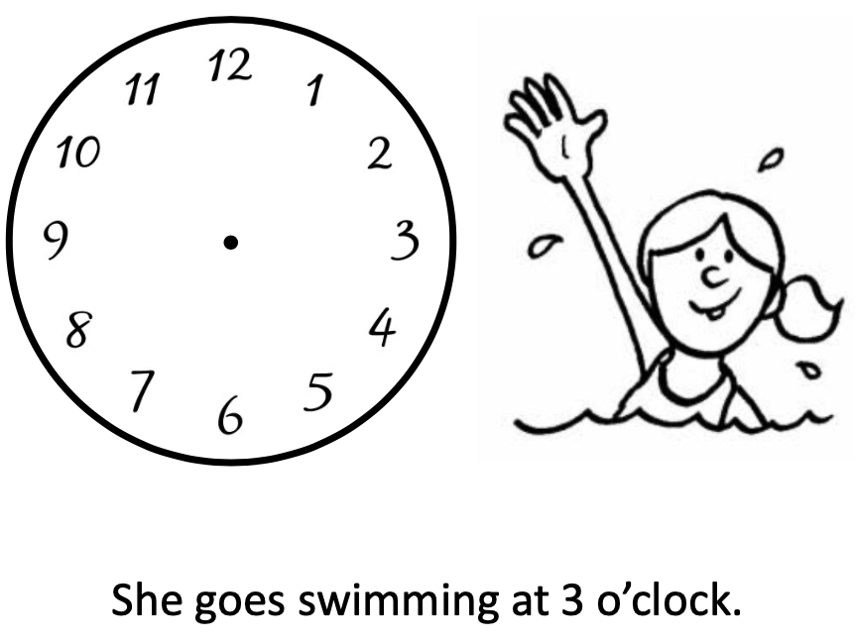
Notes:
For your task, you need to read the time that needs to be on the clock and then draw the clock hands to show that time. Remember, the minute hand is longer than the hour hand.

