Slide 1
Comparing pie charts.
Independent Task
Mathematics
Miss Parsons

Slide 2
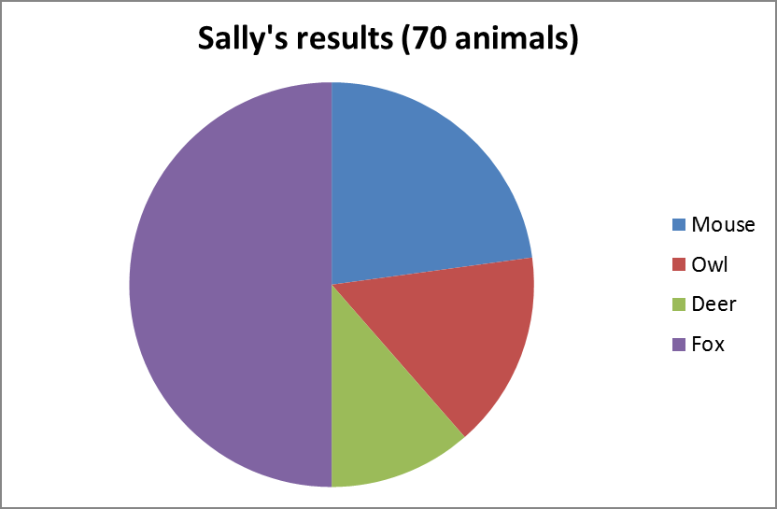
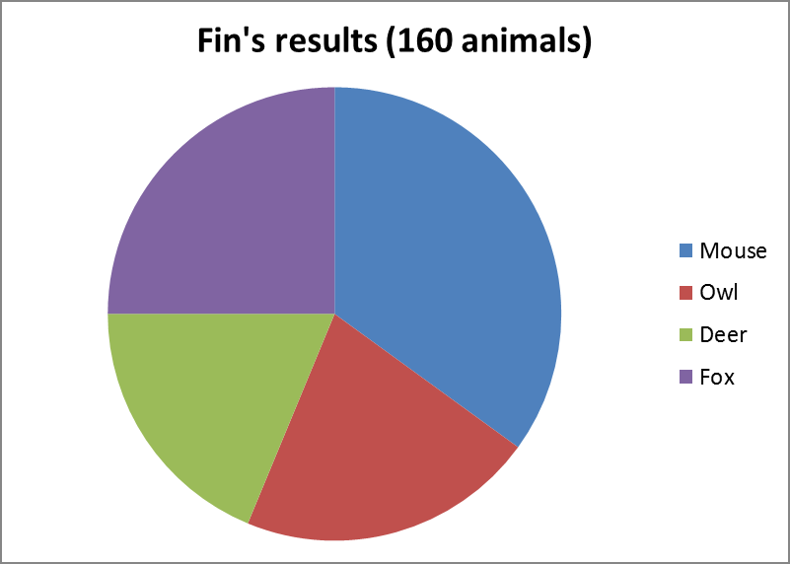
Fin and Sally observed animals in Richmond Park at night.
Who saw more foxes? Explain how you know.
Approximately how many mice did Sally see? Explain your answer.
Approximately how many owl and deer did Fin see altogether? Explain your answer.
Notes:
Lesson Agenda:

