Slide 1
Grouping and sharing
Understanding the concept of equal groups
Mathematics
Independent Task
Mrs Khaira

Slide 2
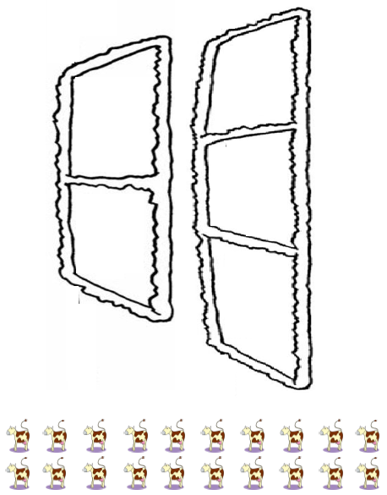
Activity 1

