Slide 1
Perpendicular bisectors
Mathematics
Mr Maseko

Slide 2
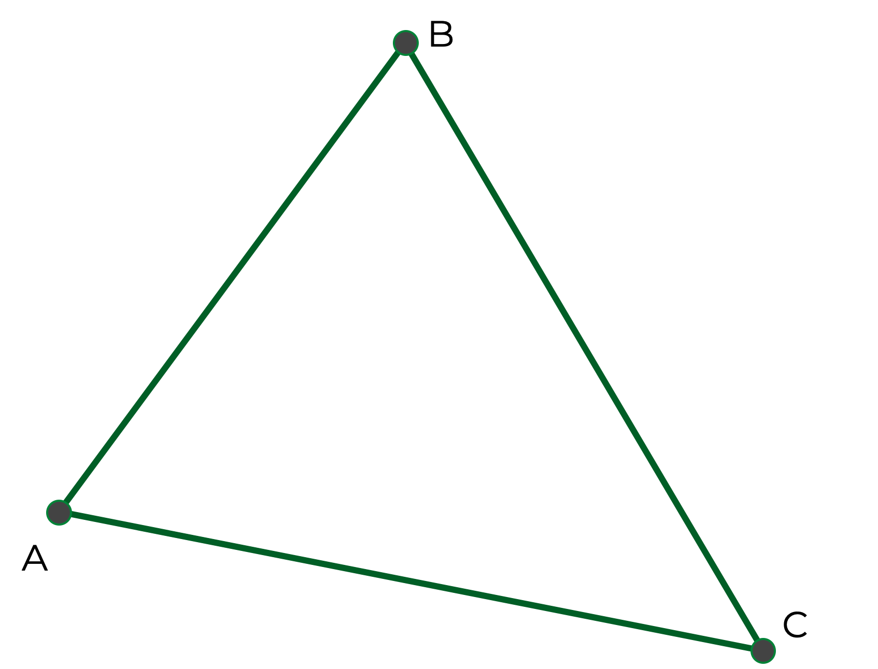
Draw a large random triangle and label the vertices A, B, C.
Fold the paper so A and B coincide, mark where the fold line meets AB.
Repeat for A and C, and B and C.
Join up these 3 points and repeat the process on the new triangle.
What do you notice?

Slide 3
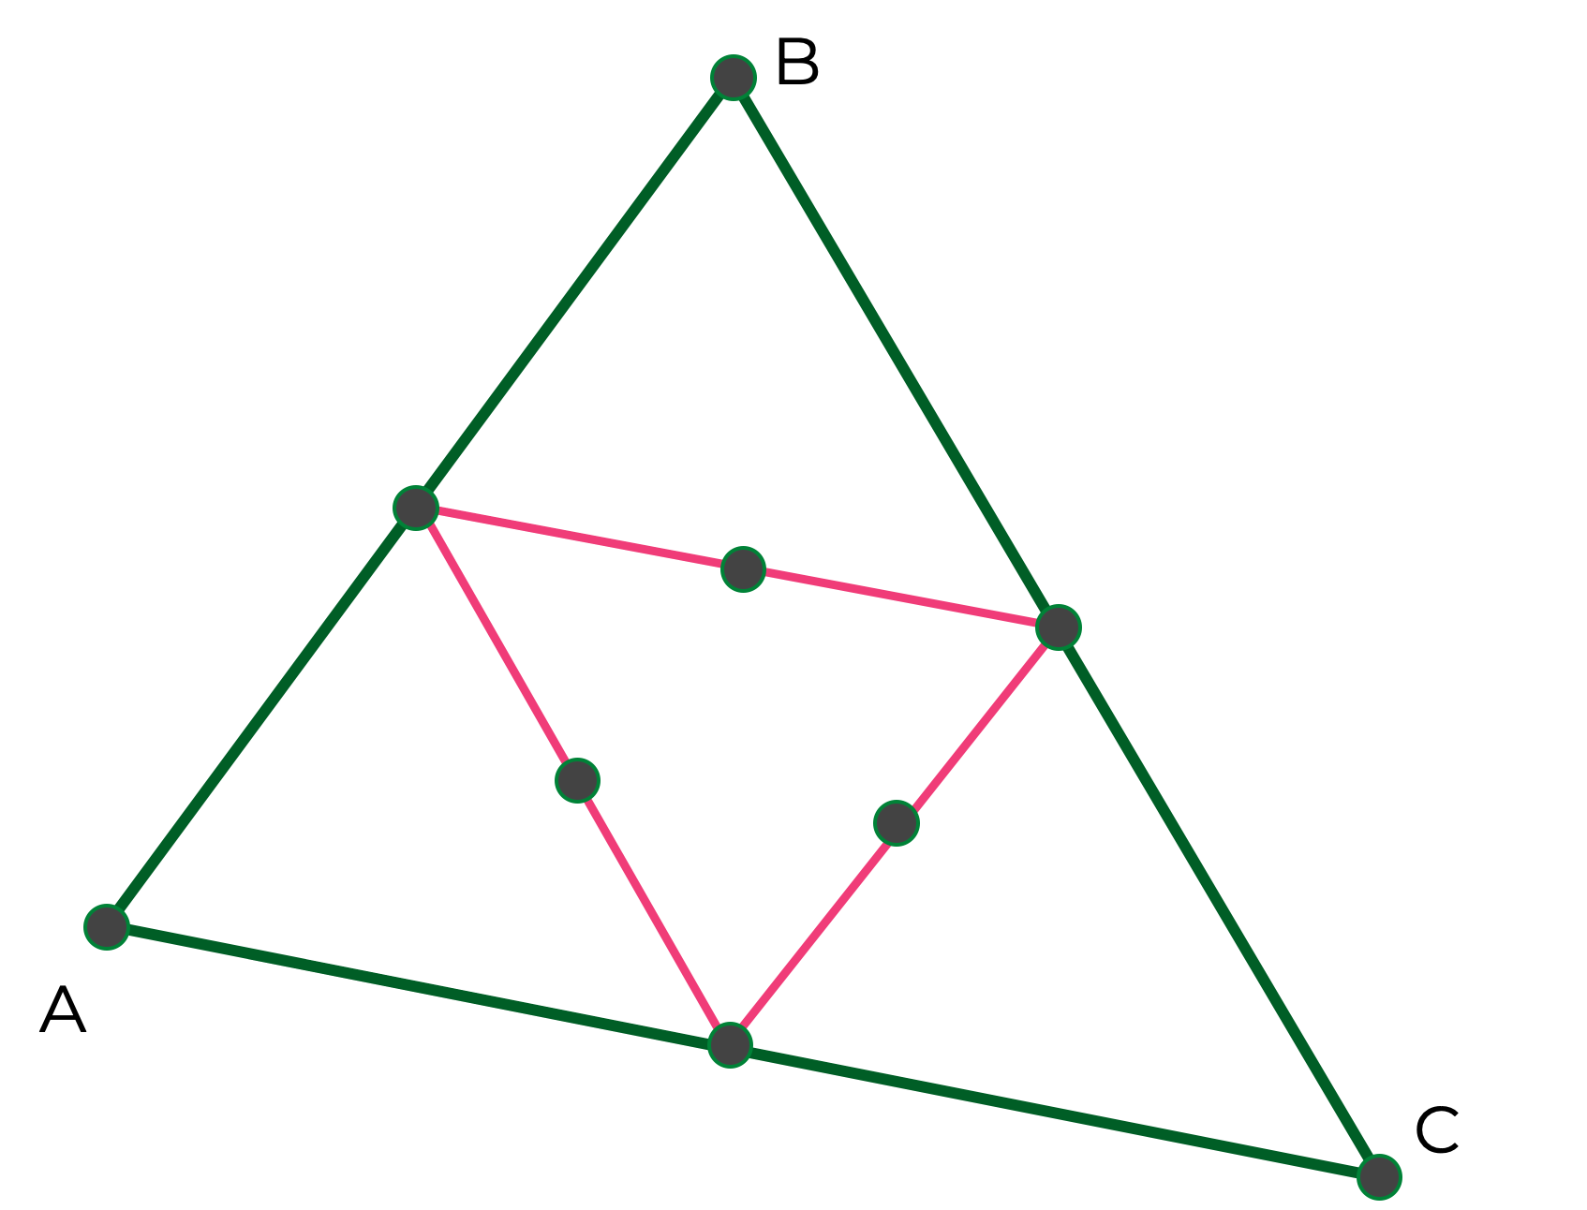
A Perpendicular bisector is a locus of points that are equidistant from two ends of a line segment.
If we have two points that are equidistant between two ends of a line segment we can draw a perpendicular bisector.

Slide 4
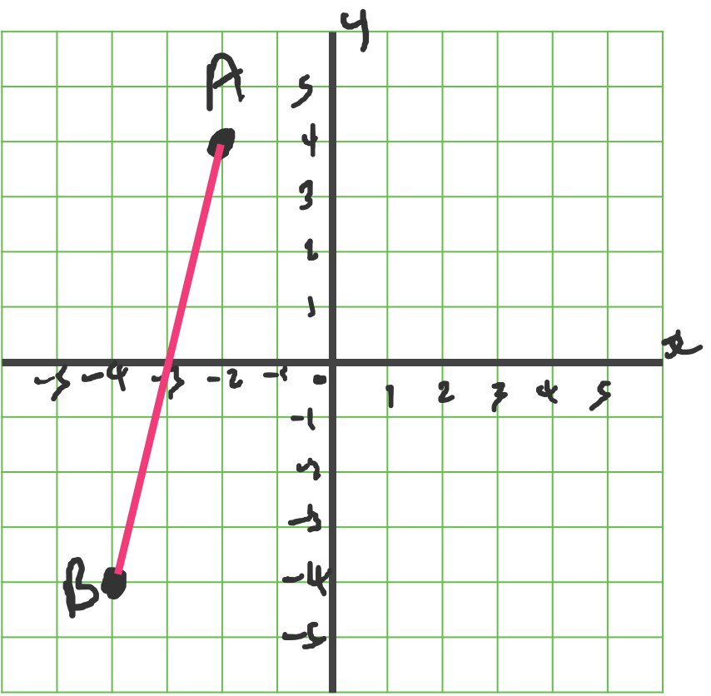
If we have two points that are equidistant between two ends of a line segment we can draw a perpendicular bisector.
On this coordinate grid state the coordinate of a point on AB that is equidistant between A and B.
State another coordinate, not on AB that is equidistant from A and B.

Slide 5
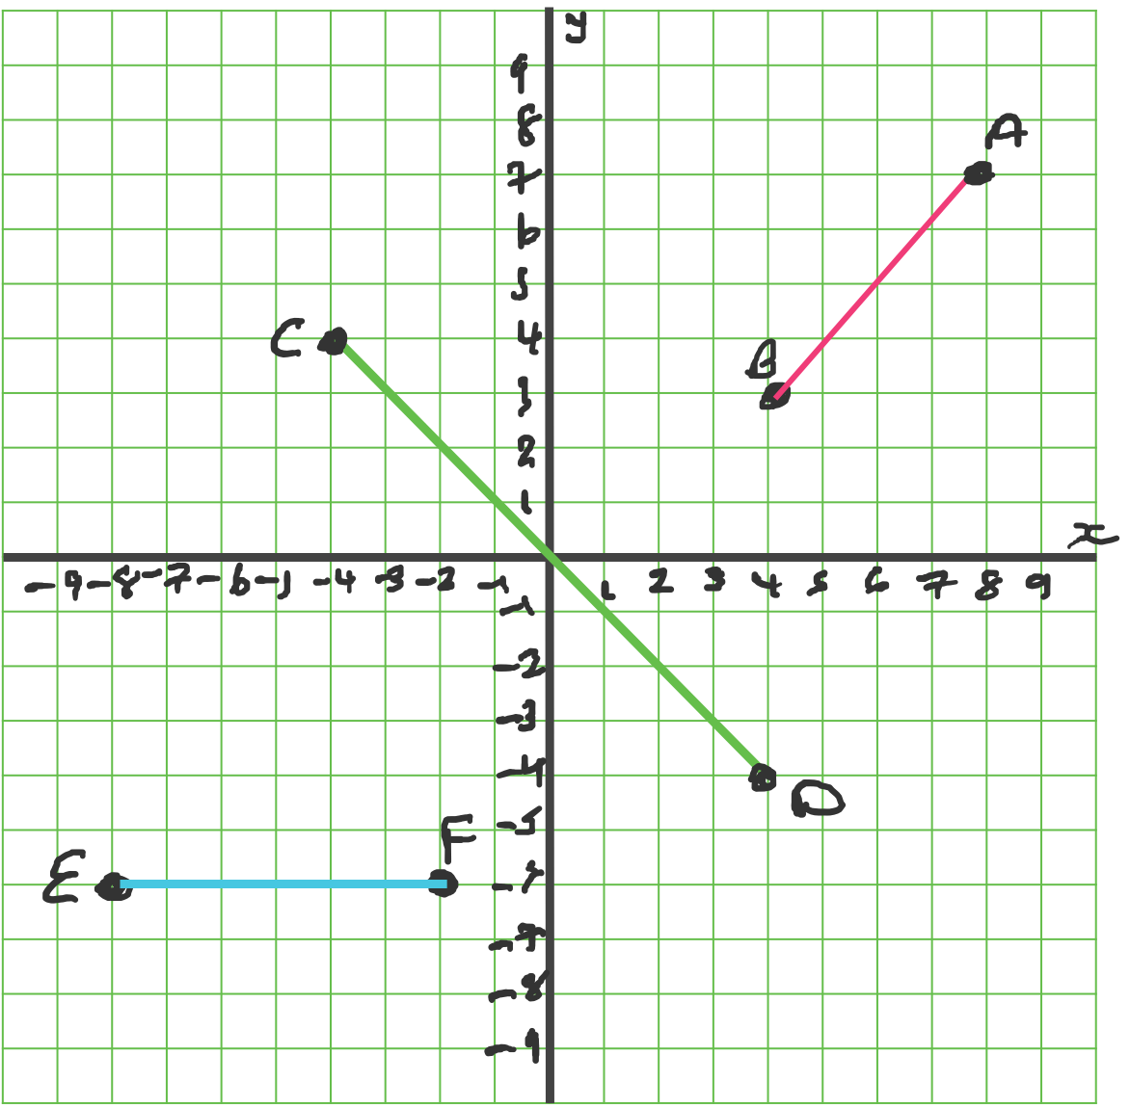
For each of these line segments draw a perpendicular bisector.

Slide 6
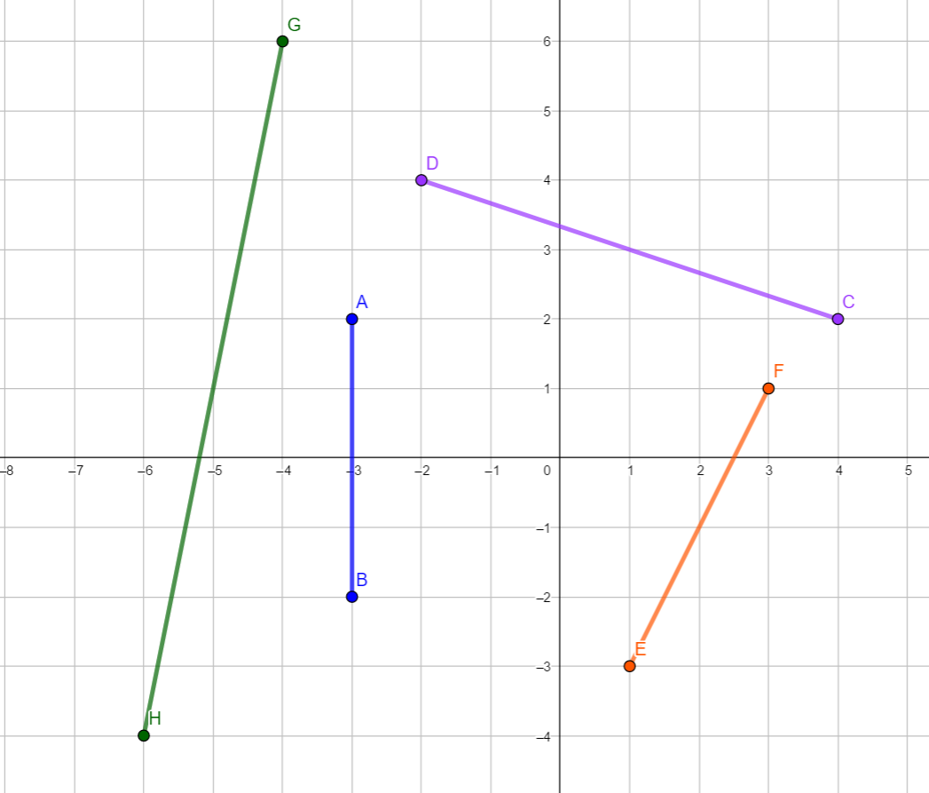
Find the equation of the perpendicular bisector of each of these line segments.

